Slide 1

Lost in Transition
Taha Haidermota
Country Head
Believe. In People. In Language. In Possibility.
2026 NEAS Conference

Slide 2
The Forces Reshaping Learning and Work in Australia
Slow transitions cost jobs, growth, and opportunity across Australia.
$12B
Education to Work Transition
-$104B
$15B
Involuntary Job exits
GDP Loss (-3.8%)
$76B
Automation disruption
Source: Lost in Transition: Fixing Australia’s $104 billion ‘learn-to-earn’ skills gap

Slide 3
Reimagining Learning for the Future of Work
Educators remain central to social mobility, innovation, and learning to learn.
2026
Shift from traditional learning model
→
Curriculum & assessment transformation
→
Continuous learning model
2050
1 degree → 1 career
+2X
80%
Domestic enrolments
(900 → 1.8M students)
Tertiary-qualified workforce target
Low domestic enrolments
Costly learn-to-work transition
Source: Lost in Transition: Fixing Australia’s $104 billion ‘learn-to-earn’ skills gap

Slide 4
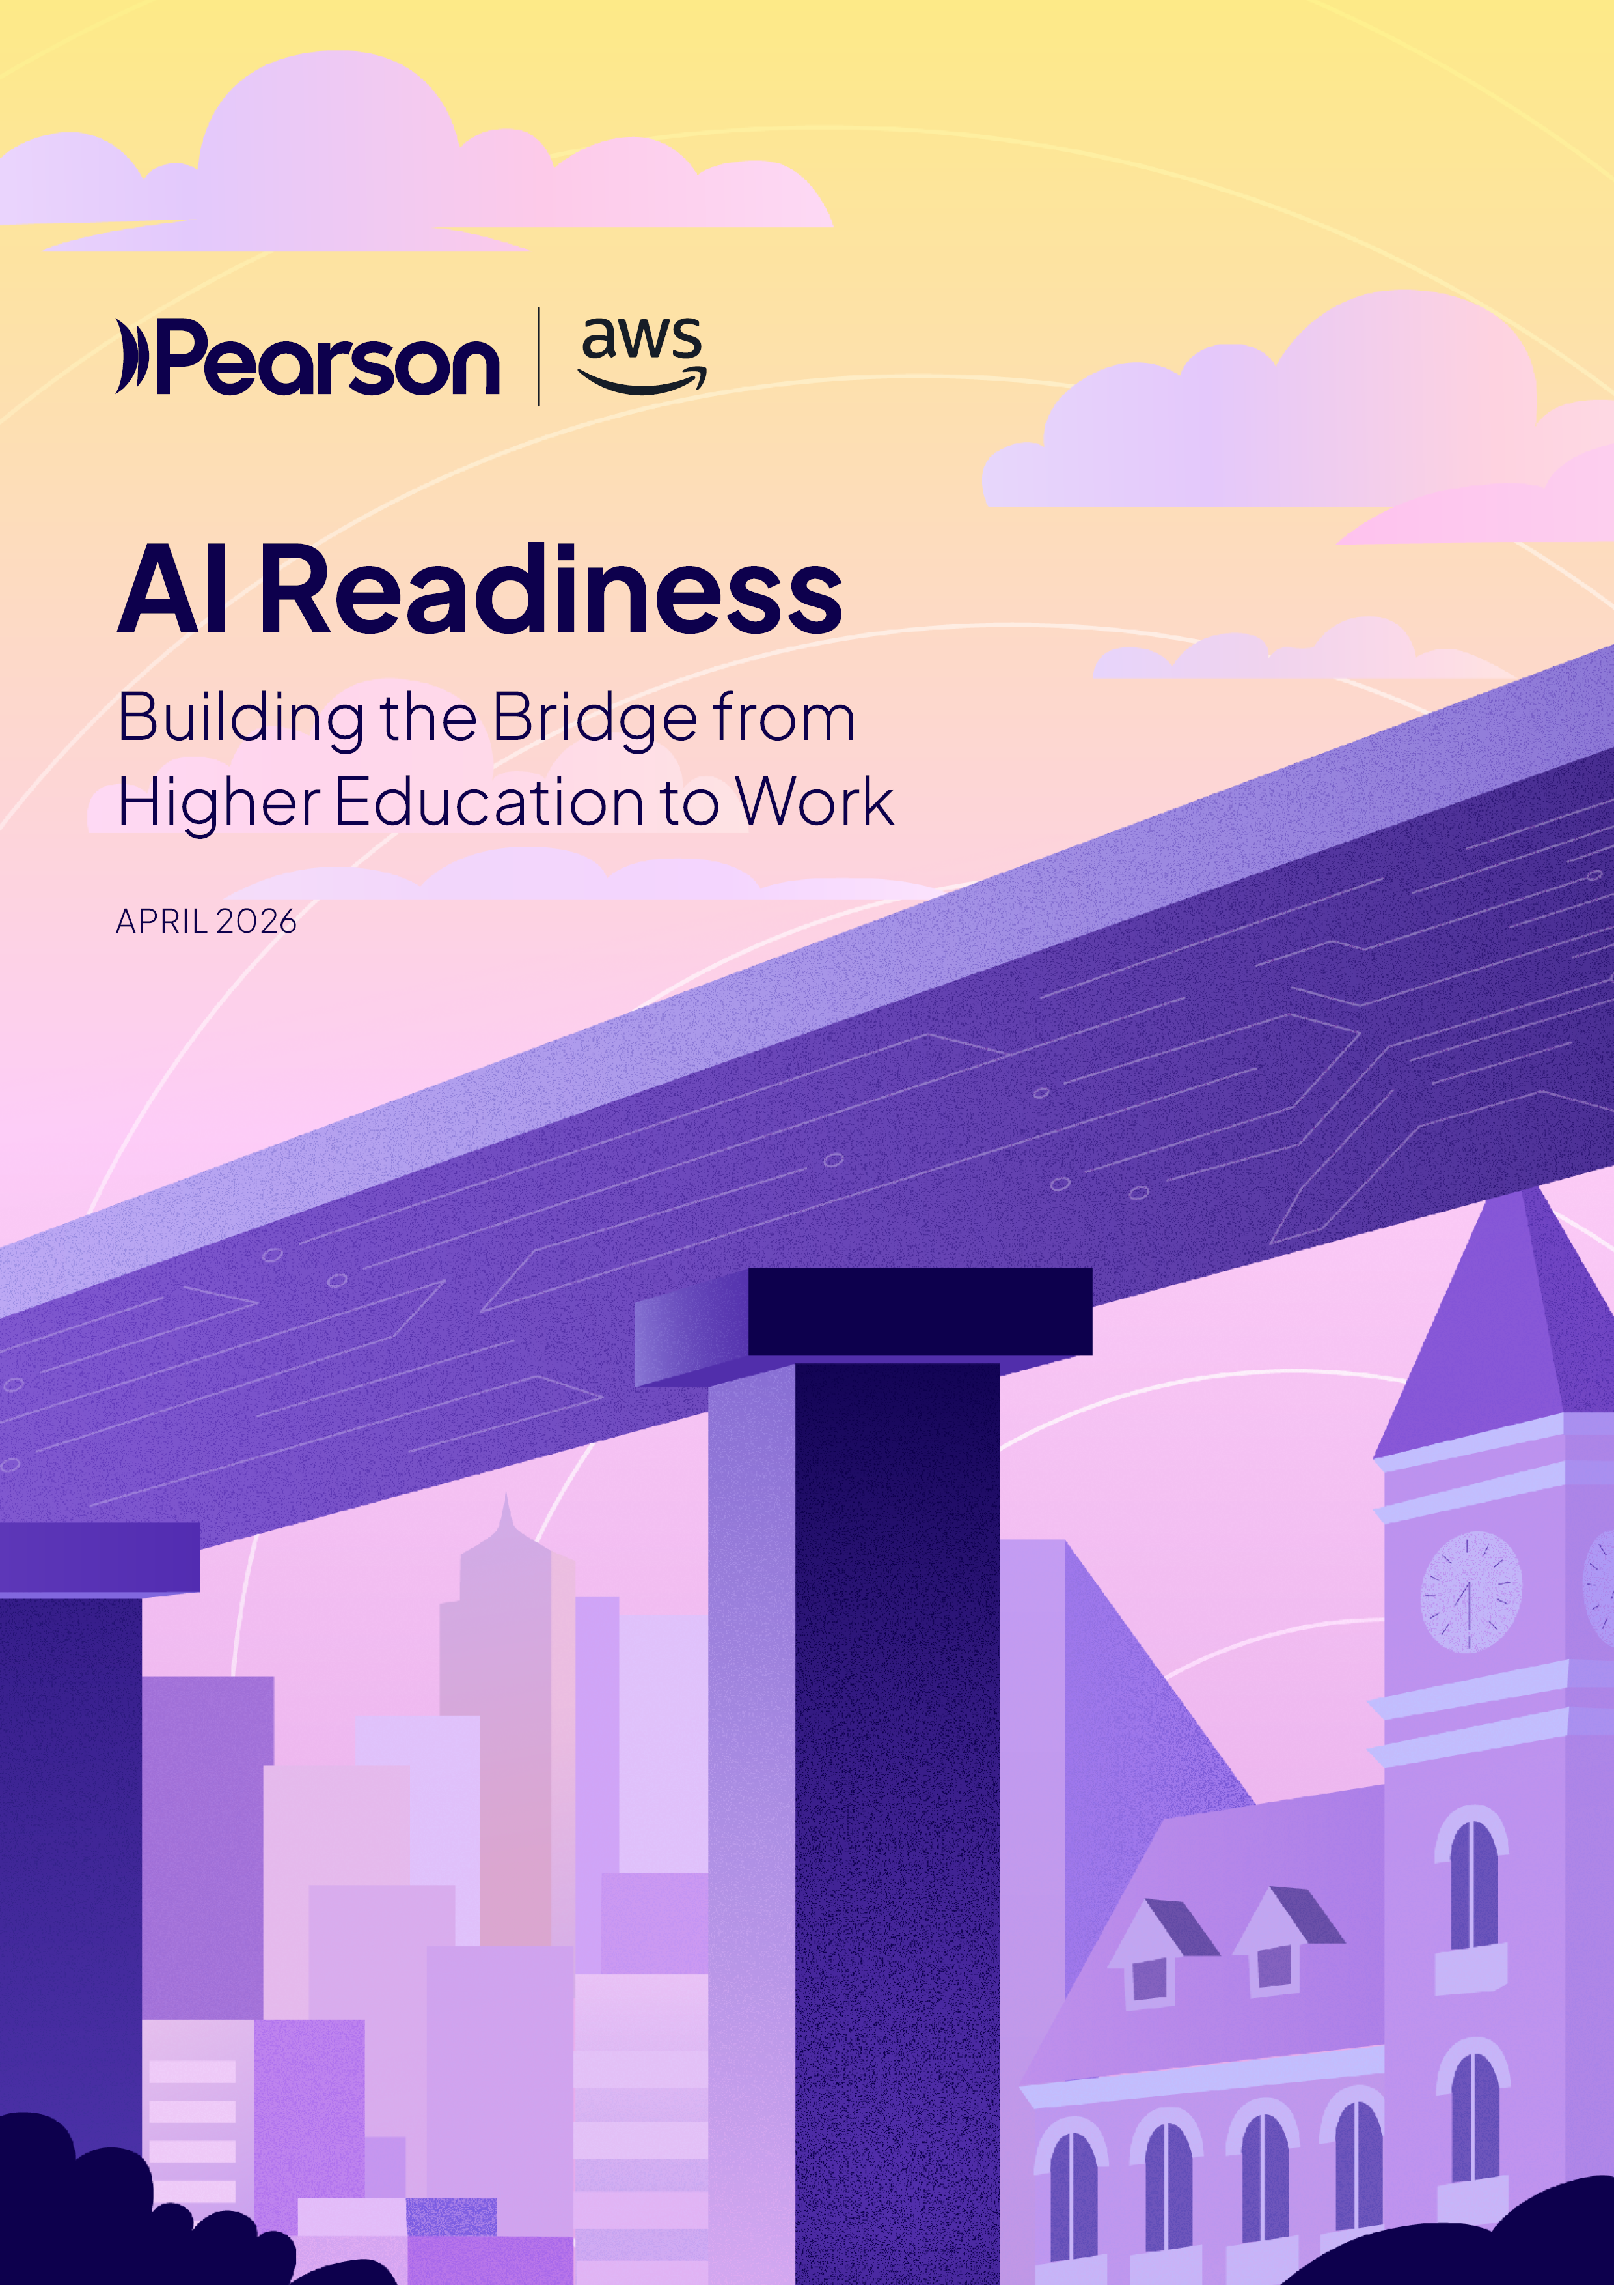
AI Readiness
Building the Bridge from
Higher Education to Work
How institutions and employers can reduce
friction and deliver AI‑ready graduates
Notes:
AI is reshaping entry‑level roles faster than education‑to‑work systems were designed to adapt. This conversation focuses on where AI readiness is actually built — in the transition between learning and real work.

Slide 5
A six-country, three-audience evidence base
AI READINESS
2,711
respondents across learners,
HE leaders, and employers
6
countries: US, UK, Brazil,
Saudi Arabia, Vietnam, Malaysia
Supplemented by in-depth interviews with institutional leaders across five markets. Conducted
in partnership with PSB Insights.
5
Notes:
The pace of AI change is broadly acknowledged, yet confidence in higher education’s ability to keep up is low. This is the starting tension driving the rest of the story.

Slide 6

AI adoption is accelerating.
Readiness is not.
AI READINESS
67%
24%
The transition from higher education to work
has always been a source of friction. AI has compressed timelines, raised stakes, and made the cost of misalignment far more visible.
The question is no longer whether to act,
but how fast.
of all respondents say AI‑driven workplace change is already very fast – and 66% expect
it to accelerate
believe universities
are keeping pace
with AI‑driven change
6
Notes:
The pace of AI change is broadly acknowledged, yet confidence in higher education’s ability to keep up is low. This is the starting tension driving the rest of the story.

Slide 7

The biggest risk isn’t what institutions lack. It’s what they believe they’ve already achieved.
AI READINESS
78%
Students rate institutional readiness 15 points lower. Employers rate critical evaluation of AI outputs — a foundational workplace skill — as graduates’ single weakest competency.
of HE leaders are confident graduates meet employer expectations
7
Notes:
Where industry connection is weakest is exactly where AI readiness should be reinforced. Without intentional design, graduates are left to bridge the gap alone.

Slide 8
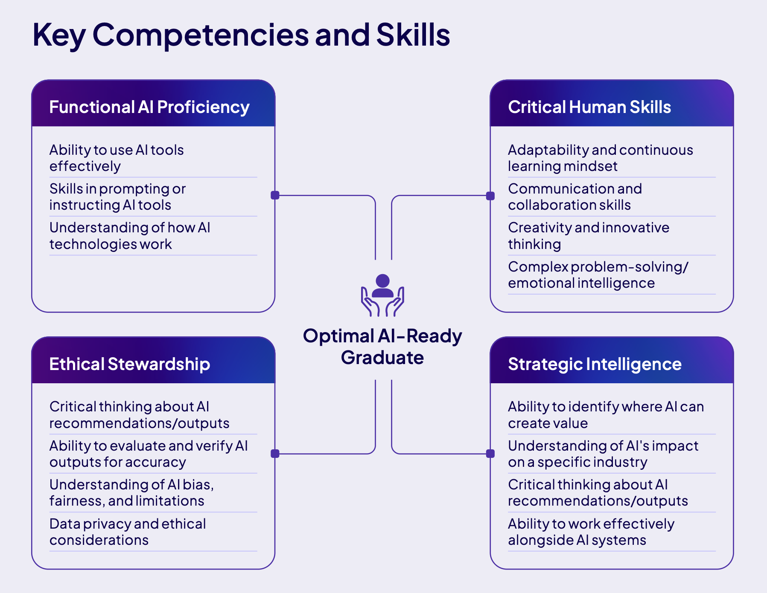
The optimal AI-ready graduate
AI READINESS
AI readiness strengthens the bridge from education to work. Its absence compounds existing weaknesses in that bridge.

Slide 9
Pace
Friction
AI READINESS
FRICTION
Key evidence
67%
70%
describe AI-driven change
as fast, yet only 24% believe universities are keeping pace
of HE leaders expect the pace
to accelerate over the next
two years
The widening gap between the speed of AI-driven workplace change and the slower cadence of curriculum and institutional decision-making. The distance between higher education and the workforce begins here.
42%
53%
of HE leaders cite speed
as the primary barrier to
curriculum adaptation
of employers say finding
graduates with the right skills
is their primary challenge
9

Slide 10
Connection Friction
AI READINESS
Friction
Key evidence
39%
25%
of industry partnerships
rank last among six HE AI
investment priorities
of HE leaders have formal
systematic processes to
gather workforce needs
Weak feedback loops between education and employers, reducing alignment between workforce needs and learning design. Where connection infrastructure is insufficient, curriculum decisions are made with partial or delayed labor market information.
31%
53%
of employers report difficulty communicating their needs
to HE institutions
of employers say they
cannot find graduates
with the right skills
10

Slide 11
Capability Friction
AI READINESS
Friction
Key evidence
40%
13%
Faculty AI expertise is
the #1 barrier to readiness,
cited by 40% of HE leaders
rate their faculty’s AI capability
as ‘very strong’; 40% say
it is ‘mixed’
Uneven faculty and instructor AI capability, limiting consistent integration of AI into learning experiences. The training deficit creates a ‘curriculum lottery’ where student outcomes depend on individual instructors rather than institutional design.
16%
5%
of institutions offer comprehensive ongoing
faculty AI training
In the US and UK, just 5% describe training access as extensive; a third report little or none
11

Slide 12
AI READINESS
Friction
Key evidence
Governance Friction
49%
34%
of students use independently sourced AI tools vs 19% using university-provided tools
are highly confident
they comply with
AI rules
The absence of clear, practical guidance translating AI access into responsible, governed practice — resulting in shadow
AI use, unclear policies, and compliance risks that extend from campus into the workplace.
62%
18%
of students cannot say
with certainty their institution
has AI policies in place
of students are entirely
unaware of any institutional
AI guidance
12

Slide 13
AI READINESS
Friction
Key evidence
Experience Friction
#1
68%
Learners and employers both
cite practical experience
as the #1 change needed
of students are satisfied with tool access, but only 18% are very satisfied with AI content depth
A disconnect between access
to AI tools and structured opportunities to practice, apply, and demonstrate real-world capability. Experience friction
is not a deficit of tools but a deficit of structured application.
42%
35%
of employers cite lack of practical experience with workplace tools as their top hiring barrier
Working alongside AI is the least-covered of six AI curriculum topics (35% well covered)
13

Slide 14
AI READINESS
Key evidence
Friction
Skills
Friction
58%
47%
Employers rate critical evaluation of AI outputs as graduates’ weakest competency (58% good/excellent — lowest of 8)
Ethics is the most-covered topic (47%) but applied judgment is the least developed
The downstream manifestation
of all preceding frictions. Skills friction reflects how systemic constraints ultimately surface
as gaps in graduates’ applied capability at work — a misalignment between what graduates demonstrate and
what employers require.
40%
21-point gap
HE leaders prioritize tool use (40%); employers prioritize communication (50%) and adaptability (45%)
In the UK: 21-point gap between institutional priority and employer demand on communication skills
14

Slide 15

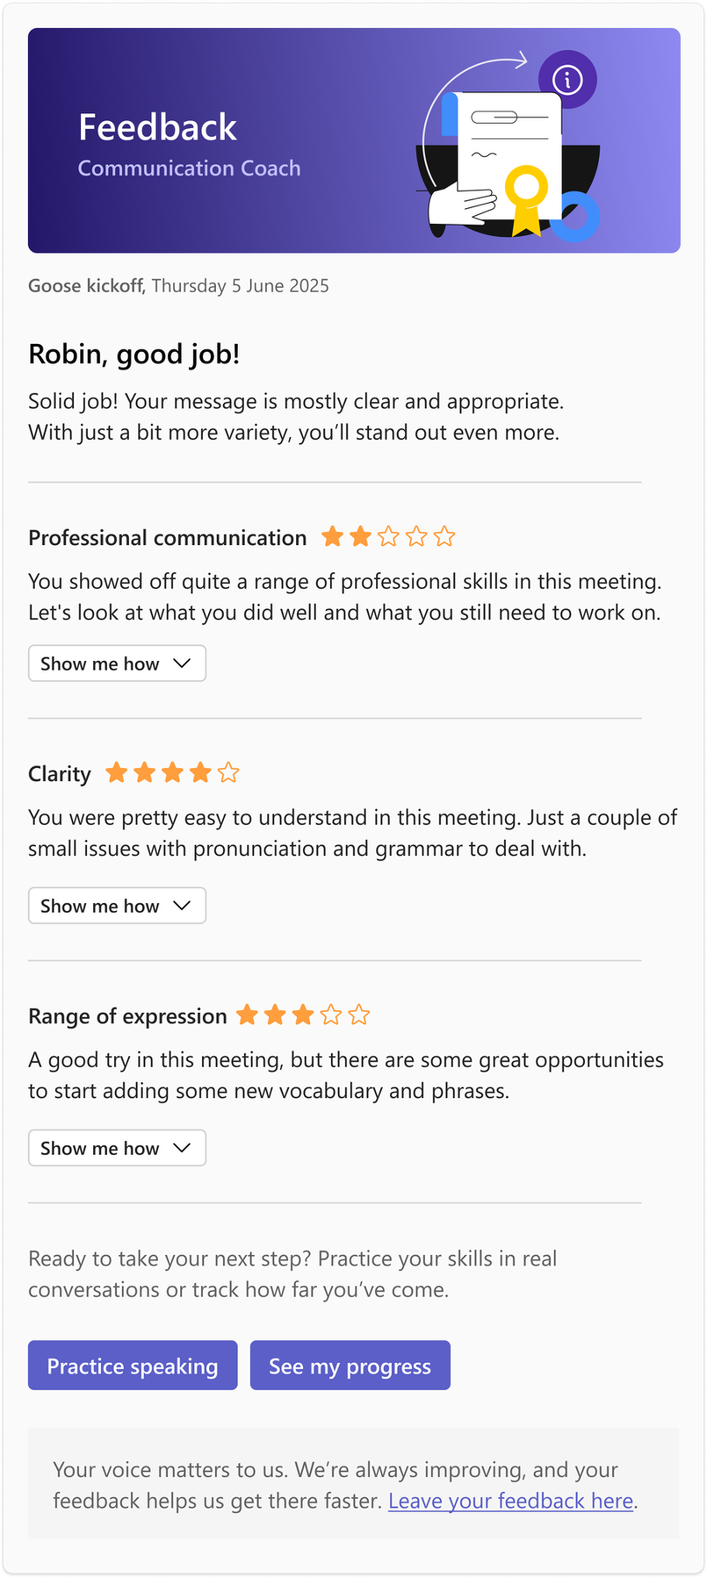
Introducing Communication Coach
Communication coach
AI‑powered workplace English learning & coaching, embedded directly in Microsoft Teams
What it is | What it does | Why it works
Teams‑native coaching tool Built for enterprise deployment Privacy‑first by design | Real‑time feedback on clarity, tone & fluency Personalised practice pathways Progress tracked over time | In the flow of work (not training sessions) Measurable improvement at scale Institution‑ready (governance & security)
Meeting → Feedback → Practice → Improvement
Notes:
Communication Coach is Pearson’s AI‑powered workplace English learning and coaching tool, built natively inside Microsoft Teams.
It gives employees real‑time feedback on their English communication (clarity, tone, fluency) and personalised practice pathways — all in the flow of work.
As workplace English improves, organisations also see stronger business communication outcomes and measurable progress at scale.

Slide 16
PTE Academic
PTE is the world’s first fully computer-based test to utilize AI technology to provide unbiased and secure results of a test taker’s English proficiency skills.
Convenient
Accurate and objective
Relevant
Enhanced security
Single 2-hour test
Fast: 95% of results within 48 hours average
Testing 365 days/year
Simple online booking, up to 24 hours in advance
Computer-based marking ensures impartial, accurate results
A wide scale from 10 to 90 that provides granular performance information to test takers and institutions
Uses genuine academic and real-world content offering a relevant test experience
Integrated tasks test more than one language skill reflecting the
combination of skills
people use every day
Advanced multi-layer security measures
Completely digital
end-to-end test providing greater accuracy and security
Confidence in results

Slide 17

Recognized around the world
Malaysia & Singapore
Canada
Growing number of universities
MQA in Malaysia
All visas
All universities
including Toronto, McGill University & the University of British Colombia
USA
1,600+ universities
including Harvard Business School and Yale
UK
Europe
Australia &
New Zealand
99% of universities
All visas
Chevening Scholarships
All universities
in Sweden, Finland, and Ireland
88% of universities
in Norway
Growing number of universities
in many other European countries
100% of universities
All visas
Australia Awards Scholarships
New Zealand Aid Scholarships
Fulbright Scholarships
Health Resources & Services Administration (HRSA) for nursing

Slide 18

“Living in Australia means safety, stability, and the chance to grow personally and professionally in a country full of opportunities.”
Salma Behmanush
Financial analyst, Qantas (L)
18

Slide 19

Thank you.
Taha Haidermota
Country Ambassador
VP Legal, Pearson
taha.haidermota@pearson.com
Notes:
Appendix: Research Methodology, case studies, framework

