Slide 1
Believing in Quality: Stakeholder Perceptions of English Language Education in Cambodia
Vutha Ros, Academic Manager
English Language Academy – Cambodia

Slide 2
What this talks covers
This talk responds to three questions from the abstract:
What do stakeholders believe quality is?
What evidence do they use to judge it?
How does the market respond to that belief?

Slide 3
How the study is framed
Stakeholder beliefs surveyed across four layers
Context — Why English? Purposes and aspirations
Input — What makes a good school? Teachers and provision
Process — What does good teaching look like? Methods and learning experience
Product — What does quality produce? Outcomes and evidence
Provider communications analysed in the local market: How schools publicly signal quality: accreditation, partnerships, exam centres, curriculum, materials

Slide 4
Who responded
122
Total Respondents
Age Cohort Breakdown
15–21
38%
22–30
29%
31+
33%
Sub-Group Focus
Parents (n=35)
Participants
Students, working adults, parents
Methodology
Surveyed online

Slide 5
The shape of that belief, in numbers
Context
4.63
Prepares learners for real-life use
Process
4.50
Uses real-life tasks and activities
Product
4.41
Produces learners who can use English in real life
Input
4.21
Teachers should hold an ELT degree (B.Ed/MA)
Mean ratings on a 1–5 scale, n=122

Slide 6
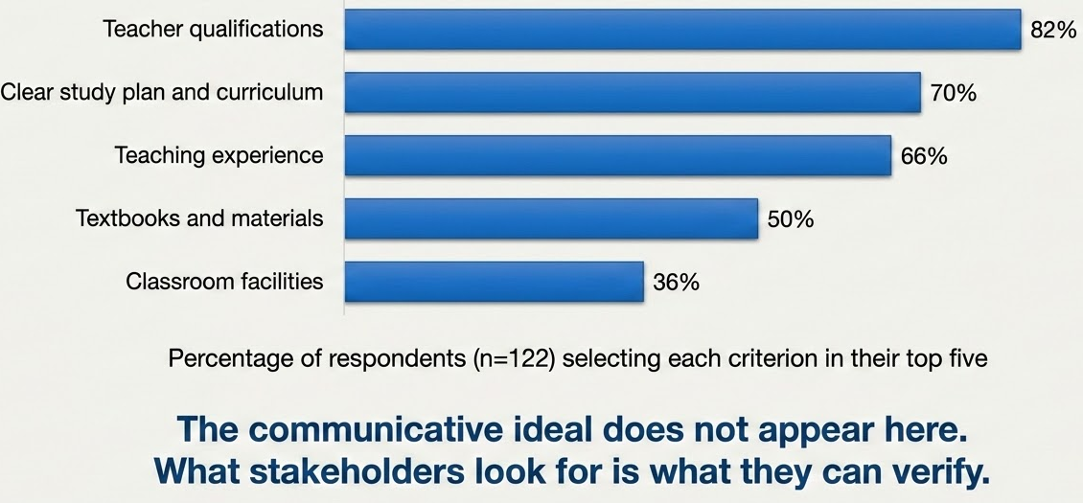
What stakeholders look for, in practice

Slide 7
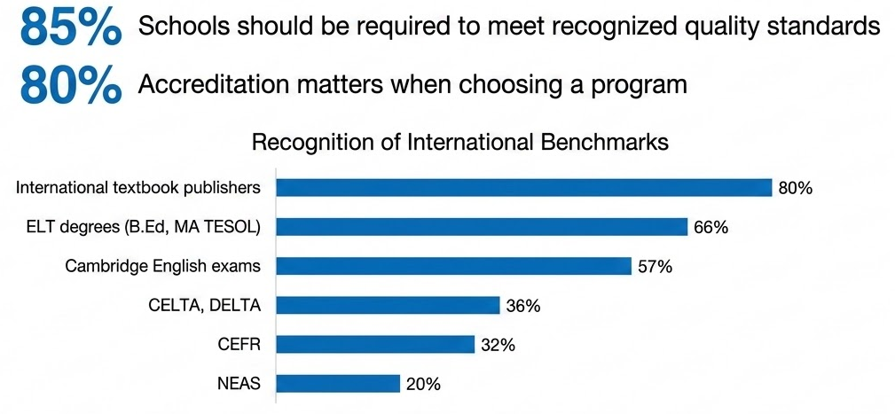
What stakeholders recognise
The demand for external standards is real and widely held, but The recognition is of brands, not standards

Slide 8


How the market communicates quality
ELT accreditation
NEAS recognised language school
Authorised exam/prep centre
e.g., TOEFL iBT; Cambridge Gold Prep
Coursebook alignment
e.g., the use Cambridge English curriculum
Curriculum licensing
e.g., Imperial English UK
External exam as exit qualification
e.g., students take Cambridge English or IELTS as their exit credential
Each is genuinely distinct. Each has a real Cambodian example.

Slide 9
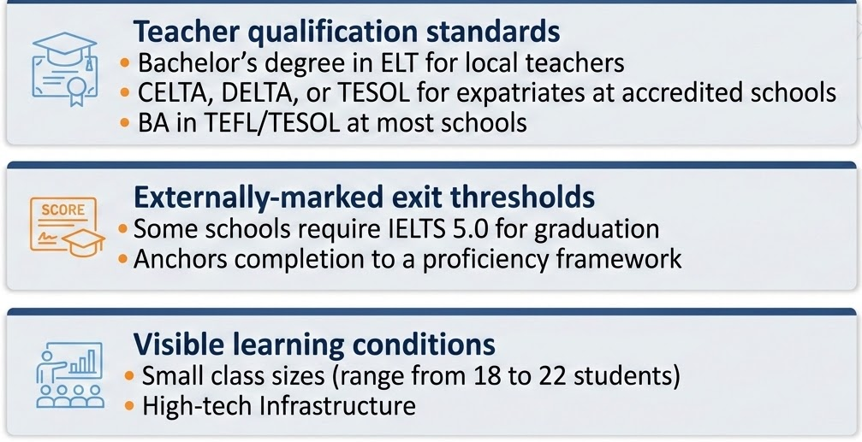
What schools also provide
Teacher qualification standards (from public job postings)
Bachelor's degree in English language teaching for local teachers; CELTA, DELTA, or TESOL for expatriate teachers at accredited schools.
BA in TEFL, TESOL, or relevant field at most schools.
Externally-marked exit thresholds
Some schools require IELTS 5.0 for graduation, anchoring program completion to an internationally recognised proficiency framework.
Visible learning conditions
Class size claims range from 22 students per class to 18, used as a point of differentiation between schools.
High-Tech Infrastructure

Slide 10
What stakeholders believe, and what the market shows them
Stakeholder Beliefs
What quality is:
Real-life use, tasks, communicative outcomes, and communication over exams.
Evidence sought:
Teacher qualifications, study plans, teaching experience, textbooks, facilities.
Market Signals
Real Investment:
Qualified teachers, externally-marked exit thresholds, small classes.
International Reference:
Accreditation, exam centers, curriculum brand alignment, brand certification, external exit exams.
Belief shapes provision. The market satisfies stakeholders' perceived quality through real investment and recognisable signals.

Slide 11
Belief on quality and belief management
ELT accreditation
Manages belief through external evaluation of practice
Authorised exam center
Manages belief through proximity to an international exam
Brand Alignment
Teaching toward a known international standard via curriculum
Brand Certification
Using and certifying through a foreign curriculum brand
Exit Qualification
Manages belief through an externally-marked credential
All five manage belief in different ways. Each does part of the work. None does all of it.

Slide 12
Belief in quality requires shared evidence
What stakeholders believe shapes what schools provide
Stakeholder belief in qualified teachers, structured curricula, modern conditions, and international reference is met by real investment from schools.
What this study suggests
Pervasive Belief: Belief in quality is real on every side: stakeholders, schools, accreditors, researchers.
Shared Evidence: Belief becomes action only where evidence is shared.
Shared Assets: Teacher qualifications, exit thresholds, learning conditions are already shared.
Gap in Knowledge: International reference warrants vary; stakeholders are not yet equipped to distinguish.

Slide 13


