Slide 1
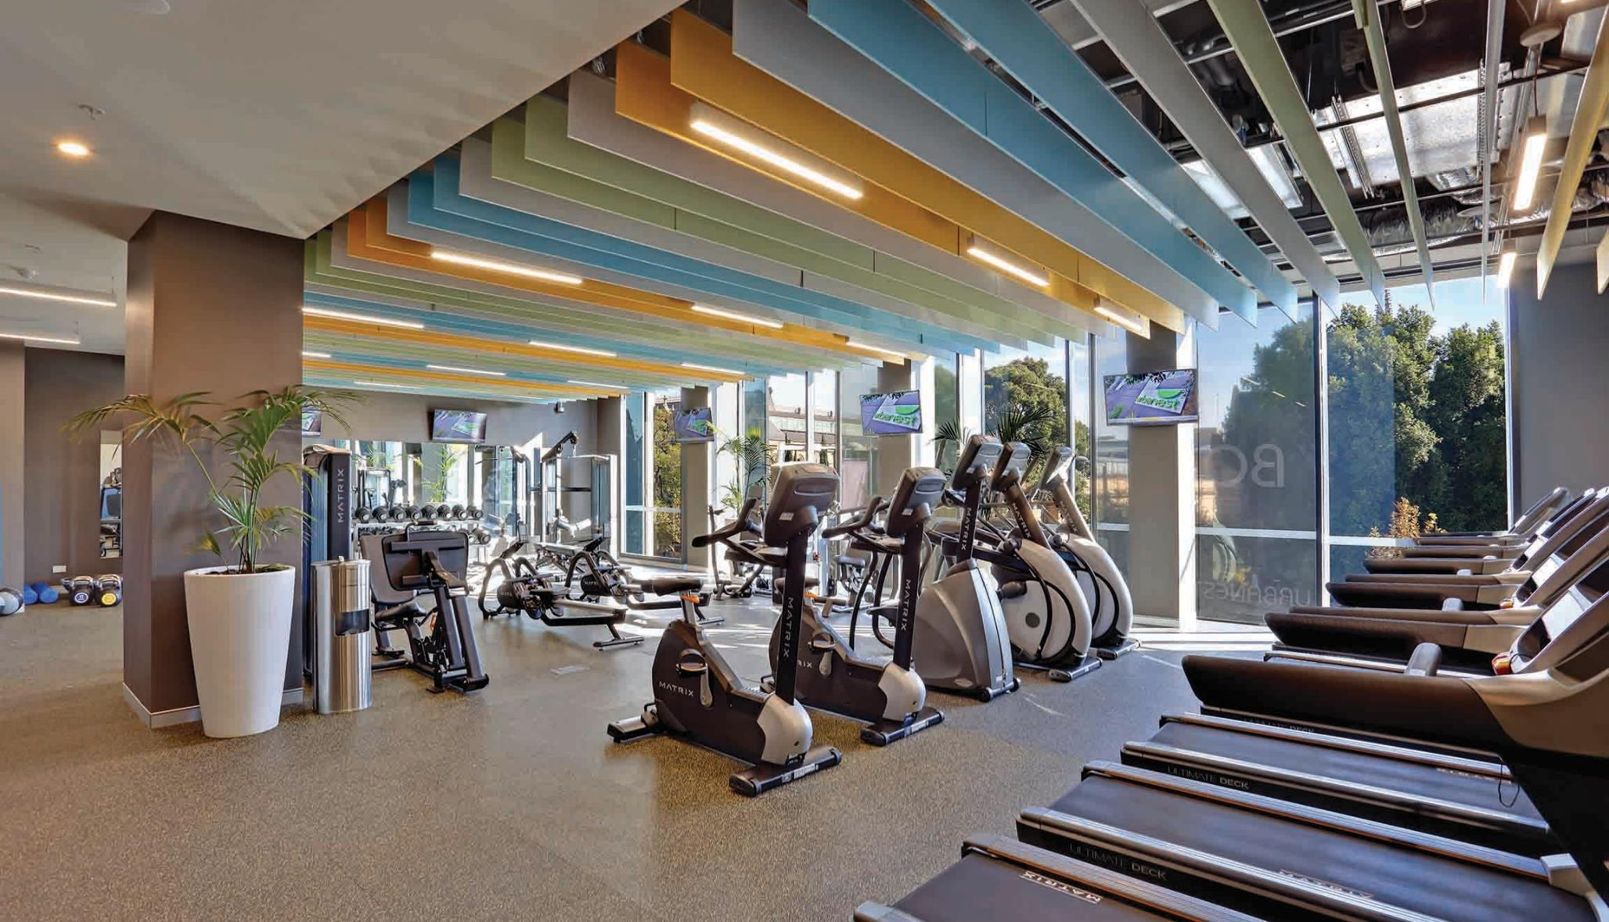



National Property Accreditation Scheme
Prof. Kent Anderson and Geoff Denison
SAA National Committee
studentaccassoc.com.au
npas.org.au
CORPORATE SPONSORS

Slide 2
Student Accommodation Association

Slide 3

DEFINITION OF STUDENT ACCOMMODATION
Accommodation which is provided for the exclusive use of students to support and enhance the education experience

Slide 4








SAA NATIONAL COMMITTEE
President
Geoff Denison
Vice President
Matt Row
Committee Member
Alex Elibank Murray
Committee Member
Rebecca Bendall
Committee Member
Craig Carracher AM
Committee Member
Tim Klitscher
Committee Member
Prof. Kent Anderson
Committee Member
Ron de Haan

Slide 5




















SAA EXECUTIVE MEMBERSHIP

Slide 6

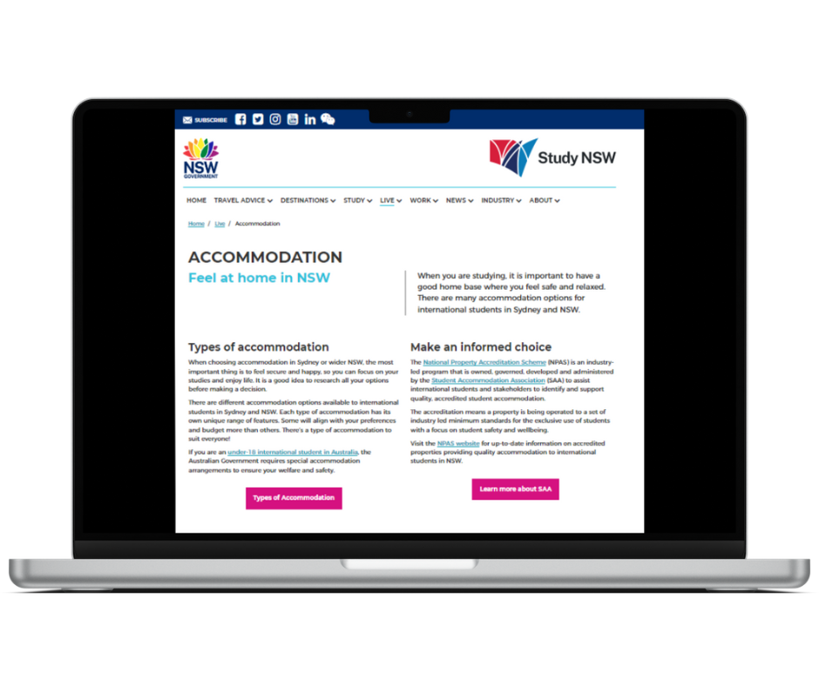
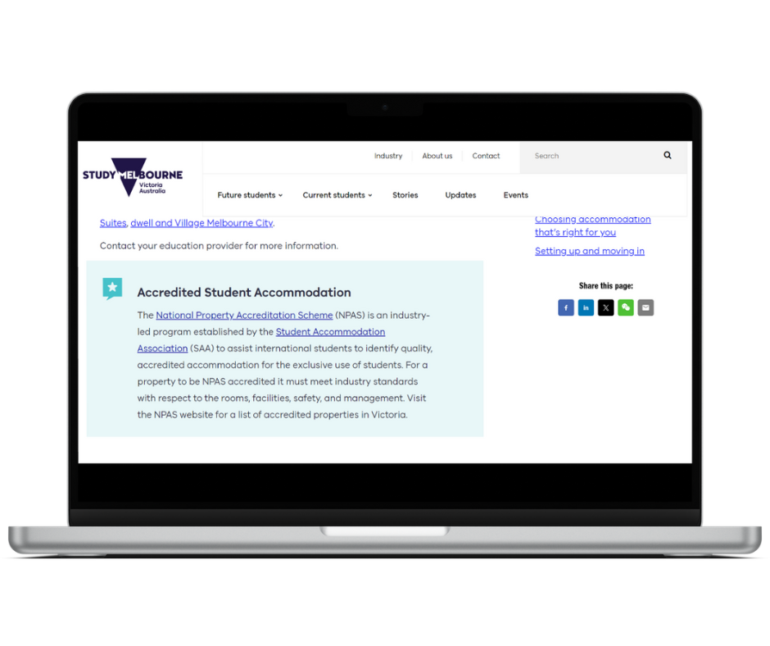
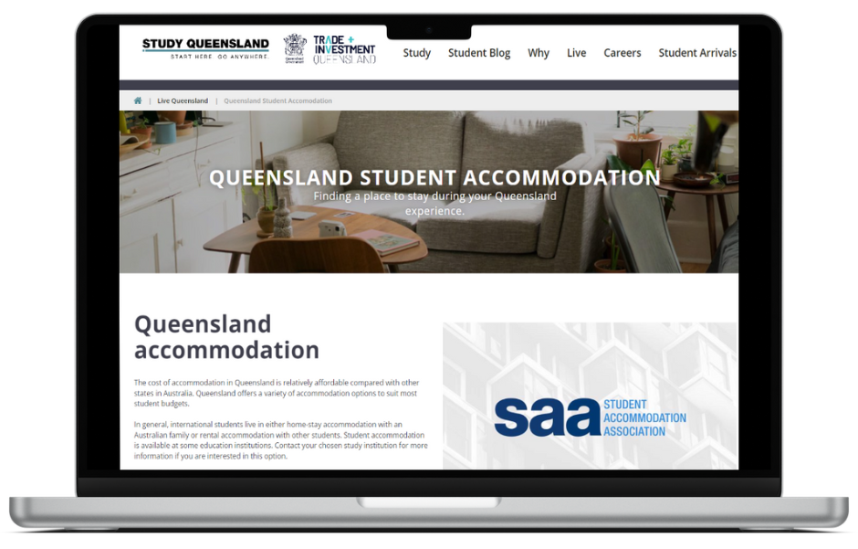
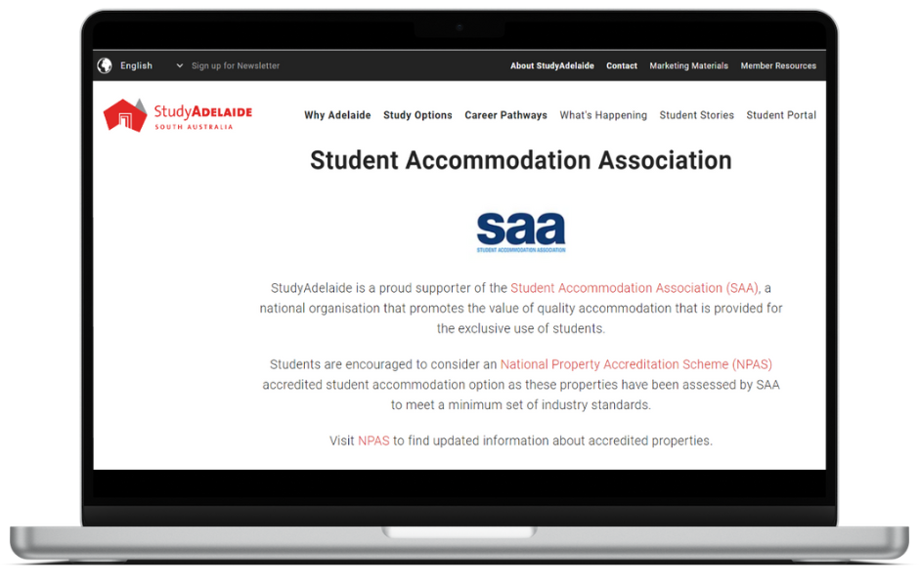
SUPPORT FROM INTERNATIONAL EDUCATION STAKEHOLDERS

Slide 7

National Property Accreditation Scheme (NPAS)

Slide 9





NPAS ASSESSMENT CATEGORIES
University Managed
Residential Colleges
Purpose Built Student Accommodation (Commercial)
Student Hostels
Managed Student Housing Portfolios
Accommodation and facilities operated or controlled by a University for the exclusive use of students.
Accommodation and facilities for the exclusive use of students demonstrating priorities around quality pastoral programs, academic support, sporting, cultural and leadership development opportunities.
Accommodation and facilities specifically designed and utilised for the exclusive use of students. Operated by experienced student accommodation providers who demonstrate a commitment to residential community engagement.
Accommodation and facilities specifically designed or adapted for the exclusive use of students. Operated by experienced student accommodation providers specialising in providing low cost accommodation for short to mid-term periods.
Residential student housing portfolio of 50 beds or more, operated by experienced student accommodation providers specialising in quality shared rental properties for the exclusive use of students.

Slide 10
NPAS ACCREDITATION FRAMEWORK
Tenancy compliance
Dispute jurisdiction
Bond treatment
Tax compliance
Insurance
Business
Profile
Building code
Furniture provision
Fire code
Internet provision
Communal study and recreational spaces
Facility and
Amenity
Internal grievance resolution
Access to customer service
Management
Model
Emergency management
Student customer education
Rules of occupancy
Operational
Plan

Slide 11

NPAS ASSESSMENT PROCESS
NPAS application is received and prepared for assessment by the SAA administration support officer
The SAA administration support officer liaises with the Secretary of SAA to engage an assessor
The SAA administrative support officer prepares a secure digital file for the application and makes it available to the assessor
The application is assessed by the assessor liaising with the property applicant to determine where all NPAS requirements are met
The assessor will submit a report with a recommendation, to the Secretary of SAA
The assessors report will be included on the next SAA National Committee for board consideration and endorsement
The Secretary of SAA will notify the applicant property of the outcome and finalise the brand licensing agreement if applicable
Mr Ron De Haan
Co-opted SAA board member
Extensive experience in the accommodation sector

Slide 12

40+
23,500+
NPAS Accredited Properties
Beds in the NPAS Accredited Portfolio
Notes:
Current reality. But this needs to be changed to define the quality accommodation and also meet the expectations of students.

Slide 13

INFORMED
CHOICE

Slide 14
Evolving Regulatory Framework

Slide 15
NEW REGULATORY LANDSCAPE
The New Overseas Student Commencement (NOSC) Framework is an Australian Government managed system regulating the number of new international students permitted to start study. It sets 2026 caps (National Planning Level) of 295,000 places to ensure sustainable education growth, utilizing Ministerial Directions for VET and higher education providers to manage provider-level allocations
NOSC
NATIONAL CODE
The National Code establishes mandatory requirements for higher education providers across 7 legally enforceable standards. They are the foundation of a new culture that prioritises gender-based violence prevention, ensures safe and timely responses, and embeds accountability at every level.

Slide 16
SHARED COMMITMENT TO ENHANCING STUDENT SAFETY AND WELLBEING
NPAS (student accommodation)
Student accommodation providers
Government
Education providers

Slide 17

THANK YOU
studentaccassoc.com.au
npas.org.au

Slide 18


