Slide 1



From Aspiration to Action:
Leveraging Quality Assurance Frameworks to Build Authentic Belief in Learner Outcomes
Notes:
Title slide

Slide 2

n national qualifications
From Aspiration to Action: Leveraging Quality assurance frameworks to Build Authentic Belief in Learner Outcomes​
Speaker One: ​
Jo Kwai ​
Curriculum Leader Assistant; Overseas Student Coordinator; EALD Yr 9 Yr 11, Secondary School, St Peters Lutheran College, Brisbane​
​
The Regulator's Lens How compliance standards are the backbone of integrity, building essential belief in national qualifications.
​
Registered teacher; cross-sectorial educator; ASQA SLG inaugural member; Tuition Protection Scheme (TPS) sitting advisory board member; Founder EA PD Fest. ​
Notes:
Jo – add your PPT background

Slide 3
From Aspiration to Action: Leveraging Quality assurance frameworks to Build Authentic Belief in Learner Outcomes
Speaker Two: ​
Leisl Bruhn ​
Dean of International Students, Ivanhoe Grammar School, Melbourne ​
.​
The Educator's Lens: How belief in student potential influences innovative curriculum design and teacher collaboration.
​
Registered teacher; experienced cross sectoral leader and educator across government and independent settings. Additional experience includes international student recruitment corporate language proficiency programs and transnational education (TNE). President Vision International

Slide 4
From Aspiration to Action: Leveraging Quality assurance frameworks to Build Authentic Belief in Learner Outcomes
Speaker Three: ​
Vanessa Newbery ​
Head of International Programs, Hills International College Ltd, Jimboomba ​
.​
The Support Lens: The vital role of connection – pastoral care, intervention planning and community engagement – in sustaining student belief in their own possibility.
Registered teacher; Executive leader; participant in 026 ASEAN-Australia BRIDGE Program

Slide 5
Road map for today's session
The Regulator’s Lens
The Educator’s Lens
The Support Lens

Slide 6
Support structures are the bridge between institutional quality assurance and the student’s personal journey to success. Strong structures transform compliance into care.
Leveraging Quality Assurance Frameworks to Build Authentic Belief in Learner Outcomes
Belief thrives in connections​ ​
Notes:
Visible: in our student handbooks; student notices and notice boards; in your written agreement – for parents and agents; in your policy and procedure documents; in our College strategic document; they form the basis of a trusted connected relationship between the potential family and their children browsing at your schools webpage, or coming on site to visit your campus during an open-day; it could be word-of- mouth – and another family has recommended your school – it is not commission based and commercialised. This is authentic and the spirit is inclusive and welcoming. At St Peters Lutheran College, the Lutheran Christian values are central and the motto PLUS ULTRA ("ever higher") is the belief that all students have the capacity to learn – and as you learn – you strive 'ever higher'. Central to this are the Lutheran Christian values, Service, academic excellence, and the formation of character. Parents believe and put trust in the school and all students study Religion – Christian Studies in lower secondary, and Religion and Ethics in senior & QCAA. The IB students have SERVICE as part of their IB program. There are strong structures both physically (with the church at the heart of the college campus) and also within the school with sub-schools, YLCS, ISC, chaplaincy, pastoral care and life skills curriculum, as well as sports, music, drama and the arts.

Slide 7
Why national consistency matters for global credibility
The regulator's role: not policing but enabling trust.
NEAS quality framework, the AITSL Teacher standards, Child protection and privacy legislation, social media and AI rules, are there to ensure there are visible boundaries and accountabilities in place to protect our sector, our profession and our students (the quality of their education and learning).
This beliefs enables a growth mindset and forward-thinking.
Belief collapses when quality is inconsistent.
Notes:
Jo – add your PPT background

Slide 8
Consistencies to belief
Currently have v500 from China, Japan, PNG, USA, Taiwan, Sri Lanka, Fiji.
Domestic students include First Nations, local catchment and wider Brisbane area.
Transfers from GPS schools, other independent schools. Students of old scholars.
We're all regulated by the same regulator and same legislation in QLD.
Int: Dept of Education & ESOS Legislation; Same peak-bodies;
Lutheran Schools of Australia
QCAA / State authorities
International Baccalaureate
Notes:
Jo – add your PPT background

Slide 9
Our schools sector needs confidence & resilience
To grow
To scale up and deal with the pits
Resilience to deal with pressure points – protect our learners.
Safeguard the reputation of what we do
Deliver what we promise
Build confidence in pathways and outcomes
BELIEF and compliance are a one-size fits all. Our regulators encourage continuous improvement, not box ticking.

Slide 10

Co-educational
2 + 1 campuses
Over 900 staff
Private independent college, P-12, QCAA & IB, PYP
Swimming school of excellence
Over 700 students in private music lessons
Founded in Lutheran ethos
Commitment to service and others is very strong
85 years strong
Only 31 visa 500 students
120 students in boarding (Boys) (Girls)
No homestay option
Notes:
Jo – add your PPT background

Slide 11
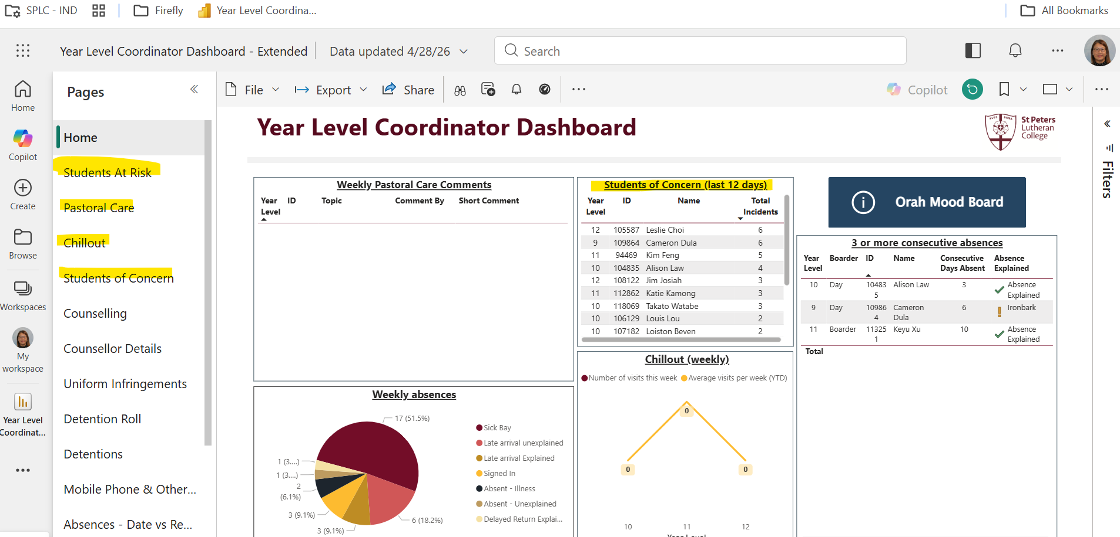
national qualifications
My dashboard – oversight of v500s
YLCs, CLs, counsellors, we all work together.
Notes:
Jo – add your PPT background

Slide 12
Belief is not abstract
… it is built through systems, standards and share responsibility.
It is embedded in a shared culture of openness, transparency, integrity and professionalism.

Slide 13
Call to action:
Believe in the power of Quality Assurance
1
Believe in the frameworks
2
Believe in the evidence
3
Believe in the profession
4
Believe in the learners
5

Slide 14

We can do this together. Thank you

Slide 15
Section 2 - The Educator’s Lens How belief in student potential influences innovative curriculum design and teacher collaboration

Slide 16
Acknowledgement of Inclusion
We acknowledge and respect all members of our community.
We respect our diversity and uphold our school values
so that everyone has the right to learn and feel safe, regardless of race, culture, identity, ability or religion.
We are a proud community of inclusion.

Slide 17
Ivanhoe Grammar School
One School • Three Campuses
Coeducational Independent School
ELC • Year 12
Established 1915
Welcoming international students since 1941
Onsite Intensive English Language Program
NEAS Quality Endorsement • 27 years
VCE • International Baccalaureate
2026 Australian School of Character • Developing young people of character
Our belief in student potential drives innovative curriculum design and deep teacher collaboration.

Slide 18
Ivanhoe
Learner
Attributes

Slide 19
How does belief influence learning design?
Academic achievement and student wellbeing are interdependent, with improvements in one strengthening outcomes in the other
Belief thrives through student centred connection, when students feel known, valued and supported by their teachers, peers and community
In calm, purposeful and inclusive learning environments

Slide 20
How to support belief in student learning
Mentor Program
Mentor the first port of call for their students, they know their students as individuals, they know their strengths, interests and learning needs
Mentors help students to build predictable routines and set clear expectations allowing students to feel safe to participate in their learning
Mentor remains the same for Senior Years – vertical structure Years 10 -12
All students have regular 1:1 Mentor Meetings to discuss their learning journey and set learning goals (amongst a myriad of other things!)
Student Futures Program
Regular meetings throughout SY with Mentors, Director of Student Futures, Student Pathways Coordinator - subject selection, support, guidance, tertiary aspirations
Futures Expo
Tertiary Options Session for International Students

Slide 21
Academic Extension Program
Boost classes
Academic Tracking
Evening study sessions
Academic Wellbeing Enhancement (AWE)
Weekly timetabled classes for Year 11/12 (Year 10 extension)
Alumni Tutor Program
Two sessions per week after school
International Student Mentor Program
Government recognition as Best Practice International Student Engagement Project
In Country Parent Teacher Interviews
Face to face PTIs in addition to online

Slide 22

How can collaboration enhance learning?
The Ivanhoe Instructional Model

Slide 24
Collaboration continued…
Student Care Team and Academic Learning Team Leaders
Director of Academic Learning
Deputy of Academic Learning
Director of AI and Digital Innovation
Director of Evidence Informed Learning
Director of Ivanhoe Institute
Head of Learning Diversity
IB and VCE Coordinators
Head of Academic Extension / Academic Extension Coordinator
Heads of Pedagogy/ Instructional Coaches

Slide 25
‘The Ivanhoe Instructional Playbook is a powerful step forward to our commitment to high quality, consistent teaching practice. It brings clarity to what great teaching looks like at Ivanhoe, evidence-based strategies, and practical tools to support every student…. More than a guide, the Playbook is a living resource that reflects our culture of growth and collaboration’.
Gerard Foley
Principal
Ivanhoe Grammar School

Slide 26

Section 3 – The Support Lens The vital role of connection - pastoral care, intervention planning, and community engagement - in sustaining student belief in their own possibility
Notes:
Vanessa - When students feel seen, safe, and supported, belief becomes practical. The support lens translates quality frameworks (NEAS/ASQA) into daily acts of pastoral care, targeted intervention, and active community engagement—so that every learner can say, “I belong here, and I can do this.” At Hills, this is not an add‑on; it’s embedded in how we operate and measure quality.
Powerful quote:
“Compliance lays the rails; connection moves the train

Slide 27
Pastoral Care builds psychological safety → belief Message: Caring environments aren’t ‘soft extras’; they are quality essentials. Psychological safety (knowing you will be respected, guided and protected) is the condition under which effort and persistence—and therefore achievement—can grow. Practice: Make pastoral care visible in policy, onboarding, and daily routines (welcome rituals, wellbeing activities, trusted contacts, safety nets). Hills example: Our Student Handbook explicitly positions quality pastoral and academic care as central to the learning environment and student wellbeing—signposting contacts, processes and supports from day one. Daily ‘Connection’ class, weekly Wellbeing class (Wellio), House activities, Head of Year catch ups, mental health checks (Switch for Schools) QA tie‑in: Treat pastoral care standards as audit items: welfare induction checklists, escalation pathways, and documented outcomes (not just ‘nice to have’ - essential).
Notes:
Vanessa.”

Slide 28
Intervention Planning converts setbacks → momentum Message: Early, tailored interventions shift the narrative from risk to progress. When students see a pathway and partners walking it with them, belief is sustained. Practice: Use data‑informed triage (attendance, progress, wellbeing signals) to trigger short, structured plans with one accountable lead, time‑bound goals, and feedback loops. Hills example: We schedule targeted support blocks (EAL/D, sports cohorts, senior study skills) to reduce load on subject teachers while directly lifting learner confidence and attainment—e.g., dedicated periods for Volleyball and Golf students, plus in‑class EAL/D support. Ongoing check ins with students and staff re. progress; added to class Teams so we know what assessments and checkpoints are coming up QA tie‑in: Align intervention records to NEAS/ASQA expectations: documented case notes, communicated plans, and evidence of follow‑through.
Notes:
Vanessa

Slide 29
Community Engagement turns belonging → resilience Message: Connection to people and place—peers, homestay, mentors, sister schools—creates the social proof that ’people like me succeed here’. Practice: Design structured touchpoints (homestay briefings, family communications, peer mentors, school‑to‑school exchanges), provide consistent messages of belonging and remove friction (transport, fees, logistics) so students can focus on learning. Hills example: Keeping students connected and confident with messaging (I’m a Hills Kid, ‘Hillsify’, A Place to Belong, House/team connections, LAWS). Planned visits to/from sister schools and coordinated support strengthen belonging and reduce barriers to participation QA tie‑in: Capture engagement outcomes (participation, satisfaction, persistence indicators) in quality reports, messages and marketing so community-building is measured, not just mentioned.
Notes:
Vanessa Closing takeaway (20–30 seconds)
Support is not a safety net—it’s a springboard. When pastoral care, intervention planning, and community engagement are embedded and evidenced, quality assurance stops being a checklist and becomes a culture. That culture fuels student belief—and belief fuels transformation.
One‑line call to action: Embed integrity and care by making support visible, planned, and measured—every week, for every learner.

Slide 30
Thank you!
Jo Kwai
St Peters Lutheran College
Vanessa Newbery
Hills International College
Leisl Bruhn
Ivanhoe Grammar

