Slide 1

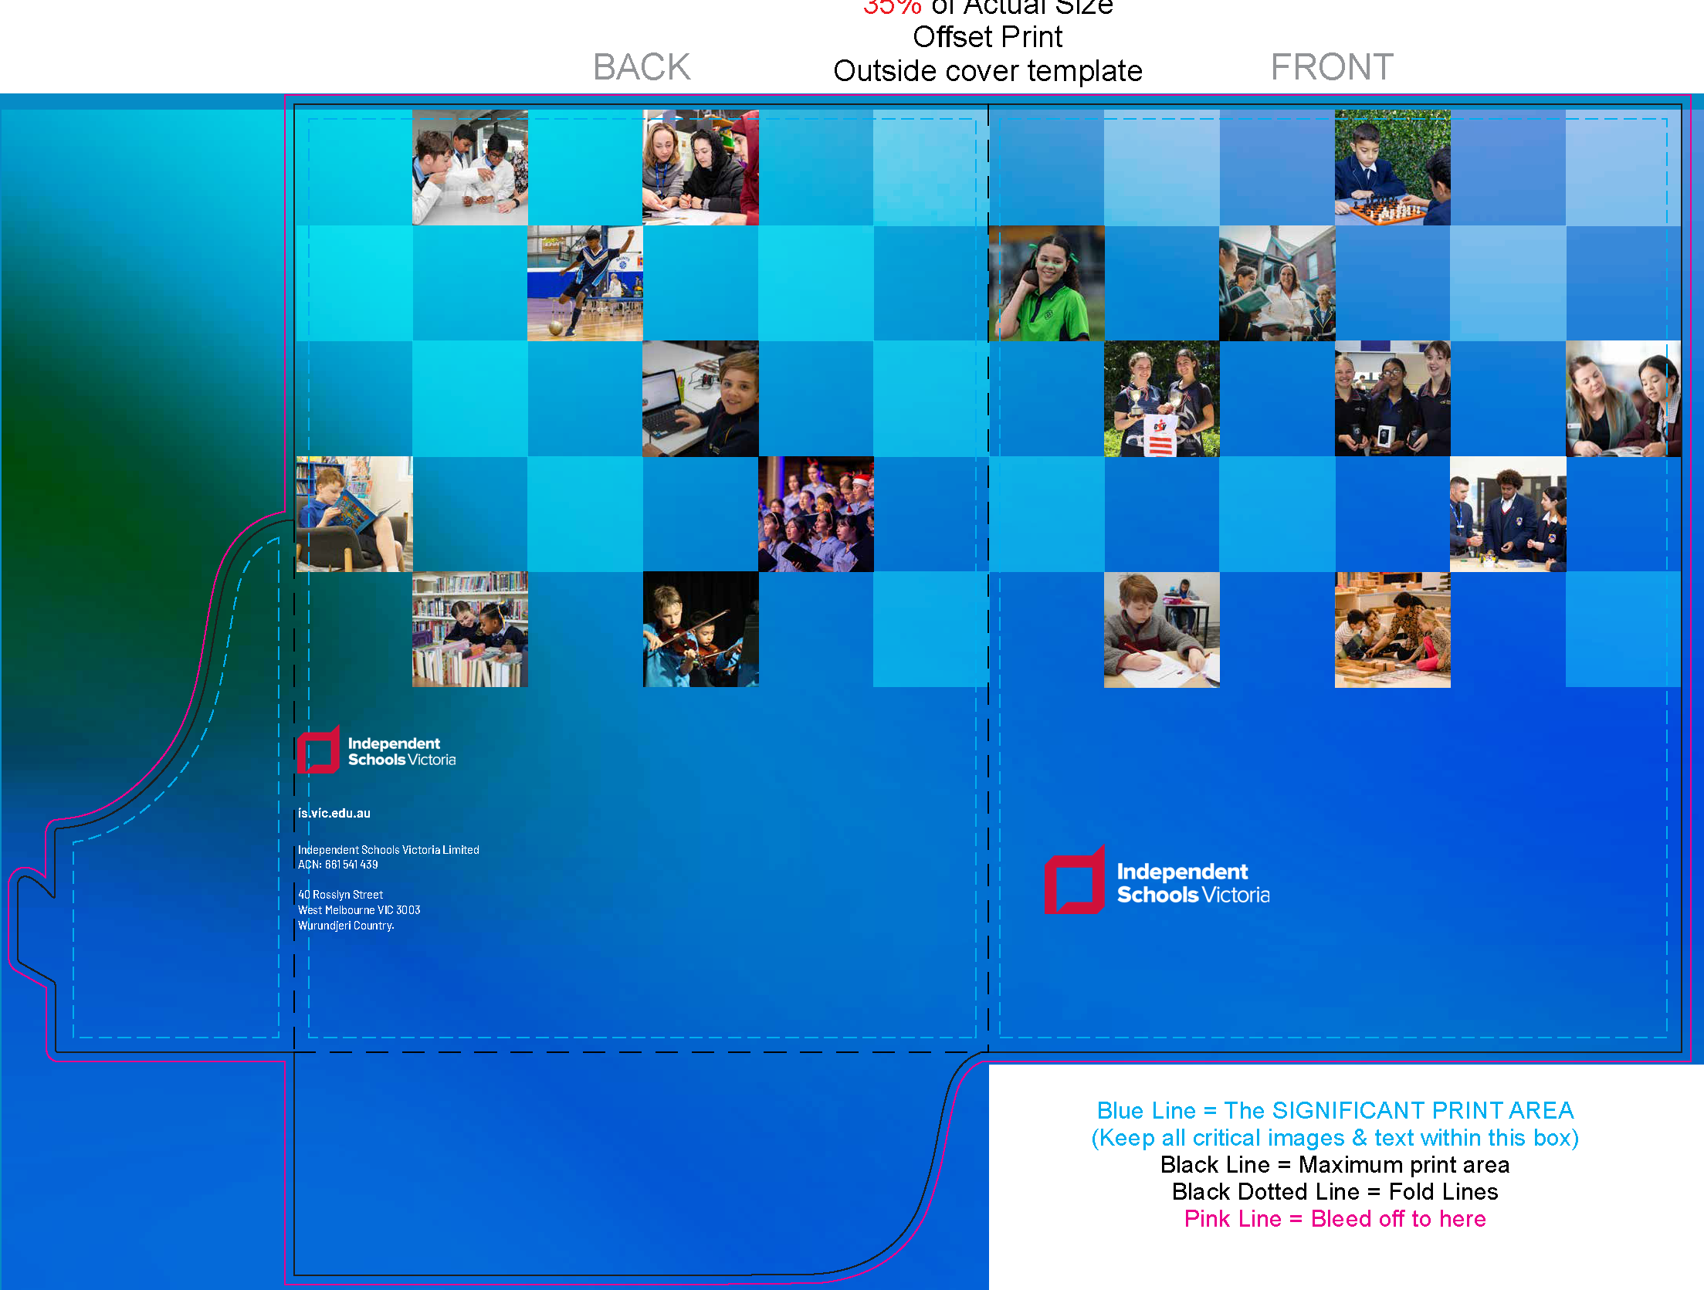

INTERNATIONAL STUDENTS AND
INDEPENDENT SCHOOLS
Rachel Holthouse, Chief Executive, Independent Schools Victoria
NEAS (MAY 2026)

Slide 2

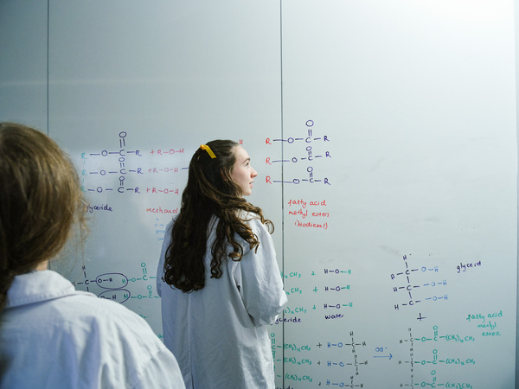
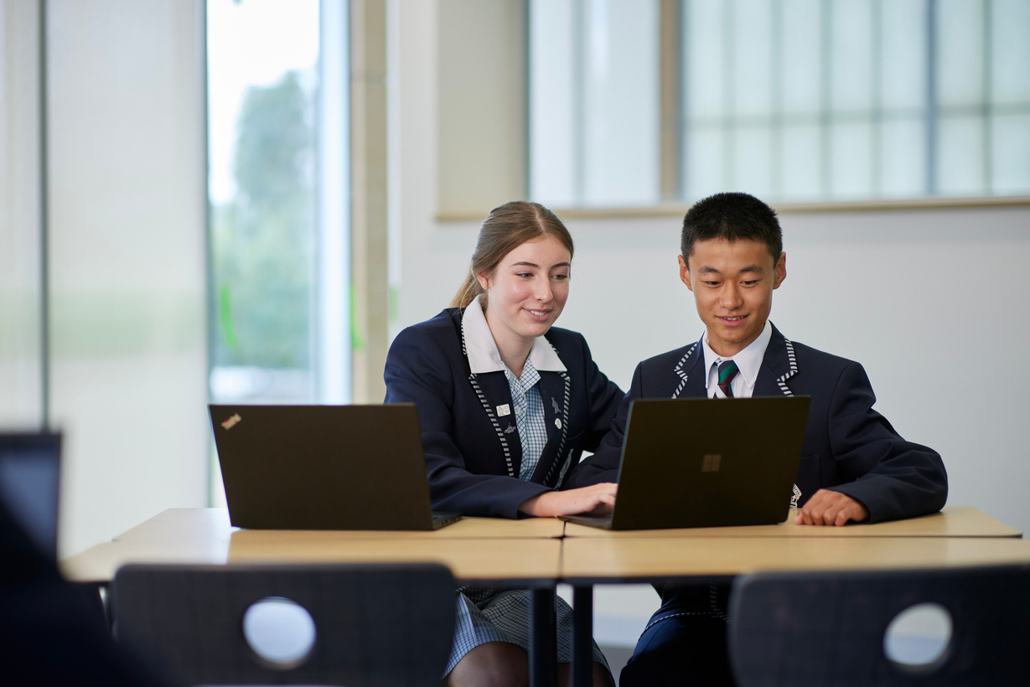

VICTORIAN INDEPENDENT SCHOOLS
Nearly one in six Victorian students attends an Independent school. That’s nearly 179,000 students.
$6.9k is the Median Fee, with more than half of Victorian Independent schools (55%) charge fees of $7,500 or less per year.
Nearly two thirds of Victorian Independent schools are faith-based (61%), with more than
16 different faiths represented.
Victoria has more than 230 Independent schools on 413 campuses.
Notes:
Independent schools in Victoria are as diverse as the communities they serve. They are not one-size-fits-all. They are faith-based schools, community-founded schools, specialist schools and regional schools. They support students with disability, students requiring tailored learning environments, and families seeking an education aligned with their religion and values.
In addition to the statistics on the screen:
68% of our schools are Kindergarten to Year 12
92% of our schools are Co-educational
13% of our schools are Special Assistance Schools
41% of our school campuses are regionally based

Slide 3
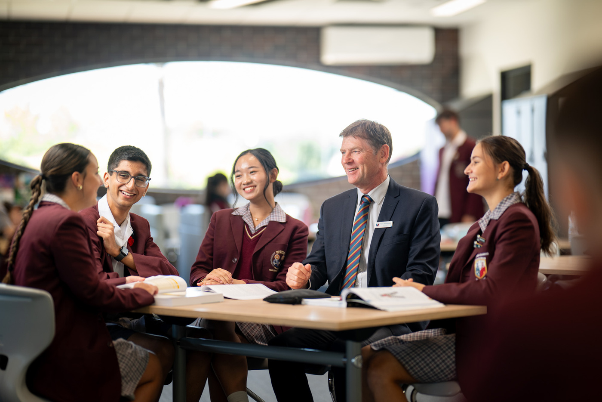
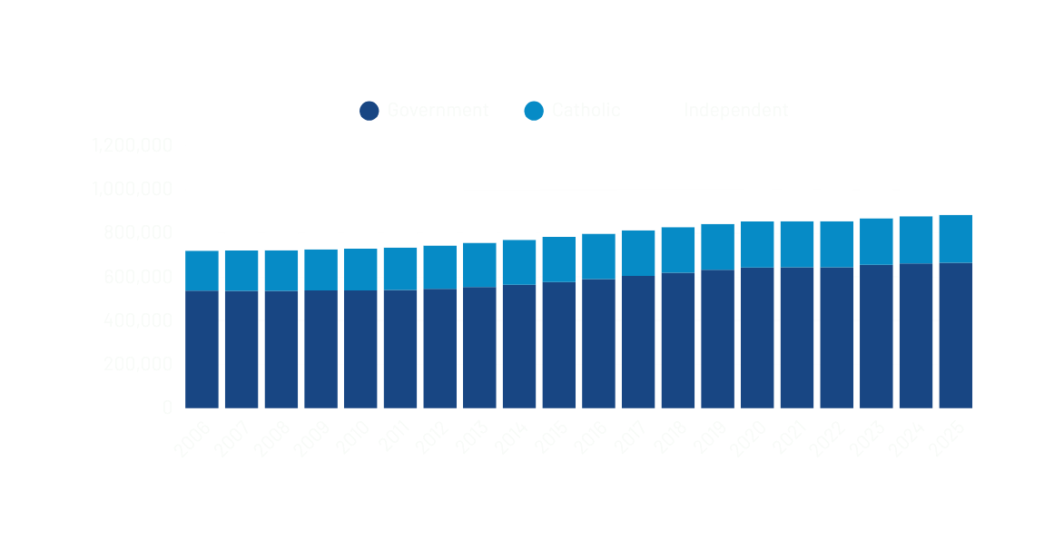
$6.6 BILLION
ECONOMIC CONTRIBUTION
In 2024, Independent schools contributed approximately $7 billion to economic activities in Victoria
16.8%
OF ENROLMENTS
In 2025, Independent school enrolments increased by 3.4%, more than both Government (0.5%) and Catholic (1.1%)
Notes:
Economic Contribution:
Victoria’s Independent schools inject $6.6 billion into the state economy each year, according to an independent impact report that we published last year.
By comparison, the economic impact of Victoria’s Independent schools is almost on par with the entire AFL industry, and the sector employs more than three times as many people as the AFL and its clubs combined. These figures underscore the scale and significance of the Independent school sector in Victoria’s economy.
Notably, there are more than 1,300 overseas students in Victorian Independent schools who contribute annually $40 million in living expenses and Visitors coming to Victoria to see their children at Independent schools generate $8.7 million in tourism spending each year
Enrolment Growth:
In 2025, Victorian Independent schools have welcomed more than 6,000 additional students.
Almost 179,000 students are now educated in Independent schools - a 3.5 per cent increase in the past 12 months - reinforcing the sector’s essential role in meeting the diverse needs of families across Victoria.

Slide 4
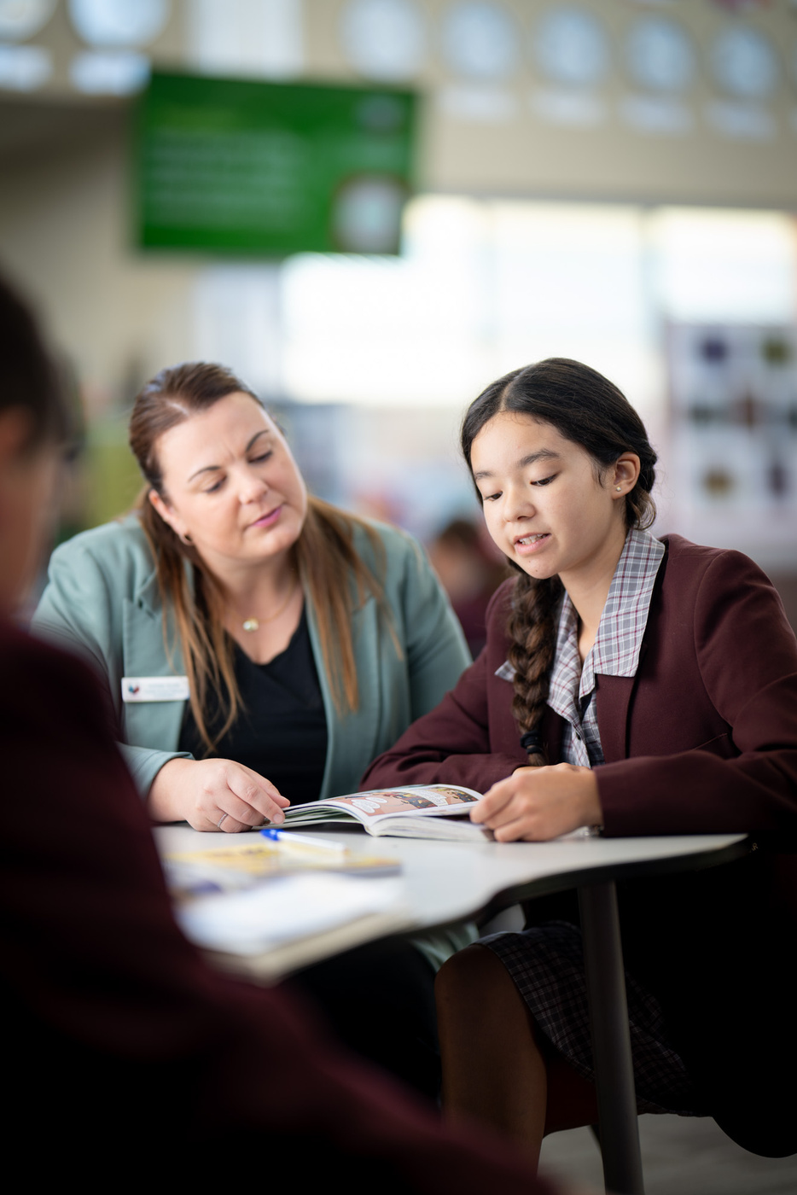
WHAT DO THE STATS SAY?
01
In 2025, 67 Victorian Independent schools hosted international students.
Overall, around 20 to 25% of Victorian Independent schools are engaged in international student programs.
02
03
Most participating schools (58) have fewer than 5% international students.
Notes:
For most Independent schools in our state, less than 5% of their total enrolments are international students and Year 7 -12 are the most popular year levels
This is a decline from 86 schools in 2018, showing that participation has not yet recovered to pre-COVID levels.
Only a small number of schools exceed 10% international students, indicating high-concentration models are uncommon.
Additional narrative:
We are working on strengthening our member schools' cultural and market literacy to equip them with the right tools and intelligence.
The school sector typically delivers high quality student pipeline to tertiary education with strong academic preparations and English proficiency.

Slide 5
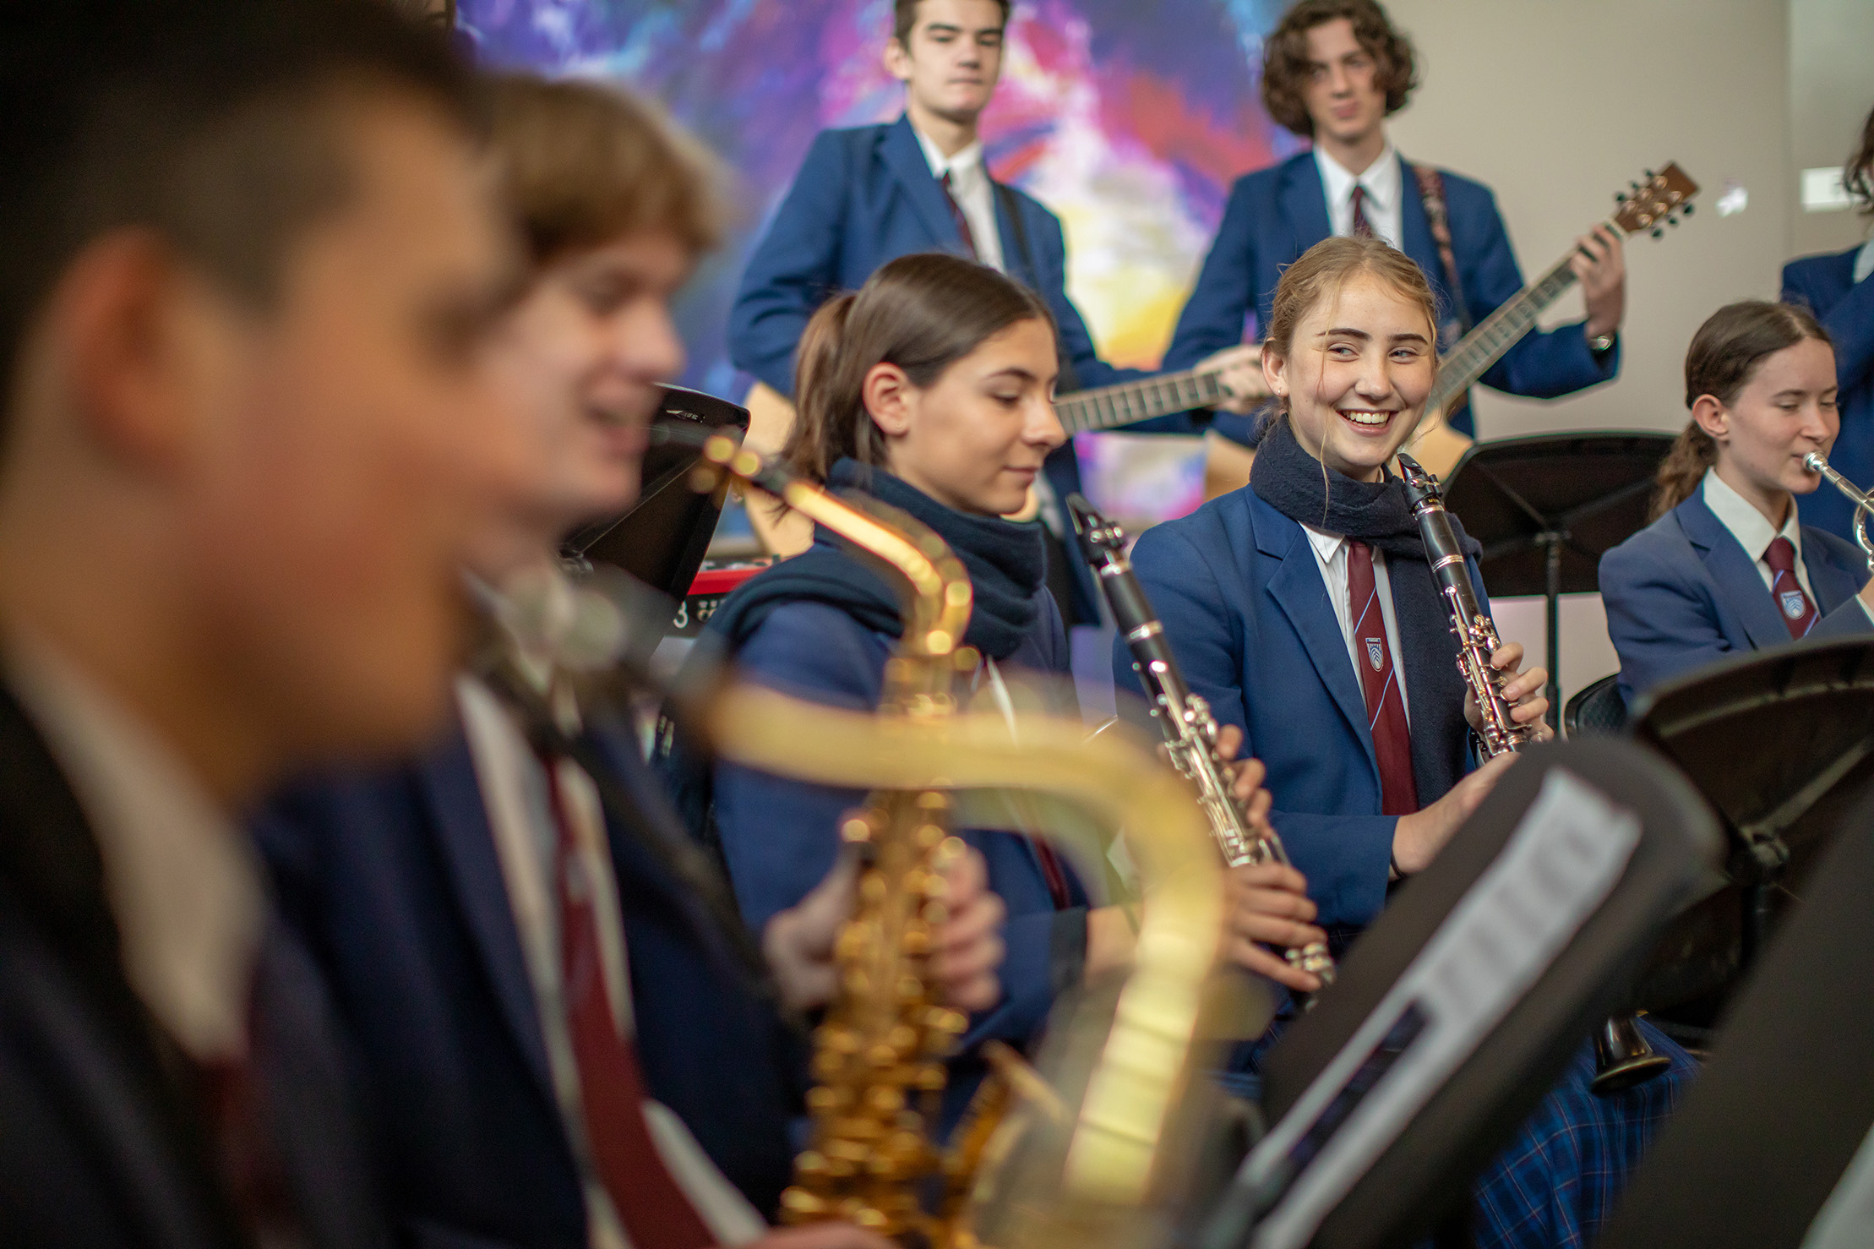
How are Independent schools distinct from Government schools?
IND: Board-governed, enabling operational flexibility.
GOV: Centralised policies and standardised fees.
Governance and
Autonomy
IND: Dedicated agents, homestay/boarding and EAL/ELICOS staff.
GOV: Generalist staff with added international duties.
Resourcing and
Student Support
IND: Premium positioning with strong pathways and boarding.
GOV: Emphasis on affordability, community-focused, geographically diverse.
Market Positioning
IND: Some have in-house CRICOS ELICOS (SSP/English Centres).
GOV: Typically do not run in‑house ELICOS.
ELICOS Model
Notes:
Governance and Autonomy
Independent schools operate under their own boards, enabling flexible fee structures, marketing, agent engagement, and program design.
Government schools operate within the Victorian Department of Education framework with centralised policies and standardised fees.
Resourcing and Student Support
Independent schools typically have dedicated international agents, homestay/boarding staff, and specialist EAL/ELICOS staff.
Government schools often rely on generalist staff with international responsibilities added to existing roles.
Market Positioning
Independent schools often position themselves as premium providers with strong academic pathways and boarding options. Independent schools tend to recover international enrolments more quickly due to stronger branding and marketing agility.
Government schools emphasise affordability, community integration, and diverse geographic locations.
ELICOS Model
Some operate in‑house CRICOS‑registered ELICOS programs, often called Secondary School Preparation (SSP) or English Language Centres. These programs allow students to complete English preparation on campus prior to moving into mainstream study, improving transition and retention.
Government Schools Typically, do not run in‑house ELICOS.
Students complete English preparation through external CRICOS‑registered ELICOS providers, coordinated by the Department of Education.

Slide 6
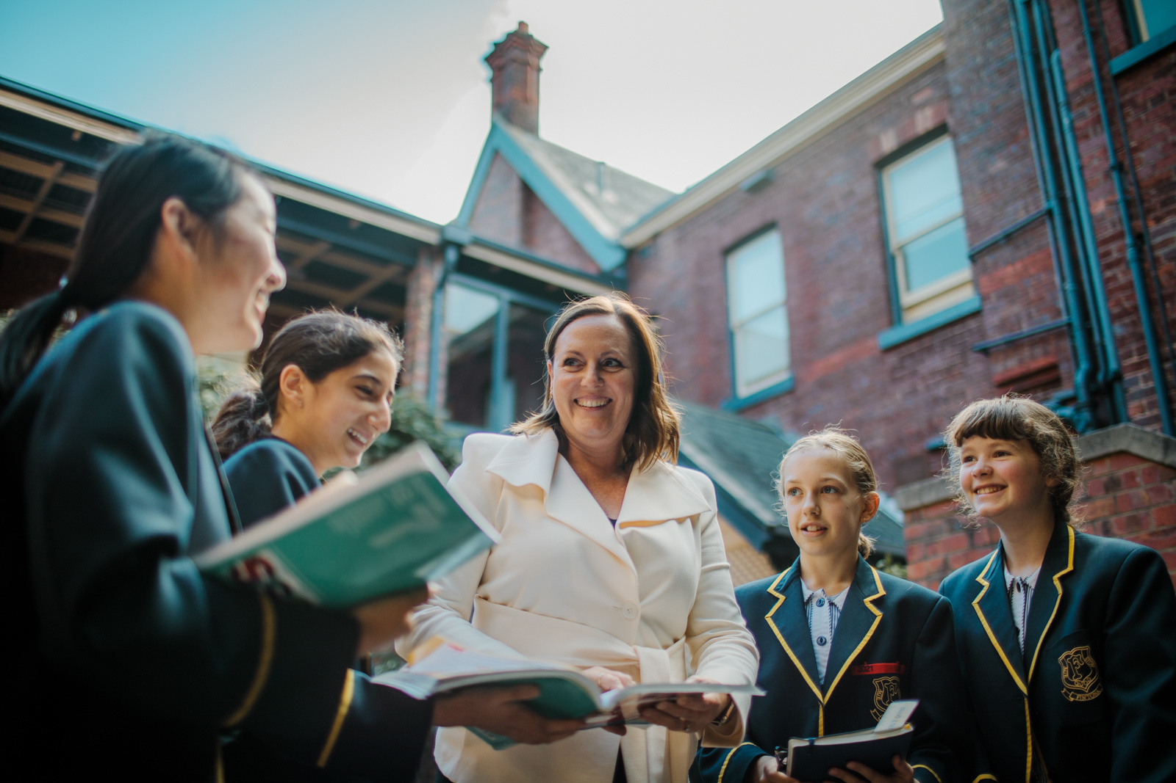
CHALLENGES
01
Many schools treat international programs as add-ons, increasing operational pressure.
02
ELICOS requires TESOL-qualified staff, curriculum development, and compliance capacity.
03
International students are younger, requiring intensive welfare and homestay oversight.
04
Homestay monitoring is resource-intensive and a major compliance risk.
05
ELICOS students are often newly arrived and need additional support.
06
Agent management and reputation risk is significant.
Notes:
Our schools experience some challenges:
Many schools treat international programs as add‑ons rather than core business which puts additional pressure on the school.
Running ELICOS requires TESOL‑qualified staff, curriculum development, and compliance capability.
International school students are younger and require intensive welfare and homestay oversight.
Homestay monitoring is resource‑intensive and a major compliance risk
ELICOS students often newly arrived and need additional support.
Agent management and reputation risk

Slide 7
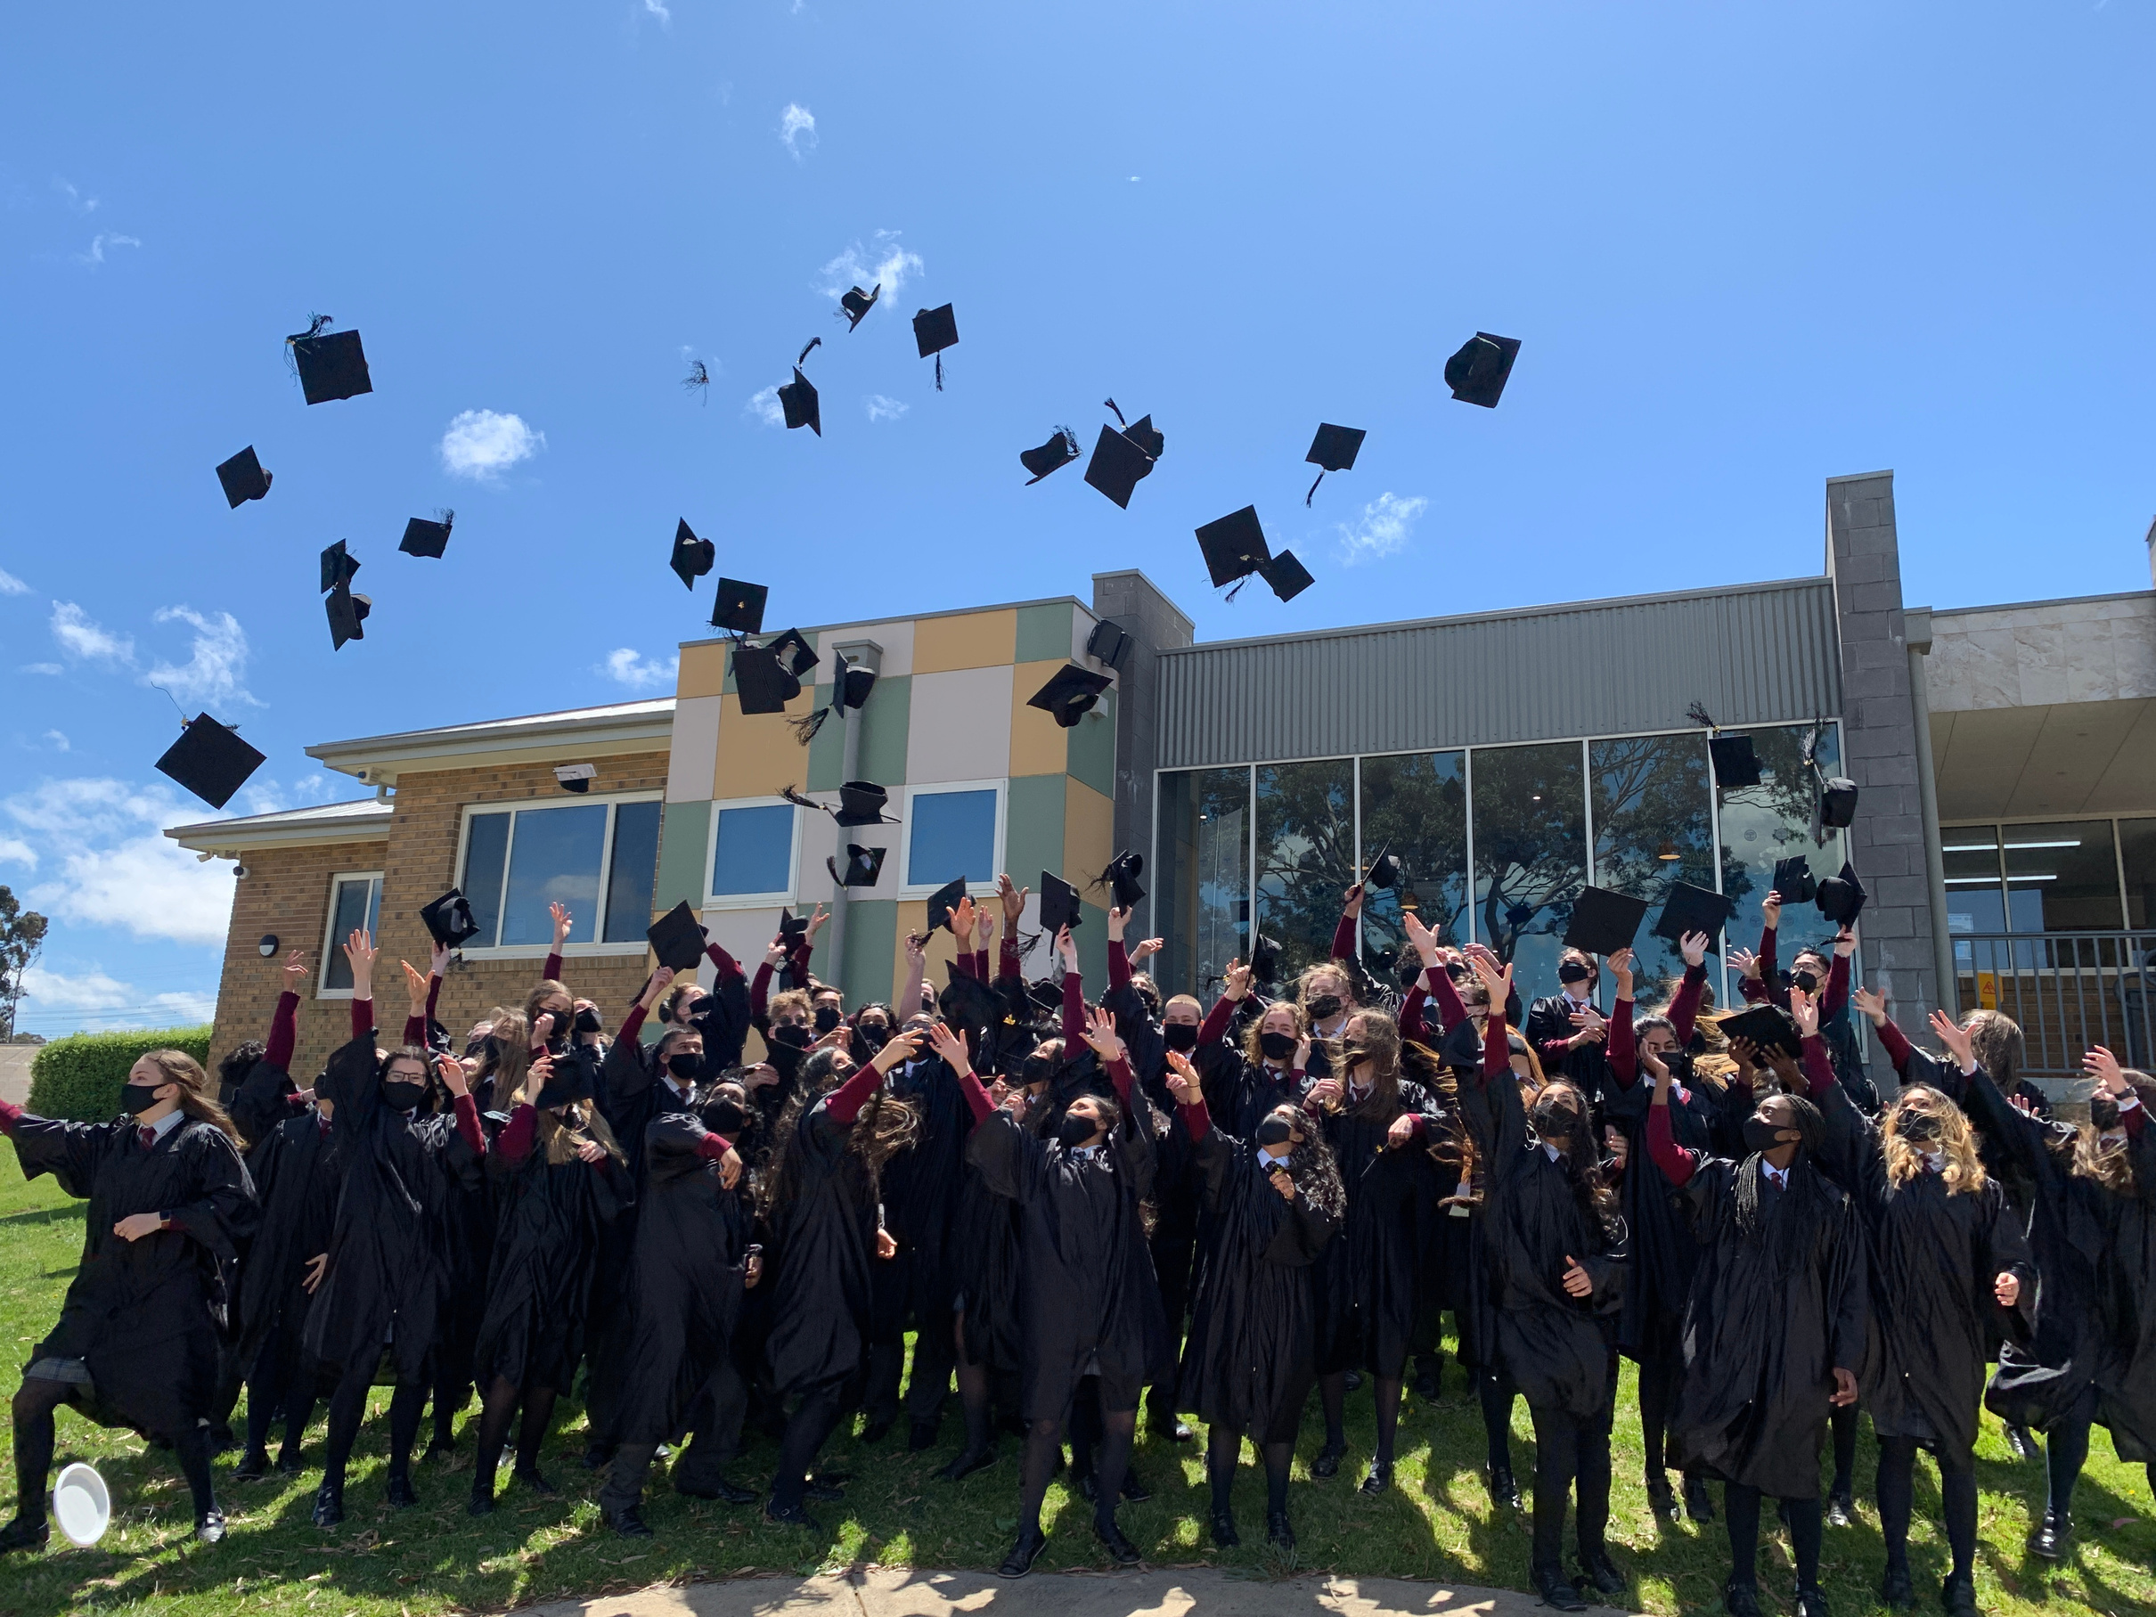
INDEPENDENT SCHOOLS AS PATHWAY PROVIDERS
University Pathways
VET Pathways
Strong ATAR/IB outcomes with university counselling
International students target Group of Eight universities
VET pathways via TAFEs/RTOs (VETiS, dual credit, diploma)
In-house ELICOS supports English and transition to VCE/IB
Strengthens university readiness and retention
Notes:
University Pathways
Strong ATAR outcomes, IB programs, and high-quality university counselling.
International students often target Group of Eight universities.
VET Pathways
Partnerships with TAFEs and private RTOs for VET in Schools, dual‑credit programs, and diploma‑to‑degree pathways.
Pathway Strength includes in‑house ELICOS support for academic English, study skills, to achieve a smooth transition into VCE/IB.
Support model improves university readiness and retention.

Slide 8














VCE OFFSHORE
01
1,500 VCE Offshore students in 2026 (+9.5% on 2025)
02
32 licensed programs in 8 countries
(e.g. China, Indonesia, Vietnam)
03
Expansion into Singapore and Papua New Guinea (2026) and Japan (2027)
Notes:
In 2025, there were 1,370 students enrolled across Year 11 and Year 12 offshore. In 2026, over 1,500 students are projected to enrol in VCE offshore, an increase on last year an of 9.5% (final numbers are confirmed in May each year).
There are five Victorian school providers (Haileybury, Firbank Grammar, Peninsula Grammar, Thomas Carr College and Caroline Chisholm Catholic College) with Salesian College Sunbury joining this group from 2027.
Salesian College Chadstone is actively seeking an offshore partner school to submit a licence application to the VCAA. Balwyn High School has expressed interest in establishing a VCE Offshore program to complement their onshore 32 licensed programs in eight countriesinternational student program.
, including established programs in China, Indonesia, Malaysia, Vietnam, Timor-Leste, and Vanuatu
New programs have commenced in Singapore and Papua New Guinea in 2026 and will in Japan from 2027.

Slide 9
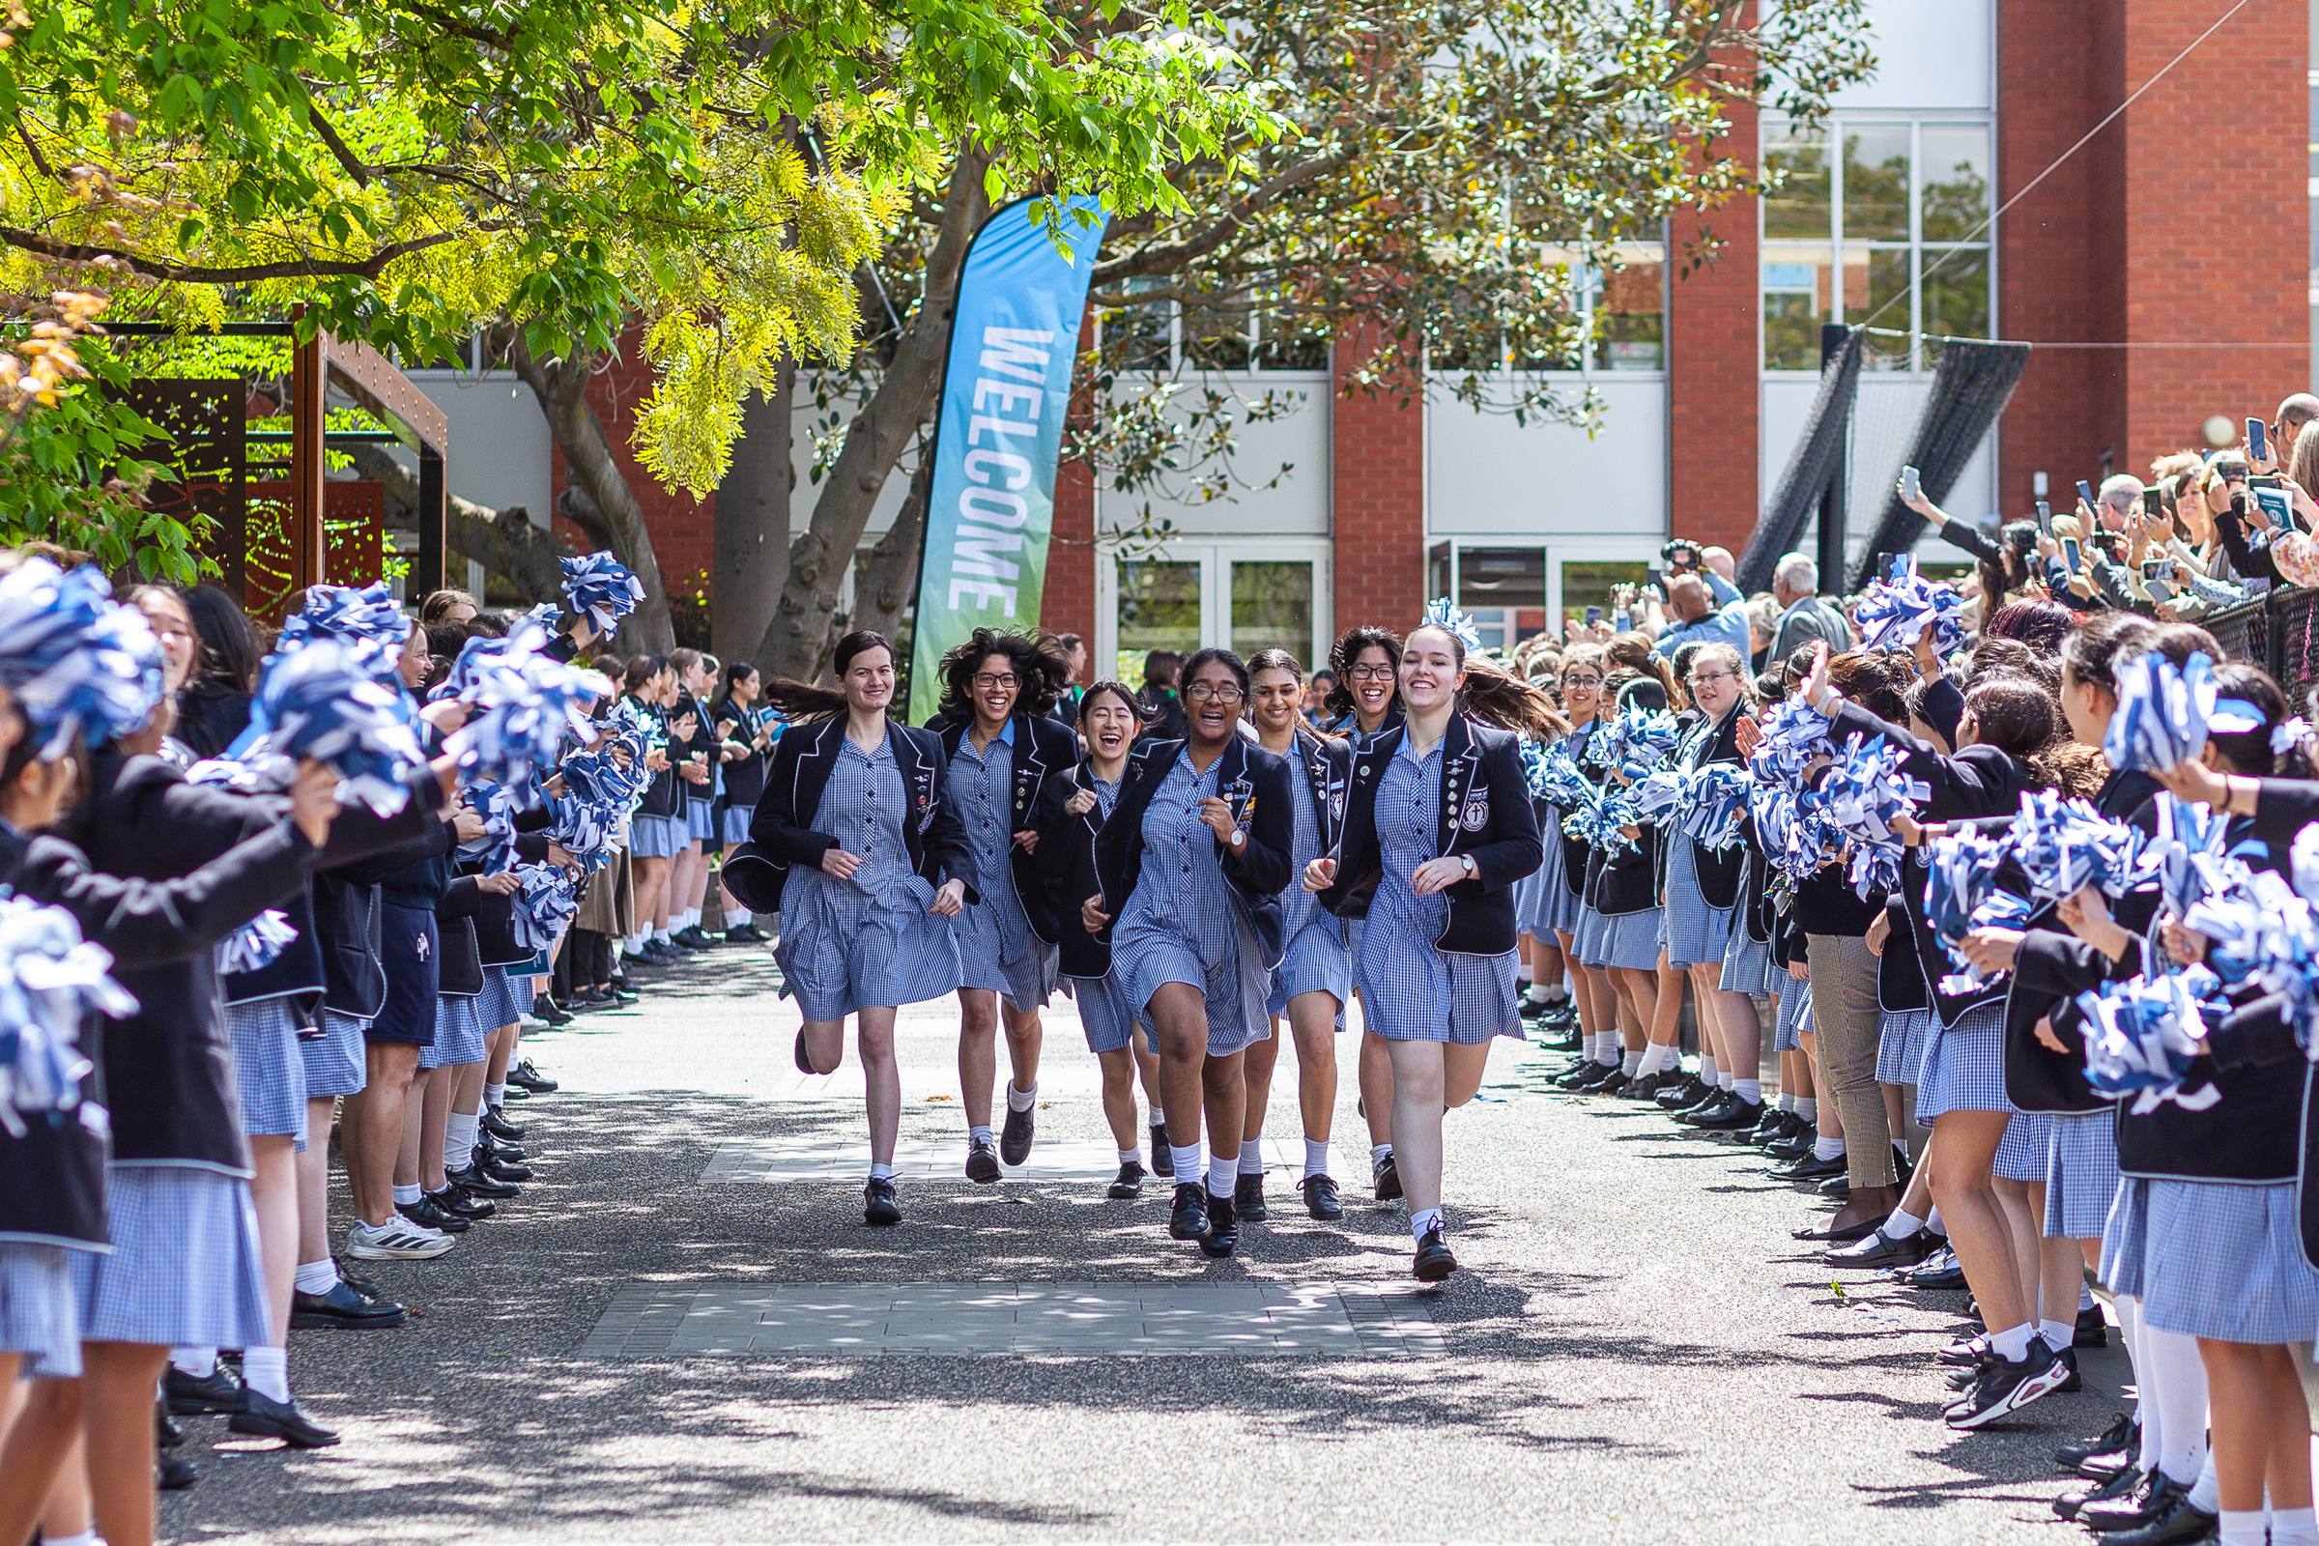
SECTOR THREATS
Tightening Policy and Regulatory Environment
Intensifying Global Competition
Structural Pressure on Western Study Destinations
High student visa fees
Increased financial scrutiny
Rising visa refusal rates
Asian destinations
Cheaper international markets
Global brand campuses
Changed market conditions
Pipelines under strain
Retention struggles
Notes:
Australia, like other key Western destinations, is facing considerably structural and market challenges.
Domestic political issues are impacting policy setting - notably high student visa fees and worsening visa grant rates.
Offshore student visa grant rate in Feb 2026 lowest month on record for the last 26 years for Higher Ed
Student Visa Finances – change in government sentiment – refusal rates increasing – more scrutiny of financial capacity
Eastward shift to Asian study destinations - especially Chinese students finding those destinations such as Hong Kong, Malaysia and Singapore just as attractive - with high ranked local universities and foreign campuses of world leading Western universities, lower fees and culturally familiar
School sector has much less resource to support its international agenda - leading to less market exposure, experience or expertise, heavy reliance on China and to a less extent, Vietnam. Virtually quite an uphill battle to diversify.

Slide 10


Thank You
is.vic.edu.au

