Slide 1
Beyond the Classroom: How Student Services Shapes International Student Success
Kashif Chauhan
ISANA National Communications Manager

Slide 2

Beyond the Classroom:
The Invisible Heart
Supporting Student Success through Lived Experience & Integrated Services

Slide 3

Meet the Speaker
Global Education Leader: Over 25 years of international experience across the UK, Europe, Middle East, North Africa, and Australia.
Student Advocate: Expertise in international student engagement, career counselling, and industry integration.
Crisis Resilience: Proven leadership through major global disruptions, including COVID-19 and the post-9/11 environment.
ISANA Expert: National Communications Manager focused on amplifying student voices and strengthening sector-wide engagement since 2020.
Multifaceted Professional: Background in public administration and AI; actively engaged in cultural industries and entrepreneurship.
Kashif Chauhan
National Communications Manager, ISANA Director, ASKAAN Consulting

Slide 4
The 2026 Landscape
A Sector at a Crossroads
Kashif Chauhan | ISANA | Save the Date: 35th ISANA Conference Melbourne 8-9 September 2026

Slide 5
A Strategic Necessity
Regulatory Shifts
Shifting frameworks and increased visa scrutiny have transitioned student services from a "peripheral function" to a mission-critical strategic necessity.
The Beyond-Housing Goal
The journey doesn't end with a bed. Our challenge is ensuring students don't just arrive, but truly belong, connect, and persist in their new environment.
Kashif Chauhan | ISANA | Save the Date: 35th ISANA Conference Melbourne 8-9 September 2026

Slide 6
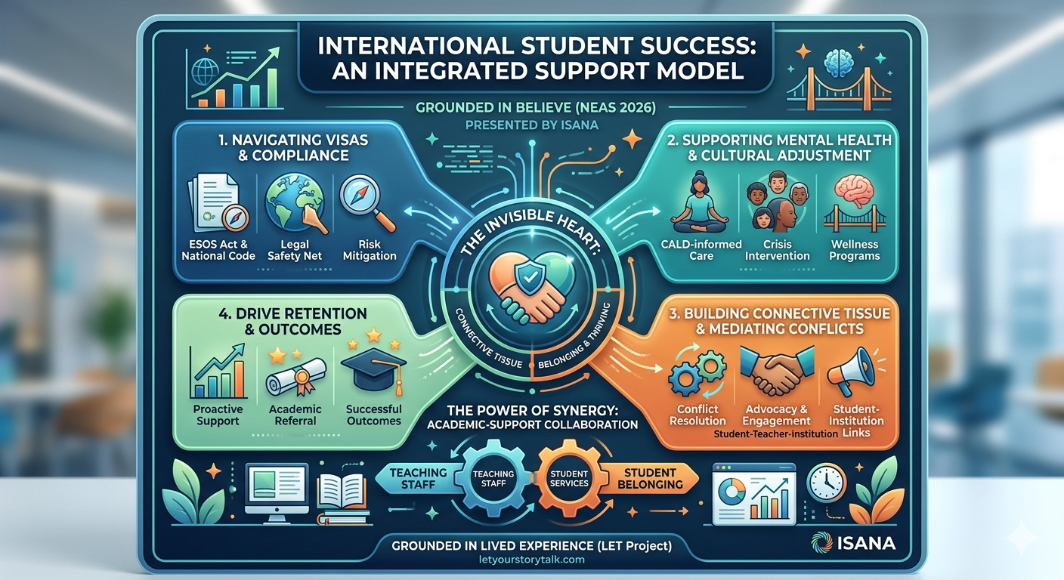
Kashif Chauhan | ISANA | Save the Date: 35th ISANA Conference Melbourne 8-9 September 2026

Slide 7
Defining Student Services:
VU Sydney
Transition: Holistic orientation programs that go beyond administration to cultural immersion.
Wellbeing: Proactive pastoral care identifies "silent signals" before they become academic crises.
Engagement: Building career readiness and campus connections through structured activities.
Kashif Chauhan | ISANA | Save the Date: 35th ISANA Conference Melbourne 8-9 September 2026

Slide 8
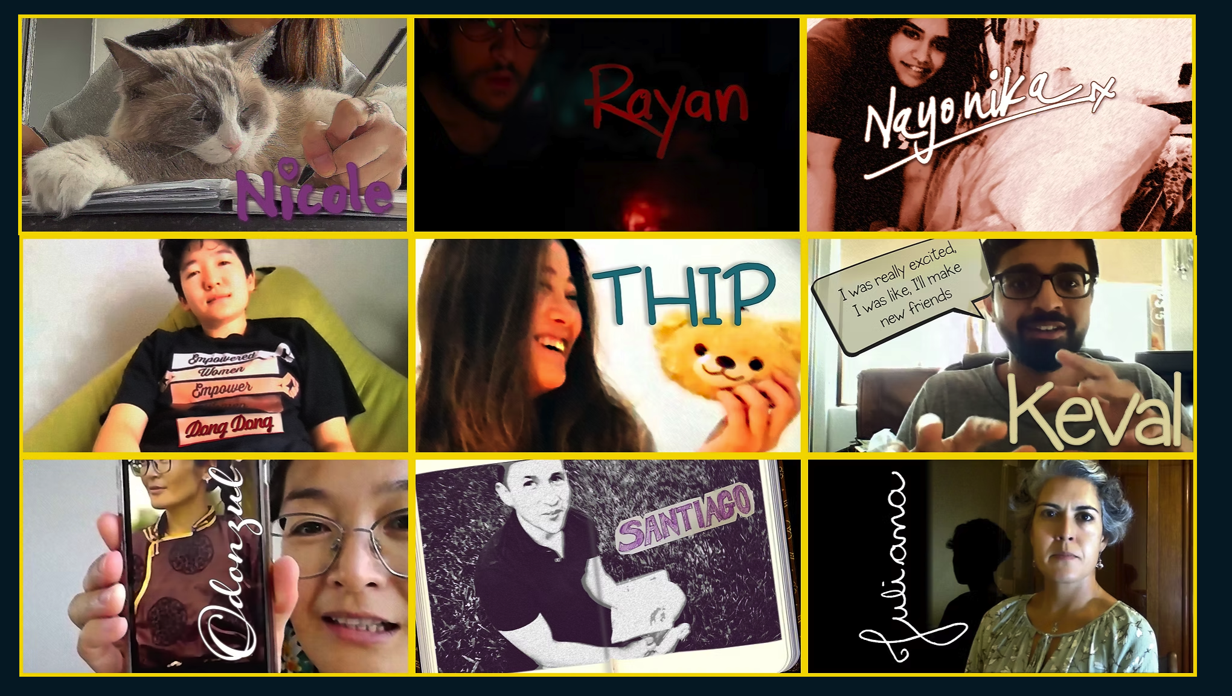
LET Your Story Talk
Lived Experience as Evidence
The ISANA Lived Experience Toolkit (LET) features nine films revealing the hidden challenges impacting international student wellbeing.
Funded by Study NSW to normalise help-seeking and destigmatise mental health support across the sector.
Kashif Chauhan | ISANA | Save the Date: 35th ISANA Conference Melbourne 8-9 September 2026

Slide 9
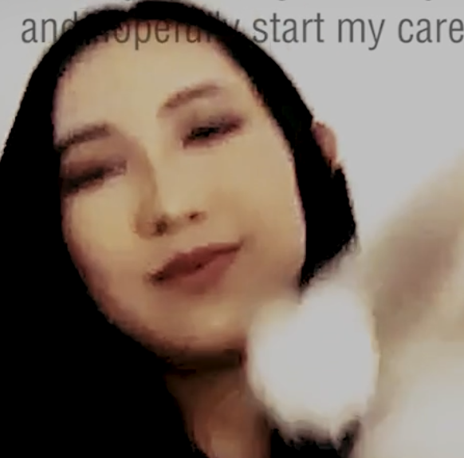
Case Study: Nicole
The Mental Health Barrier
Nicole’s journey with bipolar disorder highlights the cultural stigma surrounding help-seeking.
Student services acted as the bridge, translating clinical concepts into culturally safe support structures.
Reframing support from "therapy" to "success strategy."
https://www.letyourstorytalk.com/nicole
Kashif Chauhan | ISANA | Save the Date: 35th ISANA Conference Melbourne 8-9 September 2026

Slide 10
Case Study: Arjun
Academic Adjustment
A postgraduate student overwhelmed by the VU Block Model and late-night work shifts.
What appeared to be an "attendance issue" was actually exhaustion and visa anxiety.
Intervention: Human-centered support built his confidence to complete his first block successfully.
Kashif Chauhan | ISANA | Save the Date: 35th ISANA Conference Melbourne 8-9 September 2026

Slide 11
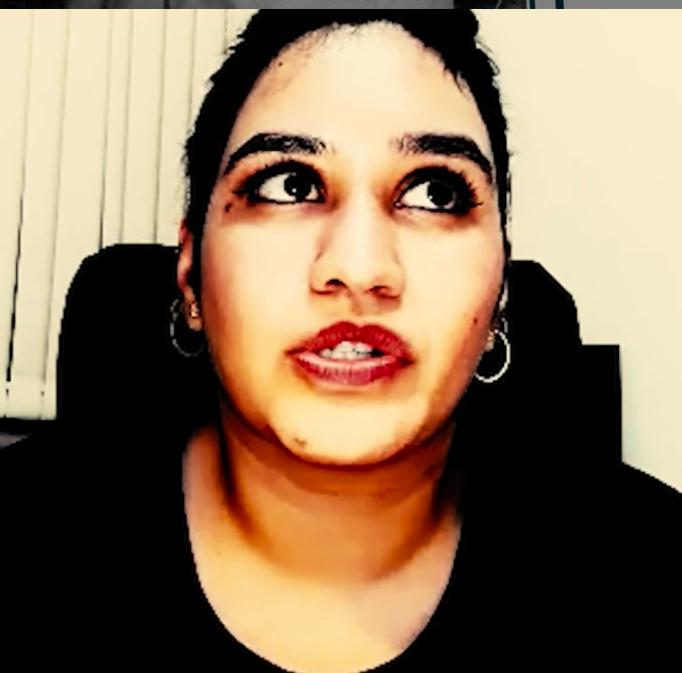
Case Study: Nayonika
TThe Struggle: Dealing with perfectionism, imposter syndrome, and high family expectations.
Internal Impact: Pressure leading to depression and unhealthy coping mechanisms (e.g., poor diet)..
The Message: Developing self-care strategies and learning to manage expectations is key to mental wellbeing.
https://www.letyourstorytalk.com/nayonika
Kashif Chauhan | ISANA | Save the Date: 35th ISANA Conference Melbourne 8-9 September 2026

Slide 12
The Retention Engine
75% Engagement Increase
Impact of Early Intervention
Proactive student services directly influence retention and outcomes. When support is integrated rather than reactive, students are significantly more likely to persist through challenges.
By identifying students at risk in Week 1, VU transforms potential withdrawals into success stories.
Kashif Chauhan | ISANA | Save the Date: 35th ISANA Conference Melbourne 8-9 September 2026

Slide 13
The Connective Tissue:
Breaking Down Silos
The Connective Tissue: Academic and support functions must work in concert. Teachers are "first responders" to student distress.
Case: Lina (Colombia): When her housing fell through, VU prioritised stability and wellbeing over immediate academics to ensure long-term retention.
The "Warm Referral" pathway ensures no student falls through the gaps.
Kashif Chauhan | ISANA | Save the Date: 35th ISANA Conference Melbourne 8-9 September 2026

Slide 14
Professionalising the Invisible
2026 Framework
Mandatory Intercultural Training: Equip all teaching staff to recognise cultural "silent signals" and stressors early.
Data-Informed Policy: Utilise "Lived Experience" data (like the LET Project) to shape institutional policy and empathy.
Integrated Support Teams: Build permanent partnerships where academic and professional staff co-design the student experience.
Warm Referrals: Transition from handing out brochures to active, human-centred case management.
The National Code & ESOS: Utilizing compliance as a tool for student protection rather than just a checklist.
Kashif Chauhan | ISANA | Save the Date: 35th ISANA Conference Melbourne 8-9 September 2026

Slide 15

Believe in Success
"Students need someone to believe in them before they believe in themselves."
www.letyourstorytalk.com | isana.org.au
Questions & Discussion
Kashif Chauhan | ISANA | Save the Date: 35th ISANA Conference Melbourne 8-9 September 2026

