Slide 1
Belief, Collaboration, and Transformation: Reimagining EAP in Transnational Education
Associate Professor Hugh Leong
Associate Executive Dean, Australia Institute of Future Education

Slide 2
AIFE Context
A TEQSA-Accredited Higher Education Provider
Australian higher education provider focused on:
  Transnational Education (TNE)
  Global academic collaboration
  Academic pathway development
  English for Academic Purposes (EAP)
Our Global Partnership Model
AIFE collaborates with universities worldwide to:
Co-develop academic programs
Deliver transnational education pathways
Support student transition into English-medium higher education
Ensure quality and consistency across multiple campuses and learning environments

Slide 3
Double Bachelors degree model
 | Year 1 | Year 2 | Year 3
 | Chinese Uni | Chinese Uni | Chinese Uni
Year 4
UWA
Year 4.5
UWA
Year 1-3 students are enrolled in CU subjects with UWA staff providing Teaching Visit collaboration with CU co-teachers
Year 4 students transfer to UWA and are formally enrolled in UWA
All students receive degrees from both UWA and CU

Slide 4
Components of Collaborative Articulation Program Partnerships
Chinese Partner Degree
ENGLISH LANGUAGE
SUBJECTS
TEACHING VISIT
SUBJECTS
JOINT DEVELOPMENT
SUBJECTS
Global Partner Degree
Global University
AIFE
Chinese University

Slide 5

Chinese Ministry of Education (MoE) objectives
True collaboration between Chinese and Global Partner universities
Professional development for Chinese staff
Internationalisation of curriculum for university and staff
Flexible international pathways for students contribute to key performance metrics for Chinese universities with strong international partnerships

Slide 6
MoE rules for Joint Education Institutes
(“Four one-thirds rule”)
1/3 of the core subjects are introduced subjects
1/3 of total subjects taught by
foreign education institute
1/3 of total teaching hours delivered by foreign education institute
1/3 of total the subjects are introduced subjects

Slide 7
Introduced Subjects Teaching Arrangements
Type of subject | Number of subjects | Teaching Staff
Teaching visit (TV) subjects | 8 | GP academic with CP co-teacher
English language subjects (AEAP) | 5 | AIFE Foreign Teachers, AIFE Chinese Teachers , AIFE Discipline staff
Joint Development (JD) subjects | 4-6 | Development collaboration between GP academic and CP co-teacher

Slide 8
Teaching visit (TV) subjects
TV subjects are a key part of the four one-thirds rule
Critical in enabling student understanding international teaching practices
Major opportunity to “showcase” the quality of the global partner
Important part of developing academic English and skills proficiency
The quality of staff engagement during TVs is critical to promoting strong transfer

Slide 9

























Our Global Partner Universities

Slide 10















Our Chinese Partner Universities

Slide 11
AIFE delivers 6 subjects of academic English, totalling 540 contact hours (hours of lessons with teachers), to students during their semesters in China. The program enhances academic skills, English proficiency, and discipline vocabulary
Aligned with AQF Levels 5–7, focusing on academic knowledge, communication, and cognitive skills.
Emphasises applied learning and real-world skills through diverse assessments.
Trains students in academic reading, critical thinking, research writing, and verbal communication.
Not an IELTS preparation course — However, AEAP also embeds Direct Entry Program (DEP) test, accepted by AIFE’s global partner universities.
What is AEAP? (AIFE English for Academic Purposes)

Slide 12
AEAP Subjects and Alignment to AQF Qualification Levels
Subject Name | AQF Level | Weeks | Study hours per week | Total study hours
Academic Language and Communication 1 (including Academic Content Workshop 1) | 5 | 15 | 10* | 150
Academic Language and Communication 2 (including Academic Content Workshop 2) | 5 | 15 | 10* | 150
Academic Language and Study Skills 1 (With DEP Test) | 6 | 15 | 6 | 90
Academic Language and Study Skills 2 | 6 | 15 | 6 | 90
Academic Culture and Research Sills 1 | 7 | 15 | 2 | 30
Academic Culture and Research Skills 2 | 7 | 15 | 2 | 30
Postgraduate Academic and Research Skills 1 | 8 | 15 |  | 150
Postgraduate Academic and Research Skills 2 | 9 | 10 |  | 100

Slide 13
Undergraduate EAP Structure
ACR2 – Evaluating research writing, analyzing academic culture & cultural differences, extended academic writing (expository writing), extended reflective writing
ACR2
ACR1 – Group discussions (Socratic seminars) on research, extended academic reading, evaluative writing, peer feedback (coaching), reflective writing
ACR1
ALS2 – Extended academic listening & notetaking, discipline-based research writing (literature review), academic poster, reflective journal, extended major vocabulary
ALS2
ALS1 - Basic research writing (research proposal, research report), notetaking skills, synthesizing sources, extended academic writing (essay writing)
ALS1
ALC2 – Foundational referencing, debating skills, oral presentation skills, argumentative essay writing,
evaluating sources, major vocabulary
ALC2
ALC1- Develop basic academic literacy, academic integrity, elementary essay writing, group speaking skills
ALC1

Slide 14
AEAP Assessment Framework
1. Academic Literacy & Language Skills
Foundational → Advanced
Integrated & expository academic writing
Reading comprehension & source synthesis
Listening & note-taking
Speaking tests and 4-skills final exams
2. Research Literacy & Academic Inquiry
Introduction → Independent research
Research summaries & skills assessments
Academic paper critiques
Research proposals
Research report portfolios
3. Academic Culture, Integrity & Reflection
Awareness → Application
Referencing & citation practices
Academic integrity & ethics
Reflective journals on learning strategies
Research credibility & scholarly communication

Slide 15
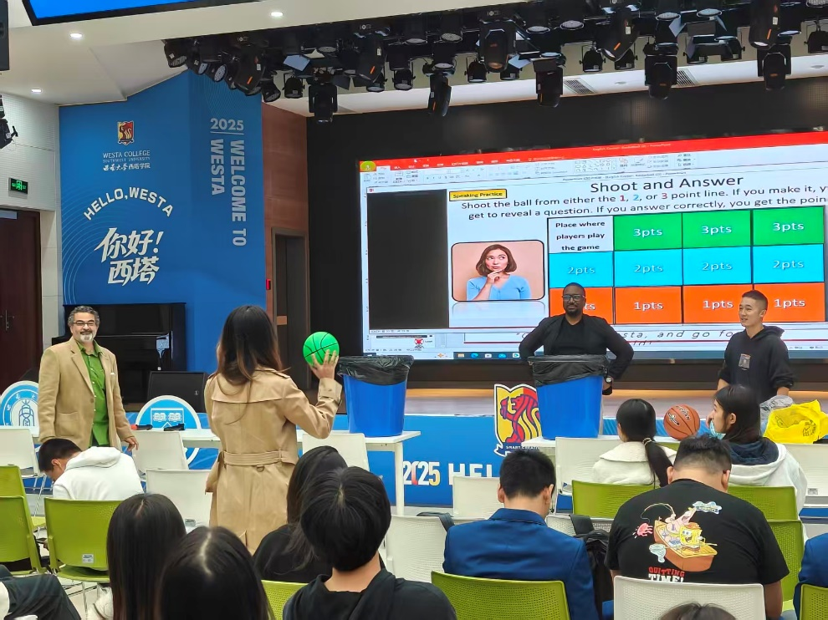
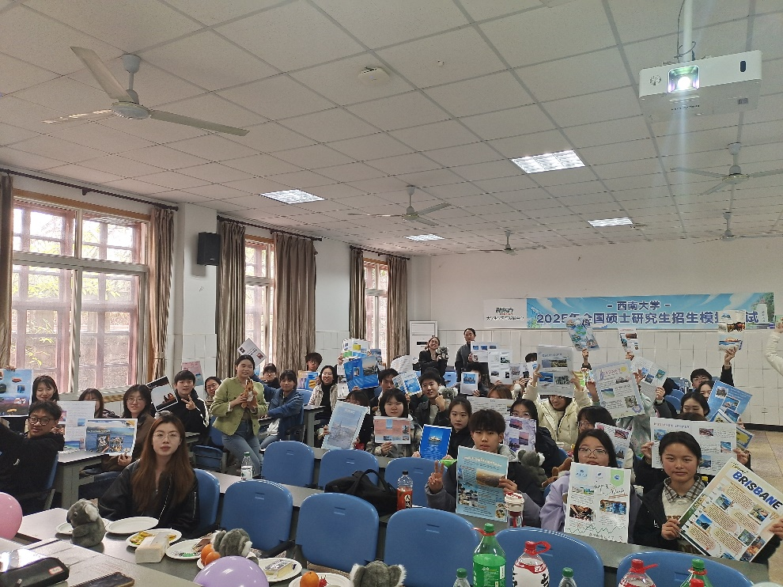
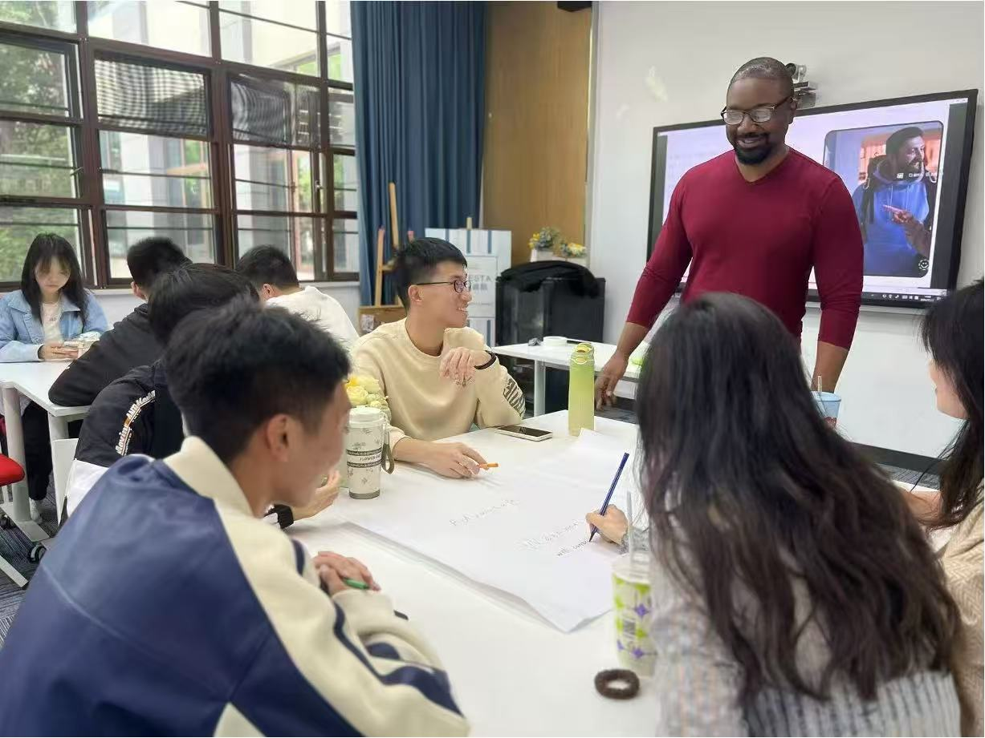
Co-Curricular English Learning
Alongside AIFE’s formal academic English learning, students also undertake a range of co-curricular English learning activities—such as English Corner activities and small-group tutorials—to provide students with cultural immersion, task-based English language use, and further speaking skills development
English Corners
Tutorials

Slide 16
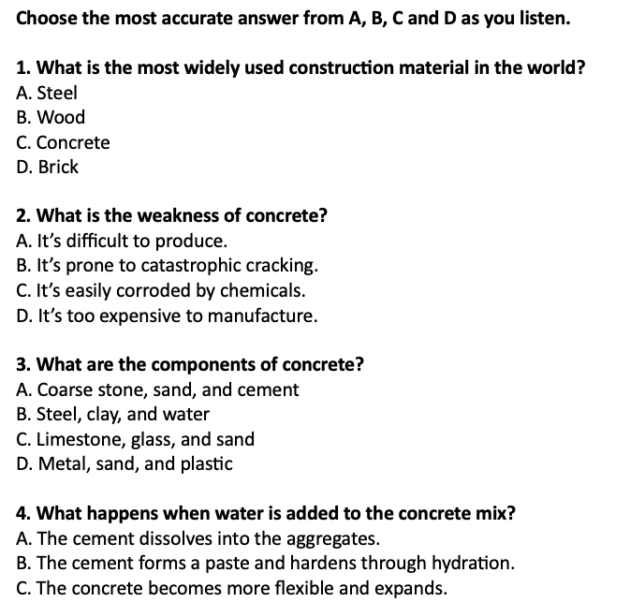
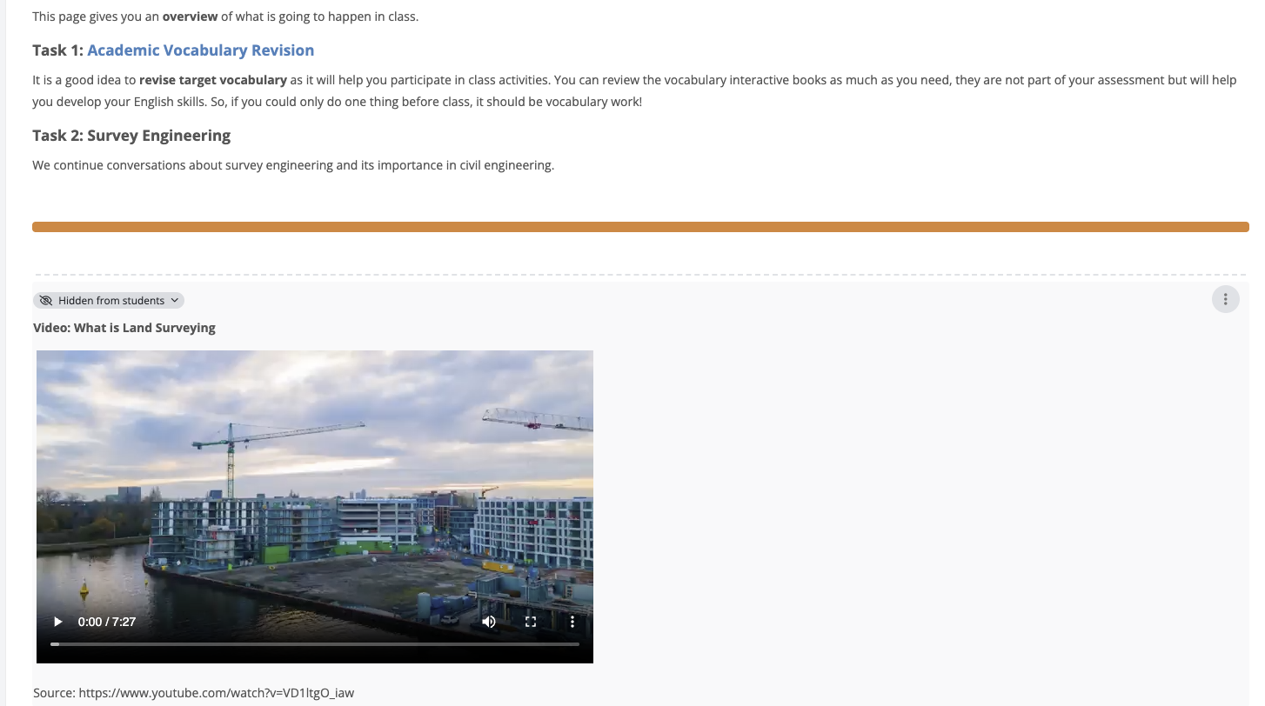
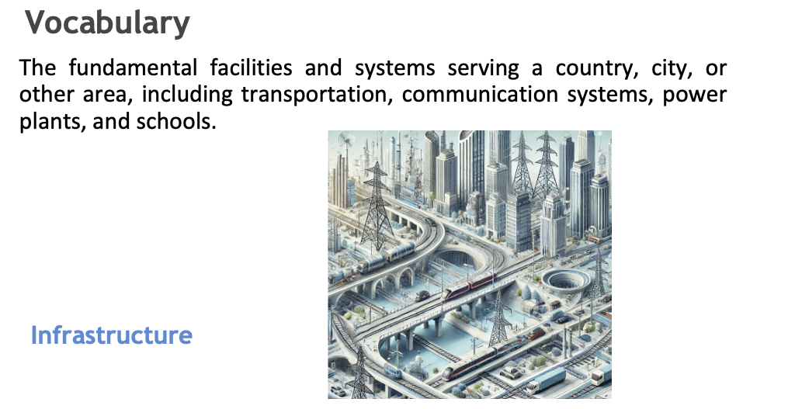
Academic Content Workshops

Slide 17
AIFE believes that successful transnational education is built through:
Collaboration
Academic integrity
Shared responsibility
Student-centred learning
Continuous reflective practice

Slide 18
Thank you!
A/Prof Hugh John Leong
Associate Executive Dean, AIFE
hughjohn.leong@aife.edu.au

