Slide 1


What really drives someone to learn English? NEAS Conference 2026 James Holden
© 2025 Duolingo, Inc. All rights Reserved
© 2026 Duolingo, Inc. All rights Reserved
Notes:
Thank you for being here. Today we’re going to explore where learners are, what they’re learning, and what that tells us about global trends in language, culture, and access.”

Slide 2

Experiment
© 2026 Duolingo, Inc. All rights Reserved
Notes:
Say:
“We’re going to do three things today…”
Pause.
“First — I want you to experience how motivation actually feels.”
“Then — we’ll unpack what’s going on underneath.”
“And finally — we’ll look at what’s changing, and what that means for us.”

Slide 3

Imagine a new language called “NEASLIAN”
High demand
Growing utility
© 2026 Duolingo, Inc. All rights Reserved

Slide 4

How motivated are you to learn NEASLIAN?
1 finger = not at all
5 fingers = very motivated
© 2026 Duolingo, Inc. All rights Reserved

Slide 5
How motivated are you if….
It takes 600 hours to achieve B2 level
© 2026 Duolingo, Inc. All rights Reserved

Slide 6
How motivated are you if….
Learning NEASLIAN will increase your salary by 50%?
© 2026 Duolingo, Inc. All rights Reserved

Slide 7
All the successful people know NEASLIAN ?
© 2026 Duolingo, Inc. All rights Reserved

Slide 8
You can use new technology instead to communicate perfectly without it?
© 2026 Duolingo, Inc. All rights Reserved

Slide 9
Someone important to you knows NEASLIAN?
© 2026 Duolingo, Inc. All rights Reserved

Slide 10
You really enjoy learning NEASLIAN?
© 2026 Duolingo, Inc. All rights Reserved

Slide 11

Reflect with a neighbour
- What changed for you across the exercise categories? Categories: Baseline motivation / Salary increase / Person you admire / Someone important / Enjoyment / You can communicate with technology
© 2026 Duolingo, Inc. All rights Reserved

Slide 12

Same person, different motivations
© 2026 Duolingo, Inc. All rights Reserved

Slide 13


My experience with student motivation
© 2026 Duolingo, Inc. All rights Reserved

Slide 14
What is motivation?
© 2026 Duolingo, Inc. All rights Reserved
Notes:
the reason why somebody does something

Slide 15
Motivation is the psychological force that explains why a person does something.
© 2026 Duolingo, Inc. All rights Reserved
Notes:
the reason why somebody does something

Slide 16
Motivation is shaped by three conditions:
Incentives x Identity x Context
© 2026 Duolingo, Inc. All rights Reserved

Slide 17
1. Incentives
What I gain
What I avoid
Examples: Salary, visa, education or career progression Driving under the speed limit to avoid a fine
© 2026 Duolingo, Inc. All rights Reserved

Slide 18
2. Identity
Who I am
Who I want to become Examples:
“I’m someone who does hard things” “I’m someone who speaks English fluently” “I want to become an Engineer for Google”
© 2026 Duolingo, Inc. All rights Reserved

Slide 19
3. Context
What the environment enables or removes
Examples: Peer behaviour, support , new technology
© 2026 Duolingo, Inc. All rights Reserved

Slide 20
Reflection What shapes motivation in your programs most? 1 – Student incentives?
2 – Student identity?
3 – Student environment?
© 2026 Duolingo, Inc. All rights Reserved

Slide 21
Reflection What shapes motivation in your learners most? 1 – Student incentives?
2 – Student identity?
3 – Student environment?
© 2026 Duolingo, Inc. All rights Reserved

Slide 22

What does motivation look like at scale?
© 2026 Duolingo, Inc. All rights Reserved

Slide 23


The world’s largest data set on language learners
800 million Learners globally
326 million English learners
1 million English tests per year
1 billion Exercises completed per day
© 2026 Duolingo, Inc. All rights Reserved

Slide 24
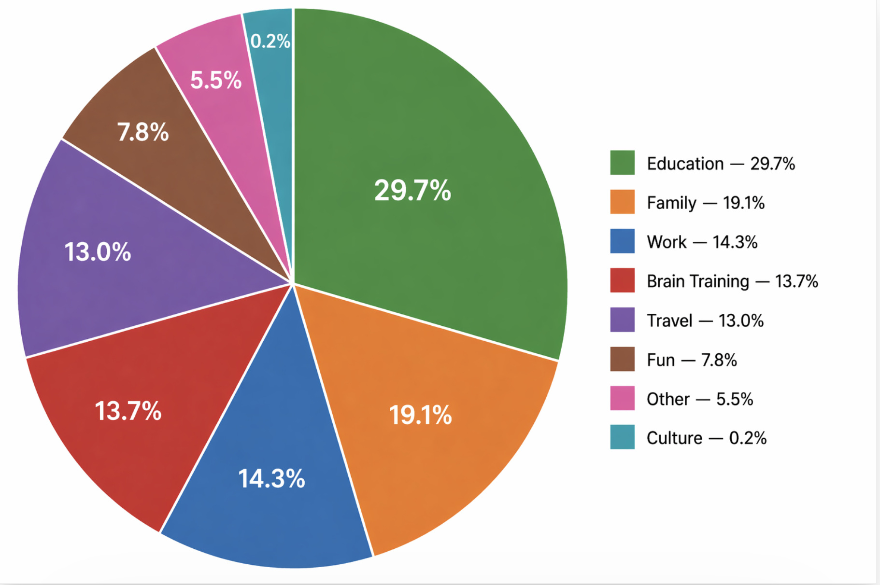
People learn English for many reasons
Duolingo users studying English – By Motivation type
100 million people
© 2026 Duolingo, Inc. All rights Reserved

Slide 25

Different motivations drive very different levels of engagement
© 2026 Duolingo, Inc. All rights Reserved

Slide 26
Learner Engagement Who spends more time learning? 1 – Those learning for education?
2 – Those learning for family?
3 – Those learning for travel?
© 2026 Duolingo, Inc. All rights Reserved

Slide 27
Travel learners spend 48% more time than Education learners
Enjoyment and personal relevance drive more sustained effort than obligation
© 2026 Duolingo, Inc. All rights Reserved

Slide 28
Education motivation is the hardest to sustain
Lowest Retention Complete less lessons Have shorter streaks
© 2026 Duolingo, Inc. All rights Reserved

Slide 29
Learner Responses
Learners studying for Education purposes: Take longer per exercise Make more errors
Learning for Education takes more effort
© 2026 Duolingo, Inc. All rights Reserved

Slide 30
Not all motivation is equally easy to stay engaged
HAVE TO MOTIVATION – ‘Effort feels heavy’ | WANT TO MOTIVATION – ‘Effort feels natural’
Driven by requirement Focused on outcomes Externally imposed | Personally meaningful Connected to identity Chosen by the learner
© 2026 Duolingo, Inc. All rights Reserved
Notes:
🧠 So your REAL definition is:
Effort = how much time and struggle it takes to complete a learning task
👉 On stage, say it like this:
“By effort, I mean how long it takes to complete a task… and how much correction or struggle is involved.”

Slide 31

Motivation → Effort
Motivation drives effort
Education typically relies on ‘have to motivation’ which takes the most effort and is hardest to stay engaged with
© 2026 Duolingo, Inc. All rights Reserved
Notes:
Our system relies on effort to drive deep learnibng
Effort builds understanding
• Effort develops capability
• Effort supports retention
Dot [7:52 PM]
7 steps · 15m 58s · Access Online · Profile
Here's a second wave of data points for your talk. Some of these are genuinely surprising — great for a 60-minute keynote. 5. English learners are NOT who you think they are 65% of English learners are over 25. Nearly a third (33%) are over 45. There are 908,000 active English learners aged 65+ . This isn't a young person's game — adults are the core of the English learning population. That's a powerful message for educators who mostly teach in classrooms of 18-year-olds.
Dot [8:08 PM]
6. The commitment is real — 6.6 million people have practiced English daily for a year+ 50% of active English learners have 100+ day streaks, and 26% have streaks over a full year . That's 6.6M people who have shown up every single day for 365+ days to practice English. These aren't casual users — they're building a daily habit.
[8:08 PM]
Chart
[8:08 PM]
Chart
[8:08 PM]
7. Motivation predicts effort, not just retention Travel-motivated learners spend 9.2 minutes/day vs 6.2 for school-motivated learners — 48% more . They also carry the longest streaks (281 days avg). The people who choose to learn English invest more than those who are told to. School-motivated learners have the shortest streaks (204 days) and lowest daily time.
[8:09 PM]
8. The geography of English learning is shifting fast South Korea's English learning DAU grew +439% in two years. China +225%. Japan +110% . Asia is where the growth is — and these markets have very different motivations (family and travel dominate over school). The demand for English is globalizing faster than ever.
[8:09 PM]
Chart
[8:09 PM]
9. Word of mouth is king, but social video is rising fast 39% of new users say they heard about Duolingo through friends or family . But YouTube (+2.5pp) and TikTok (+2.1pp) are the fastest-growing discovery channels since 2024. English learning is becoming a social/cultural phenomenon, not just an educational one. 10. How people learn is diversifying Beyond traditional lessons, 30.8M English learners engaged with stories and 28.6M with Duoradio (podcast-style listening) in just the first 2 weeks of April . People aren't just doing drills — they're consuming English through narratives and audio. That's a major shift in how people engage with language learning.

Slide 32
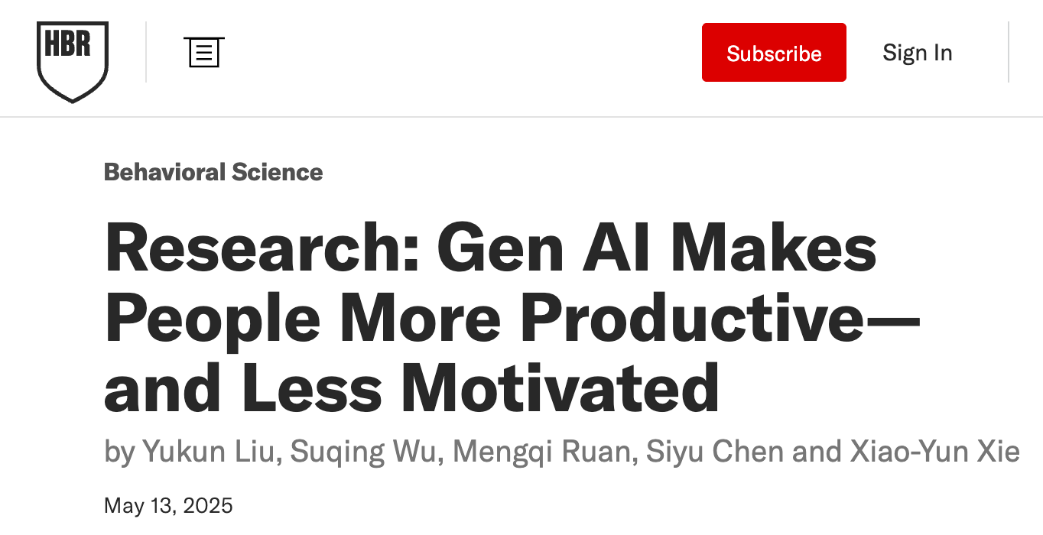
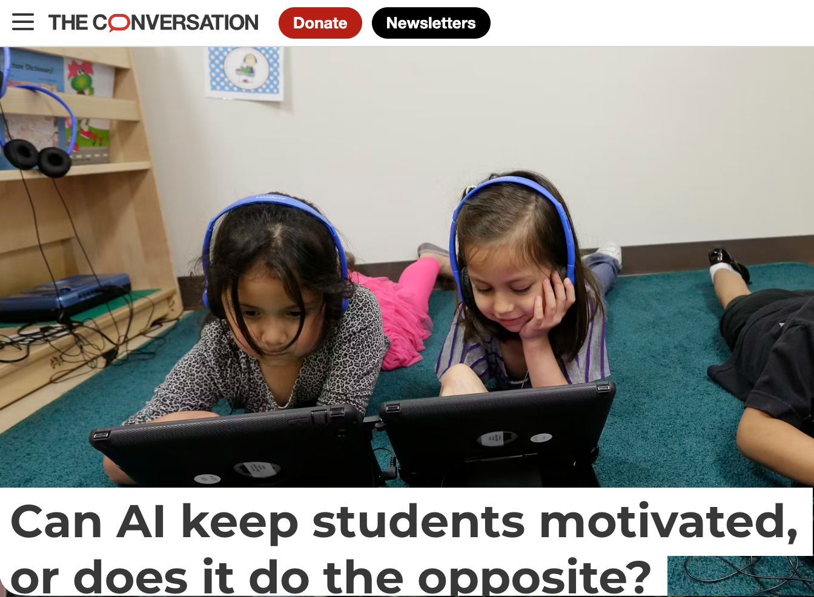


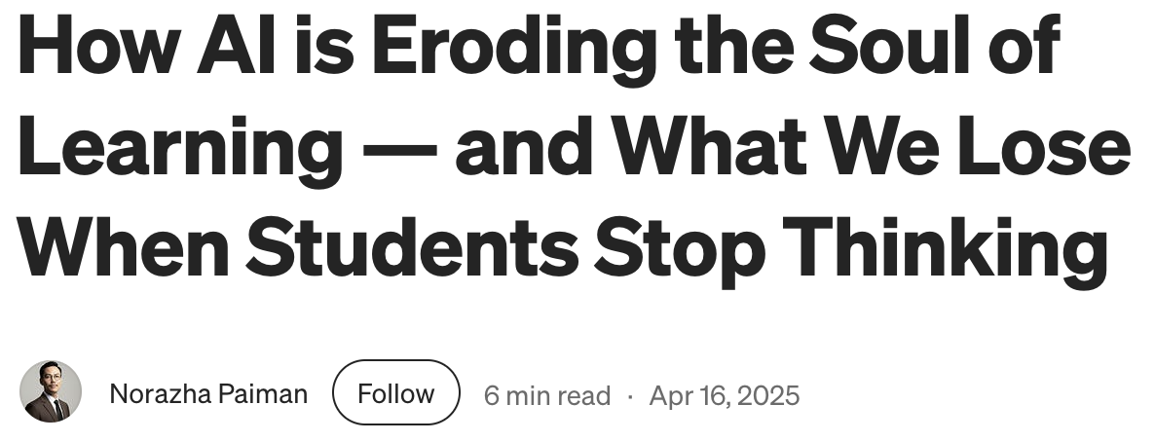

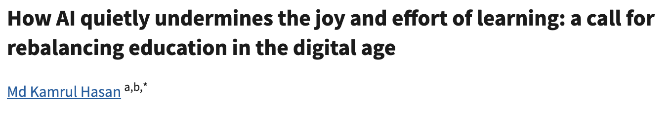
What’s changing for students?
© 2026 Duolingo, Inc. All rights Reserved

Slide 33
The environment has changed
Help is one click away
Tasks can be completed instantly
Students are supported at every step
© 2026 Duolingo, Inc. All rights Reserved
Notes:
English is the most studied language in 79% of all countries Chinese , Korean and Italian soared – Major reason to study these languages is culture 4. Motivation predicts who sticks with it Travelers retain best (22.2% at D14), followed by Work learners (20.6%). School-motivated learners are actually below average at 18.4% . The people who "need" English for school aren't as engaged as those who "want" it for travel or career goals. Intrinsic motivation matters.
[7:34 PM]
Bonus talking points for the AI angle: - Compared to other languages, English learners are uniquely driven by necessity (school 25% vs 13% for Japanese). Meanwhile, Japanese and Spanish learners are far more fun-driven (23% and 18% vs 7.5% for English) . As AI removes barriers to communication, the "…
[7:34 PM]
Chart
James Holden [7:52 PM]
@Dot these are great points. My talk is for 60 minutes, what are some other interesting data points about our learners and motivation which could have impact? Anything about how learners are changing over time?
Dot [7:52 PM]
7 steps · 15m 58s · Access Online · Profile
Here's a second wave of data points for your talk. Some of these are genuinely surprising — great for a 60-minute keynote. 5. English learners are NOT who you think they are 65% of English learners are over 25. Nearly a third (33%) are over 45. There are 908,000 active English learners aged 65+ . This isn't a young person's game — adults are the core of the English learning population. That's a powerful message for educators who mostly teach in classrooms of 18-year-olds.
Dot [8:08 PM]
6. The commitment is real — 6.6 million people have practiced English daily for a year+ 50% of active English learners have 100+ day streaks, and 26% have streaks over a full year . That's 6.6M people who have shown up every single day for 365+ days to practice English. These aren't casual users — they're building a daily habit.
[8:08 PM]
Chart
[8:08 PM]
Chart
[8:08 PM]
7. Motivation predicts effort, not just retention Travel-motivated learners spend 9.2 minutes/day vs 6.2 for school-motivated learners — 48% more . They also carry the longest streaks (281 days avg). The people who choose to learn English invest more than those who are told to. School-motivated learners have the shortest streaks (204 days) and lowest daily time.
[8:09 PM]
8. The geography of English learning is shifting fast South Korea's English learning DAU grew +439% in two years. China +225%. Japan +110% . Asia is where the growth is — and these markets have very different motivations (family and travel dominate over school). The demand for English is globalizing faster than ever.
[8:09 PM]
Chart
[8:09 PM]
9. Word of mouth is king, but social video is rising fast 39% of new users say they heard about Duolingo through friends or family . But YouTube (+2.5pp) and TikTok (+2.1pp) are the fastest-growing discovery channels since 2024. English learning is becoming a social/cultural phenomenon, not just an educational one. 10. How people learn is diversifying Beyond traditional lessons, 30.8M English learners engaged with stories and 28.6M with Duoradio (podcast-style listening) in just the first 2 weeks of April . People aren't just doing drills — they're consuming English through narratives and audio. That's a major shift in how people engage with language learning.

Slide 34

What does this look like?
Students write with AI - then refine the output
Student translate - before they think in English
Students submit work they can’t reproduce live
© 2026 Duolingo, Inc. All rights Reserved
Notes:
English is the most studied language in 79% of all countries Chinese , Korean and Italian soared – Major reason to study these languages is culture 4. Motivation predicts who sticks with it Travelers retain best (22.2% at D14), followed by Work learners (20.6%). School-motivated learners are actually below average at 18.4% . The people who "need" English for school aren't as engaged as those who "want" it for travel or career goals. Intrinsic motivation matters.
[7:34 PM]
Bonus talking points for the AI angle: - Compared to other languages, English learners are uniquely driven by necessity (school 25% vs 13% for Japanese). Meanwhile, Japanese and Spanish learners are far more fun-driven (23% and 18% vs 7.5% for English) . As AI removes barriers to communication, the "…
[7:34 PM]
Chart
James Holden [7:52 PM]
@Dot these are great points. My talk is for 60 minutes, what are some other interesting data points about our learners and motivation which could have impact? Anything about how learners are changing over time?
Dot [7:52 PM]
7 steps · 15m 58s · Access Online · Profile
Here's a second wave of data points for your talk. Some of these are genuinely surprising — great for a 60-minute keynote. 5. English learners are NOT who you think they are 65% of English learners are over 25. Nearly a third (33%) are over 45. There are 908,000 active English learners aged 65+ . This isn't a young person's game — adults are the core of the English learning population. That's a powerful message for educators who mostly teach in classrooms of 18-year-olds.
Dot [8:08 PM]
6. The commitment is real — 6.6 million people have practiced English daily for a year+ 50% of active English learners have 100+ day streaks, and 26% have streaks over a full year . That's 6.6M people who have shown up every single day for 365+ days to practice English. These aren't casual users — they're building a daily habit.
[8:08 PM]
Chart
[8:08 PM]
Chart
[8:08 PM]
7. Motivation predicts effort, not just retention Travel-motivated learners spend 9.2 minutes/day vs 6.2 for school-motivated learners — 48% more . They also carry the longest streaks (281 days avg). The people who choose to learn English invest more than those who are told to. School-motivated learners have the shortest streaks (204 days) and lowest daily time.
[8:09 PM]
8. The geography of English learning is shifting fast South Korea's English learning DAU grew +439% in two years. China +225%. Japan +110% . Asia is where the growth is — and these markets have very different motivations (family and travel dominate over school). The demand for English is globalizing faster than ever.
[8:09 PM]
Chart
[8:09 PM]
9. Word of mouth is king, but social video is rising fast 39% of new users say they heard about Duolingo through friends or family . But YouTube (+2.5pp) and TikTok (+2.1pp) are the fastest-growing discovery channels since 2024. English learning is becoming a social/cultural phenomenon, not just an educational one. 10. How people learn is diversifying Beyond traditional lessons, 30.8M English learners engaged with stories and 28.6M with Duoradio (podcast-style listening) in just the first 2 weeks of April . People aren't just doing drills — they're consuming English through narratives and audio. That's a major shift in how people engage with language learning.

Slide 35

Effort is becoming less necessary
• Tasks can be completed faster • Less struggle is needed • “Good enough” is easier to reach
© 2026 Duolingo, Inc. All rights Reserved
Notes:
English is the most studied language in 79% of all countries Chinese , Korean and Italian soared – Major reason to study these languages is culture 4. Motivation predicts who sticks with it Travelers retain best (22.2% at D14), followed by Work learners (20.6%). School-motivated learners are actually below average at 18.4% . The people who "need" English for school aren't as engaged as those who "want" it for travel or career goals. Intrinsic motivation matters.
[7:34 PM]
Bonus talking points for the AI angle: - Compared to other languages, English learners are uniquely driven by necessity (school 25% vs 13% for Japanese). Meanwhile, Japanese and Spanish learners are far more fun-driven (23% and 18% vs 7.5% for English) . As AI removes barriers to communication, the "…
[7:34 PM]
Chart
James Holden [7:52 PM]
@Dot these are great points. My talk is for 60 minutes, what are some other interesting data points about our learners and motivation which could have impact? Anything about how learners are changing over time?
Dot [7:52 PM]
7 steps · 15m 58s · Access Online · Profile
Here's a second wave of data points for your talk. Some of these are genuinely surprising — great for a 60-minute keynote. 5. English learners are NOT who you think they are 65% of English learners are over 25. Nearly a third (33%) are over 45. There are 908,000 active English learners aged 65+ . This isn't a young person's game — adults are the core of the English learning population. That's a powerful message for educators who mostly teach in classrooms of 18-year-olds.
Dot [8:08 PM]
6. The commitment is real — 6.6 million people have practiced English daily for a year+ 50% of active English learners have 100+ day streaks, and 26% have streaks over a full year . That's 6.6M people who have shown up every single day for 365+ days to practice English. These aren't casual users — they're building a daily habit.
[8:08 PM]
Chart
[8:08 PM]
Chart
[8:08 PM]
7. Motivation predicts effort, not just retention Travel-motivated learners spend 9.2 minutes/day vs 6.2 for school-motivated learners — 48% more . They also carry the longest streaks (281 days avg). The people who choose to learn English invest more than those who are told to. School-motivated learners have the shortest streaks (204 days) and lowest daily time.
[8:09 PM]
8. The geography of English learning is shifting fast South Korea's English learning DAU grew +439% in two years. China +225%. Japan +110% . Asia is where the growth is — and these markets have very different motivations (family and travel dominate over school). The demand for English is globalizing faster than ever.
[8:09 PM]
Chart
[8:09 PM]
9. Word of mouth is king, but social video is rising fast 39% of new users say they heard about Duolingo through friends or family . But YouTube (+2.5pp) and TikTok (+2.1pp) are the fastest-growing discovery channels since 2024. English learning is becoming a social/cultural phenomenon, not just an educational one. 10. How people learn is diversifying Beyond traditional lessons, 30.8M English learners engaged with stories and 28.6M with Duoradio (podcast-style listening) in just the first 2 weeks of April . People aren't just doing drills — they're consuming English through narratives and audio. That's a major shift in how people engage with language learning.

Slide 36
Strong output is now easy to produce
Writing doesn’t start from scratch
Output can be refined instantly
© 2026 Duolingo, Inc. All rights Reserved
Notes:
English is the most studied language in 79% of all countries Chinese , Korean and Italian soared – Major reason to study these languages is culture 4. Motivation predicts who sticks with it Travelers retain best (22.2% at D14), followed by Work learners (20.6%). School-motivated learners are actually below average at 18.4% . The people who "need" English for school aren't as engaged as those who "want" it for travel or career goals. Intrinsic motivation matters.
[7:34 PM]
Bonus talking points for the AI angle: - Compared to other languages, English learners are uniquely driven by necessity (school 25% vs 13% for Japanese). Meanwhile, Japanese and Spanish learners are far more fun-driven (23% and 18% vs 7.5% for English) . As AI removes barriers to communication, the "…
[7:34 PM]
Chart
James Holden [7:52 PM]
@Dot these are great points. My talk is for 60 minutes, what are some other interesting data points about our learners and motivation which could have impact? Anything about how learners are changing over time?
Dot [7:52 PM]
7 steps · 15m 58s · Access Online · Profile
Here's a second wave of data points for your talk. Some of these are genuinely surprising — great for a 60-minute keynote. 5. English learners are NOT who you think they are 65% of English learners are over 25. Nearly a third (33%) are over 45. There are 908,000 active English learners aged 65+ . This isn't a young person's game — adults are the core of the English learning population. That's a powerful message for educators who mostly teach in classrooms of 18-year-olds.
Dot [8:08 PM]
6. The commitment is real — 6.6 million people have practiced English daily for a year+ 50% of active English learners have 100+ day streaks, and 26% have streaks over a full year . That's 6.6M people who have shown up every single day for 365+ days to practice English. These aren't casual users — they're building a daily habit.
[8:08 PM]
Chart
[8:08 PM]
Chart
[8:08 PM]
7. Motivation predicts effort, not just retention Travel-motivated learners spend 9.2 minutes/day vs 6.2 for school-motivated learners — 48% more . They also carry the longest streaks (281 days avg). The people who choose to learn English invest more than those who are told to. School-motivated learners have the shortest streaks (204 days) and lowest daily time.
[8:09 PM]
8. The geography of English learning is shifting fast South Korea's English learning DAU grew +439% in two years. China +225%. Japan +110% . Asia is where the growth is — and these markets have very different motivations (family and travel dominate over school). The demand for English is globalizing faster than ever.
[8:09 PM]
Chart
[8:09 PM]
9. Word of mouth is king, but social video is rising fast 39% of new users say they heard about Duolingo through friends or family . But YouTube (+2.5pp) and TikTok (+2.1pp) are the fastest-growing discovery channels since 2024. English learning is becoming a social/cultural phenomenon, not just an educational one. 10. How people learn is diversifying Beyond traditional lessons, 30.8M English learners engaged with stories and 28.6M with Duoradio (podcast-style listening) in just the first 2 weeks of April . People aren't just doing drills — they're consuming English through narratives and audio. That's a major shift in how people engage with language learning.

Slide 37
Strong output ≠ deep understanding
© 2026 Duolingo, Inc. All rights Reserved
Notes:
English is the most studied language in 79% of all countries Chinese , Korean and Italian soared – Major reason to study these languages is culture 4. Motivation predicts who sticks with it Travelers retain best (22.2% at D14), followed by Work learners (20.6%). School-motivated learners are actually below average at 18.4% . The people who "need" English for school aren't as engaged as those who "want" it for travel or career goals. Intrinsic motivation matters.
[7:34 PM]
Bonus talking points for the AI angle: - Compared to other languages, English learners are uniquely driven by necessity (school 25% vs 13% for Japanese). Meanwhile, Japanese and Spanish learners are far more fun-driven (23% and 18% vs 7.5% for English) . As AI removes barriers to communication, the "…
[7:34 PM]
Chart
James Holden [7:52 PM]
@Dot these are great points. My talk is for 60 minutes, what are some other interesting data points about our learners and motivation which could have impact? Anything about how learners are changing over time?
Dot [7:52 PM]
7 steps · 15m 58s · Access Online · Profile
Here's a second wave of data points for your talk. Some of these are genuinely surprising — great for a 60-minute keynote. 5. English learners are NOT who you think they are 65% of English learners are over 25. Nearly a third (33%) are over 45. There are 908,000 active English learners aged 65+ . This isn't a young person's game — adults are the core of the English learning population. That's a powerful message for educators who mostly teach in classrooms of 18-year-olds.
Dot [8:08 PM]
6. The commitment is real — 6.6 million people have practiced English daily for a year+ 50% of active English learners have 100+ day streaks, and 26% have streaks over a full year . That's 6.6M people who have shown up every single day for 365+ days to practice English. These aren't casual users — they're building a daily habit.
[8:08 PM]
Chart
[8:08 PM]
Chart
[8:08 PM]
7. Motivation predicts effort, not just retention Travel-motivated learners spend 9.2 minutes/day vs 6.2 for school-motivated learners — 48% more . They also carry the longest streaks (281 days avg). The people who choose to learn English invest more than those who are told to. School-motivated learners have the shortest streaks (204 days) and lowest daily time.
[8:09 PM]
8. The geography of English learning is shifting fast South Korea's English learning DAU grew +439% in two years. China +225%. Japan +110% . Asia is where the growth is — and these markets have very different motivations (family and travel dominate over school). The demand for English is globalizing faster than ever.
[8:09 PM]
Chart
[8:09 PM]
9. Word of mouth is king, but social video is rising fast 39% of new users say they heard about Duolingo through friends or family . But YouTube (+2.5pp) and TikTok (+2.1pp) are the fastest-growing discovery channels since 2024. English learning is becoming a social/cultural phenomenon, not just an educational one. 10. How people learn is diversifying Beyond traditional lessons, 30.8M English learners engaged with stories and 28.6M with Duoradio (podcast-style listening) in just the first 2 weeks of April . People aren't just doing drills — they're consuming English through narratives and audio. That's a major shift in how people engage with language learning.

Slide 38
Low effort reduces deep learning
Less effort → less thinking → weaker retention
Learning becomes surface level
Cognitive offloading
© 2026 Duolingo, Inc. All rights Reserved
Notes:
English is the most studied language in 79% of all countries Chinese , Korean and Italian soared – Major reason to study these languages is culture 4. Motivation predicts who sticks with it Travelers retain best (22.2% at D14), followed by Work learners (20.6%). School-motivated learners are actually below average at 18.4% . The people who "need" English for school aren't as engaged as those who "want" it for travel or career goals. Intrinsic motivation matters.
[7:34 PM]
Bonus talking points for the AI angle: - Compared to other languages, English learners are uniquely driven by necessity (school 25% vs 13% for Japanese). Meanwhile, Japanese and Spanish learners are far more fun-driven (23% and 18% vs 7.5% for English) . As AI removes barriers to communication, the "…
[7:34 PM]
Chart
James Holden [7:52 PM]
@Dot these are great points. My talk is for 60 minutes, what are some other interesting data points about our learners and motivation which could have impact? Anything about how learners are changing over time?
Dot [7:52 PM]
7 steps · 15m 58s · Access Online · Profile
Here's a second wave of data points for your talk. Some of these are genuinely surprising — great for a 60-minute keynote. 5. English learners are NOT who you think they are 65% of English learners are over 25. Nearly a third (33%) are over 45. There are 908,000 active English learners aged 65+ . This isn't a young person's game — adults are the core of the English learning population. That's a powerful message for educators who mostly teach in classrooms of 18-year-olds.
Dot [8:08 PM]
6. The commitment is real — 6.6 million people have practiced English daily for a year+ 50% of active English learners have 100+ day streaks, and 26% have streaks over a full year . That's 6.6M people who have shown up every single day for 365+ days to practice English. These aren't casual users — they're building a daily habit.
[8:08 PM]
Chart
[8:08 PM]
Chart
[8:08 PM]
7. Motivation predicts effort, not just retention Travel-motivated learners spend 9.2 minutes/day vs 6.2 for school-motivated learners — 48% more . They also carry the longest streaks (281 days avg). The people who choose to learn English invest more than those who are told to. School-motivated learners have the shortest streaks (204 days) and lowest daily time.
[8:09 PM]
8. The geography of English learning is shifting fast South Korea's English learning DAU grew +439% in two years. China +225%. Japan +110% . Asia is where the growth is — and these markets have very different motivations (family and travel dominate over school). The demand for English is globalizing faster than ever.
[8:09 PM]
Chart
[8:09 PM]
9. Word of mouth is king, but social video is rising fast 39% of new users say they heard about Duolingo through friends or family . But YouTube (+2.5pp) and TikTok (+2.1pp) are the fastest-growing discovery channels since 2024. English learning is becoming a social/cultural phenomenon, not just an educational one. 10. How people learn is diversifying Beyond traditional lessons, 30.8M English learners engaged with stories and 28.6M with Duoradio (podcast-style listening) in just the first 2 weeks of April . People aren't just doing drills — they're consuming English through narratives and audio. That's a major shift in how people engage with language learning.

Slide 39
Emerging research
Students who used AI demonstrated lower retention after 45 days (57% vs 68%) compared to traditional study methods
Barcaui, A. (2025), ‘ChatGPT as a cognitive crutch: Evidence from a randomized controlled trial on knowledge retention’, Social Sciences & Humanities:
© 2026 Duolingo, Inc. All rights Reserved
Notes:
When students have unrestricted access to AI assistants, they often exhibit reduced critical thinking, decreased problem-solving effort, and potential over-reliance on automated responses (Bastani et al., 2024; Niloy et al., 2023; Cotton et al., 2023). This phenomenon aligns with established theories of cognitive offloading, the tendency to rely on external resources as a substitute for internal memory, which may fundamentally alter how students encode and retain information (Niloy et al., 2023; Cotton et al., 2023). Cognitive offloading refers to delegating mental operations (e.g., retrieval, synthesis, planning) to external tools, thereby reducing internal effort during encoding. The ease of obtaining instant, comprehensive answers from ChatGPT could be creating a generation of students who remember where to find information rather than the information itself, echoing concerns raised about the “Google effect” on memory (Sparrow et al., 2011)

Slide 40
Effort → Deep Learning
Effort drives deep learning
New learning environments reduce effort at the expense of deep learning
© 2026 Duolingo, Inc. All rights Reserved
Notes:
Our system relies on effort to drive deep learnibng
Effort builds understanding
• Effort develops capability
• Effort supports retention
Dot [7:52 PM]
7 steps · 15m 58s · Access Online · Profile
Here's a second wave of data points for your talk. Some of these are genuinely surprising — great for a 60-minute keynote. 5. English learners are NOT who you think they are 65% of English learners are over 25. Nearly a third (33%) are over 45. There are 908,000 active English learners aged 65+ . This isn't a young person's game — adults are the core of the English learning population. That's a powerful message for educators who mostly teach in classrooms of 18-year-olds.
Dot [8:08 PM]
6. The commitment is real — 6.6 million people have practiced English daily for a year+ 50% of active English learners have 100+ day streaks, and 26% have streaks over a full year . That's 6.6M people who have shown up every single day for 365+ days to practice English. These aren't casual users — they're building a daily habit.
[8:08 PM]
Chart
[8:08 PM]
Chart
[8:08 PM]
7. Motivation predicts effort, not just retention Travel-motivated learners spend 9.2 minutes/day vs 6.2 for school-motivated learners — 48% more . They also carry the longest streaks (281 days avg). The people who choose to learn English invest more than those who are told to. School-motivated learners have the shortest streaks (204 days) and lowest daily time.
[8:09 PM]
8. The geography of English learning is shifting fast South Korea's English learning DAU grew +439% in two years. China +225%. Japan +110% . Asia is where the growth is — and these markets have very different motivations (family and travel dominate over school). The demand for English is globalizing faster than ever.
[8:09 PM]
Chart
[8:09 PM]
9. Word of mouth is king, but social video is rising fast 39% of new users say they heard about Duolingo through friends or family . But YouTube (+2.5pp) and TikTok (+2.1pp) are the fastest-growing discovery channels since 2024. English learning is becoming a social/cultural phenomenon, not just an educational one. 10. How people learn is diversifying Beyond traditional lessons, 30.8M English learners engaged with stories and 28.6M with Duoradio (podcast-style listening) in just the first 2 weeks of April . People aren't just doing drills — they're consuming English through narratives and audio. That's a major shift in how people engage with language learning.

Slide 41
So what do we do?
© 2026 Duolingo, Inc. All rights Reserved

Slide 42
Reflection
Think about one assessment you use today.
Could a student complete it well using AI — without really thinking?
© 2026 Duolingo, Inc. All rights Reserved
Notes:
English is the most studied language in 79% of all countries Chinese , Korean and Italian soared – Major reason to study these languages is culture 4. Motivation predicts who sticks with it Travelers retain best (22.2% at D14), followed by Work learners (20.6%). School-motivated learners are actually below average at 18.4% . The people who "need" English for school aren't as engaged as those who "want" it for travel or career goals. Intrinsic motivation matters.
[7:34 PM]
Bonus talking points for the AI angle: - Compared to other languages, English learners are uniquely driven by necessity (school 25% vs 13% for Japanese). Meanwhile, Japanese and Spanish learners are far more fun-driven (23% and 18% vs 7.5% for English) . As AI removes barriers to communication, the "…
[7:34 PM]
Chart
James Holden [7:52 PM]
@Dot these are great points. My talk is for 60 minutes, what are some other interesting data points about our learners and motivation which could have impact? Anything about how learners are changing over time?
Dot [7:52 PM]
7 steps · 15m 58s · Access Online · Profile
Here's a second wave of data points for your talk. Some of these are genuinely surprising — great for a 60-minute keynote. 5. English learners are NOT who you think they are 65% of English learners are over 25. Nearly a third (33%) are over 45. There are 908,000 active English learners aged 65+ . This isn't a young person's game — adults are the core of the English learning population. That's a powerful message for educators who mostly teach in classrooms of 18-year-olds.
Dot [8:08 PM]
6. The commitment is real — 6.6 million people have practiced English daily for a year+ 50% of active English learners have 100+ day streaks, and 26% have streaks over a full year . That's 6.6M people who have shown up every single day for 365+ days to practice English. These aren't casual users — they're building a daily habit.
[8:08 PM]
Chart
[8:08 PM]
Chart
[8:08 PM]
7. Motivation predicts effort, not just retention Travel-motivated learners spend 9.2 minutes/day vs 6.2 for school-motivated learners — 48% more . They also carry the longest streaks (281 days avg). The people who choose to learn English invest more than those who are told to. School-motivated learners have the shortest streaks (204 days) and lowest daily time.
[8:09 PM]
8. The geography of English learning is shifting fast South Korea's English learning DAU grew +439% in two years. China +225%. Japan +110% . Asia is where the growth is — and these markets have very different motivations (family and travel dominate over school). The demand for English is globalizing faster than ever.
[8:09 PM]
Chart
[8:09 PM]
9. Word of mouth is king, but social video is rising fast 39% of new users say they heard about Duolingo through friends or family . But YouTube (+2.5pp) and TikTok (+2.1pp) are the fastest-growing discovery channels since 2024. English learning is becoming a social/cultural phenomenon, not just an educational one. 10. How people learn is diversifying Beyond traditional lessons, 30.8M English learners engaged with stories and 28.6M with Duoradio (podcast-style listening) in just the first 2 weeks of April . People aren't just doing drills — they're consuming English through narratives and audio. That's a major shift in how people engage with language learning.

Slide 43
We need to design learning where effort is necessary and visible
© 2026 Duolingo, Inc. All rights Reserved
Notes:
Learning used to require effort
Technology is removing that requirement
Our role is to redesign where effort lives

Slide 44
1. Shift from output → thinking
• Writing is no longer the challenge • Thinking is the challenge • Make thinking visible
© 2026 Duolingo, Inc. All rights Reserved

Slide 45
2. Design for visible high effort
Low-effort tasks
Generate with AI
Refine and polish.
High-effort tasks
Live discussion
Spontaneous speaking
Explaining reasoning
© 2026 Duolingo, Inc. All rights Reserved
Notes:
English is the most studied language in 79% of all countries Chinese , Korean and Italian soared – Major reason to study these languages is culture 4. Motivation predicts who sticks with it Travelers retain best (22.2% at D14), followed by Work learners (20.6%). School-motivated learners are actually below average at 18.4% . The people who "need" English for school aren't as engaged as those who "want" it for travel or career goals. Intrinsic motivation matters.
[7:34 PM]
Bonus talking points for the AI angle: - Compared to other languages, English learners are uniquely driven by necessity (school 25% vs 13% for Japanese). Meanwhile, Japanese and Spanish learners are far more fun-driven (23% and 18% vs 7.5% for English) . As AI removes barriers to communication, the "…
[7:34 PM]
Chart
James Holden [7:52 PM]
@Dot these are great points. My talk is for 60 minutes, what are some other interesting data points about our learners and motivation which could have impact? Anything about how learners are changing over time?
Dot [7:52 PM]
7 steps · 15m 58s · Access Online · Profile
Here's a second wave of data points for your talk. Some of these are genuinely surprising — great for a 60-minute keynote. 5. English learners are NOT who you think they are 65% of English learners are over 25. Nearly a third (33%) are over 45. There are 908,000 active English learners aged 65+ . This isn't a young person's game — adults are the core of the English learning population. That's a powerful message for educators who mostly teach in classrooms of 18-year-olds.
Dot [8:08 PM]
6. The commitment is real — 6.6 million people have practiced English daily for a year+ 50% of active English learners have 100+ day streaks, and 26% have streaks over a full year . That's 6.6M people who have shown up every single day for 365+ days to practice English. These aren't casual users — they're building a daily habit.
[8:08 PM]
Chart
[8:08 PM]
Chart
[8:08 PM]
7. Motivation predicts effort, not just retention Travel-motivated learners spend 9.2 minutes/day vs 6.2 for school-motivated learners — 48% more . They also carry the longest streaks (281 days avg). The people who choose to learn English invest more than those who are told to. School-motivated learners have the shortest streaks (204 days) and lowest daily time.
[8:09 PM]
8. The geography of English learning is shifting fast South Korea's English learning DAU grew +439% in two years. China +225%. Japan +110% . Asia is where the growth is — and these markets have very different motivations (family and travel dominate over school). The demand for English is globalizing faster than ever.
[8:09 PM]
Chart
[8:09 PM]
9. Word of mouth is king, but social video is rising fast 39% of new users say they heard about Duolingo through friends or family . But YouTube (+2.5pp) and TikTok (+2.1pp) are the fastest-growing discovery channels since 2024. English learning is becoming a social/cultural phenomenon, not just an educational one. 10. How people learn is diversifying Beyond traditional lessons, 30.8M English learners engaged with stories and 28.6M with Duoradio (podcast-style listening) in just the first 2 weeks of April . People aren't just doing drills — they're consuming English through narratives and audio. That's a major shift in how people engage with language learning.

Slide 46
3. Move beyond ‘have to’ motivation
• Requirements aren’t enough • Motivation needs meaning • Connect learning to identity
© 2026 Duolingo, Inc. All rights Reserved
Notes:
If students don’t want to engage with effort, they won’t sustain it.”

Slide 47
The reality
• Your students have to learn English • Institutions must assess outcomes • Requirements are not going away
We need to build “want to” alongside “have to” motivation
© 2026 Duolingo, Inc. All rights Reserved
Notes:
If students don’t want to engage with effort, they won’t sustain it.”

Slide 48
4. Assessment must change too
• If output is easy → we must assess thinking • If tools assist → we assess independence • If answers can be polished → we assess process
This is why modern assessments are moving toward real-time, adaptive, and integrated tasks
© 2026 Duolingo, Inc. All rights Reserved
Notes:
If students don’t want to engage with effort, they won’t sustain it.”

Slide 49
Motivation → Effort → Deep Learning
Motivation drives effort
Effort drives deep learning
The new environment is reducing the need for effort
We must redesign learning so effort is necessary and visible
© 2026 Duolingo, Inc. All rights Reserved
Notes:
English is the most studied language in 79% of all countries Chinese , Korean and Italian soared – Major reason to study these languages is culture 4. Motivation predicts who sticks with it Travelers retain best (22.2% at D14), followed by Work learners (20.6%). School-motivated learners are actually below average at 18.4% . The people who "need" English for school aren't as engaged as those who "want" it for travel or career goals. Intrinsic motivation matters.
[7:34 PM]
Bonus talking points for the AI angle: - Compared to other languages, English learners are uniquely driven by necessity (school 25% vs 13% for Japanese). Meanwhile, Japanese and Spanish learners are far more fun-driven (23% and 18% vs 7.5% for English) . As AI removes barriers to communication, the "…
[7:34 PM]
Chart
James Holden [7:52 PM]
@Dot these are great points. My talk is for 60 minutes, what are some other interesting data points about our learners and motivation which could have impact? Anything about how learners are changing over time?
Dot [7:52 PM]
7 steps · 15m 58s · Access Online · Profile
Here's a second wave of data points for your talk. Some of these are genuinely surprising — great for a 60-minute keynote. 5. English learners are NOT who you think they are 65% of English learners are over 25. Nearly a third (33%) are over 45. There are 908,000 active English learners aged 65+ . This isn't a young person's game — adults are the core of the English learning population. That's a powerful message for educators who mostly teach in classrooms of 18-year-olds.
Dot [8:08 PM]
6. The commitment is real — 6.6 million people have practiced English daily for a year+ 50% of active English learners have 100+ day streaks, and 26% have streaks over a full year . That's 6.6M people who have shown up every single day for 365+ days to practice English. These aren't casual users — they're building a daily habit.
[8:08 PM]
Chart
[8:08 PM]
Chart
[8:08 PM]
7. Motivation predicts effort, not just retention Travel-motivated learners spend 9.2 minutes/day vs 6.2 for school-motivated learners — 48% more . They also carry the longest streaks (281 days avg). The people who choose to learn English invest more than those who are told to. School-motivated learners have the shortest streaks (204 days) and lowest daily time.
[8:09 PM]
8. The geography of English learning is shifting fast South Korea's English learning DAU grew +439% in two years. China +225%. Japan +110% . Asia is where the growth is — and these markets have very different motivations (family and travel dominate over school). The demand for English is globalizing faster than ever.
[8:09 PM]
Chart
[8:09 PM]
9. Word of mouth is king, but social video is rising fast 39% of new users say they heard about Duolingo through friends or family . But YouTube (+2.5pp) and TikTok (+2.1pp) are the fastest-growing discovery channels since 2024. English learning is becoming a social/cultural phenomenon, not just an educational one. 10. How people learn is diversifying Beyond traditional lessons, 30.8M English learners engaged with stories and 28.6M with Duoradio (podcast-style listening) in just the first 2 weeks of April . People aren't just doing drills — they're consuming English through narratives and audio. That's a major shift in how people engage with language learning.

Slide 50

We must teach in a way that taps into ‘want to motivation’ and where effort is necessary and visible.
© 2026 Duolingo, Inc. All rights Reserved
Notes:
English is the most studied language in 79% of all countries Chinese , Korean and Italian soared – Major reason to study these languages is culture 4. Motivation predicts who sticks with it Travelers retain best (22.2% at D14), followed by Work learners (20.6%). School-motivated learners are actually below average at 18.4% . The people who "need" English for school aren't as engaged as those who "want" it for travel or career goals. Intrinsic motivation matters.
[7:34 PM]
Bonus talking points for the AI angle: - Compared to other languages, English learners are uniquely driven by necessity (school 25% vs 13% for Japanese). Meanwhile, Japanese and Spanish learners are far more fun-driven (23% and 18% vs 7.5% for English) . As AI removes barriers to communication, the "…
[7:34 PM]
Chart
James Holden [7:52 PM]
@Dot these are great points. My talk is for 60 minutes, what are some other interesting data points about our learners and motivation which could have impact? Anything about how learners are changing over time?
Dot [7:52 PM]
7 steps · 15m 58s · Access Online · Profile
Here's a second wave of data points for your talk. Some of these are genuinely surprising — great for a 60-minute keynote. 5. English learners are NOT who you think they are 65% of English learners are over 25. Nearly a third (33%) are over 45. There are 908,000 active English learners aged 65+ . This isn't a young person's game — adults are the core of the English learning population. That's a powerful message for educators who mostly teach in classrooms of 18-year-olds.
Dot [8:08 PM]
6. The commitment is real — 6.6 million people have practiced English daily for a year+ 50% of active English learners have 100+ day streaks, and 26% have streaks over a full year . That's 6.6M people who have shown up every single day for 365+ days to practice English. These aren't casual users — they're building a daily habit.
[8:08 PM]
Chart
[8:08 PM]
Chart
[8:08 PM]
7. Motivation predicts effort, not just retention Travel-motivated learners spend 9.2 minutes/day vs 6.2 for school-motivated learners — 48% more . They also carry the longest streaks (281 days avg). The people who choose to learn English invest more than those who are told to. School-motivated learners have the shortest streaks (204 days) and lowest daily time.
[8:09 PM]
8. The geography of English learning is shifting fast South Korea's English learning DAU grew +439% in two years. China +225%. Japan +110% . Asia is where the growth is — and these markets have very different motivations (family and travel dominate over school). The demand for English is globalizing faster than ever.
[8:09 PM]
Chart
[8:09 PM]
9. Word of mouth is king, but social video is rising fast 39% of new users say they heard about Duolingo through friends or family . But YouTube (+2.5pp) and TikTok (+2.1pp) are the fastest-growing discovery channels since 2024. English learning is becoming a social/cultural phenomenon, not just an educational one. 10. How people learn is diversifying Beyond traditional lessons, 30.8M English learners engaged with stories and 28.6M with Duoradio (podcast-style listening) in just the first 2 weeks of April . People aren't just doing drills — they're consuming English through narratives and audio. That's a major shift in how people engage with language learning.

Slide 51
If students don’t need to think
They won’t learn to think.
© 2026 Duolingo, Inc. All rights Reserved
Notes:
English is the most studied language in 79% of all countries Chinese , Korean and Italian soared – Major reason to study these languages is culture 4. Motivation predicts who sticks with it Travelers retain best (22.2% at D14), followed by Work learners (20.6%). School-motivated learners are actually below average at 18.4% . The people who "need" English for school aren't as engaged as those who "want" it for travel or career goals. Intrinsic motivation matters.
[7:34 PM]
Bonus talking points for the AI angle: - Compared to other languages, English learners are uniquely driven by necessity (school 25% vs 13% for Japanese). Meanwhile, Japanese and Spanish learners are far more fun-driven (23% and 18% vs 7.5% for English) . As AI removes barriers to communication, the "…
[7:34 PM]
Chart
James Holden [7:52 PM]
@Dot these are great points. My talk is for 60 minutes, what are some other interesting data points about our learners and motivation which could have impact? Anything about how learners are changing over time?
Dot [7:52 PM]
7 steps · 15m 58s · Access Online · Profile
Here's a second wave of data points for your talk. Some of these are genuinely surprising — great for a 60-minute keynote. 5. English learners are NOT who you think they are 65% of English learners are over 25. Nearly a third (33%) are over 45. There are 908,000 active English learners aged 65+ . This isn't a young person's game — adults are the core of the English learning population. That's a powerful message for educators who mostly teach in classrooms of 18-year-olds.
Dot [8:08 PM]
6. The commitment is real — 6.6 million people have practiced English daily for a year+ 50% of active English learners have 100+ day streaks, and 26% have streaks over a full year . That's 6.6M people who have shown up every single day for 365+ days to practice English. These aren't casual users — they're building a daily habit.
[8:08 PM]
Chart
[8:08 PM]
Chart
[8:08 PM]
7. Motivation predicts effort, not just retention Travel-motivated learners spend 9.2 minutes/day vs 6.2 for school-motivated learners — 48% more . They also carry the longest streaks (281 days avg). The people who choose to learn English invest more than those who are told to. School-motivated learners have the shortest streaks (204 days) and lowest daily time.
[8:09 PM]
8. The geography of English learning is shifting fast South Korea's English learning DAU grew +439% in two years. China +225%. Japan +110% . Asia is where the growth is — and these markets have very different motivations (family and travel dominate over school). The demand for English is globalizing faster than ever.
[8:09 PM]
Chart
[8:09 PM]
9. Word of mouth is king, but social video is rising fast 39% of new users say they heard about Duolingo through friends or family . But YouTube (+2.5pp) and TikTok (+2.1pp) are the fastest-growing discovery channels since 2024. English learning is becoming a social/cultural phenomenon, not just an educational one. 10. How people learn is diversifying Beyond traditional lessons, 30.8M English learners engaged with stories and 28.6M with Duoradio (podcast-style listening) in just the first 2 weeks of April . People aren't just doing drills — they're consuming English through narratives and audio. That's a major shift in how people engage with language learning.

