Slide 1
Oracy: Shining a Light on Meaningful Communication Speaker: Jo Cummins Freelance ELT Writer jo_cumminsELT@outlook.com

Slide 2
What makes a successful speaking activity?

Slide 3
What is Oracy?
‘the ability to use the oral skills of speaking and listening’
Andrew Wilkinson, 1960
‘the skills involved in using spoken language to communicate effectively’
- Cambridge International Education brief, 2022

Slide 4
Wait, don’t we already do this in ELT?!
Yes, we do!
‘Thought undergoes many changes as it turns into speech’ – Vygotsky (1934)
Communicative Language Teaching – 1960s
Task-based learning – 1970s
Project and problem-based learning

Slide 5
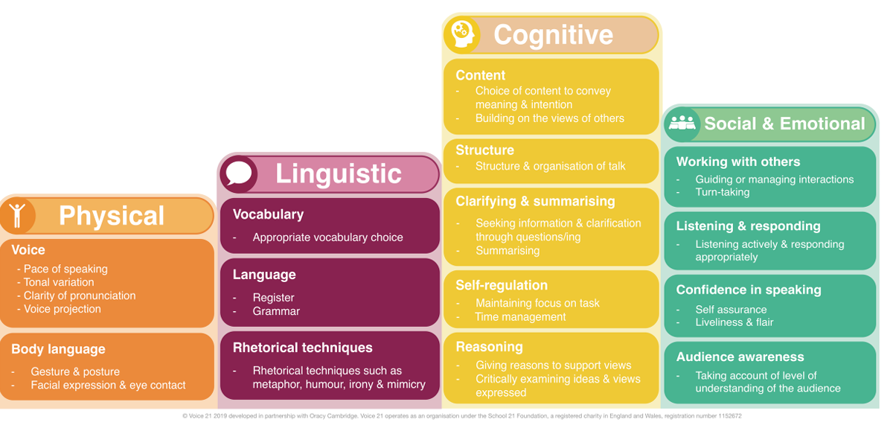
The Cambridge Oracy Skills Framework

Slide 6
When will our students use Oracy?
Exams
Seminars
Presentations
Social media (e.g. videos)
In their work
Vivas
Group work
Job interviews
Travel

Slide 7
Oracy in a digital world
Increasing use of AI = Increasing use of oral assessments?
Children increasingly online = more need for explicit teaching of communication skills?
Online learning = Guidelines and rules for communication more relevant?

Slide 8
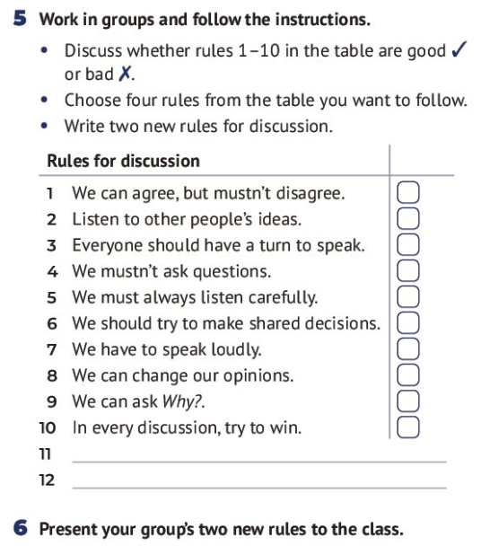
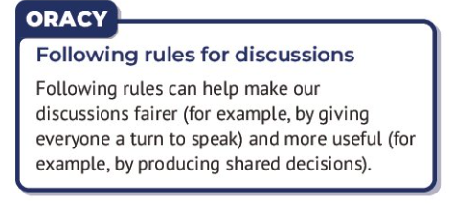
Starting out with Oracy
Shining Lights, Student’s Book 1 A2, CUP&A,
Cummins & Sage 2026

Slide 9
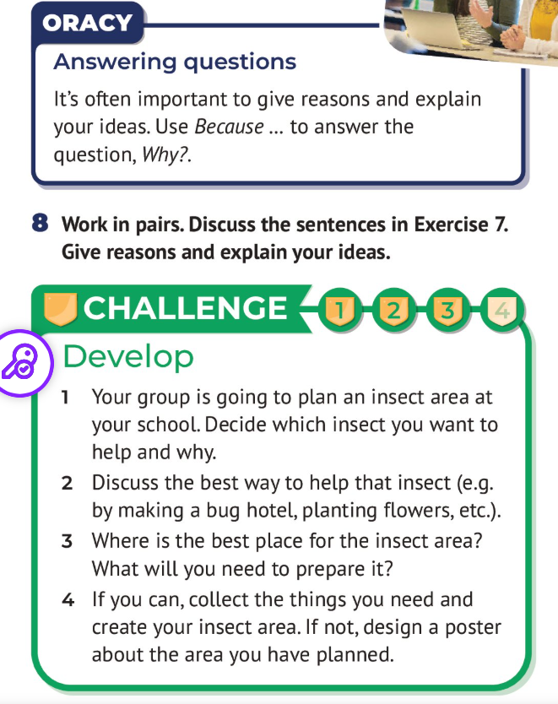
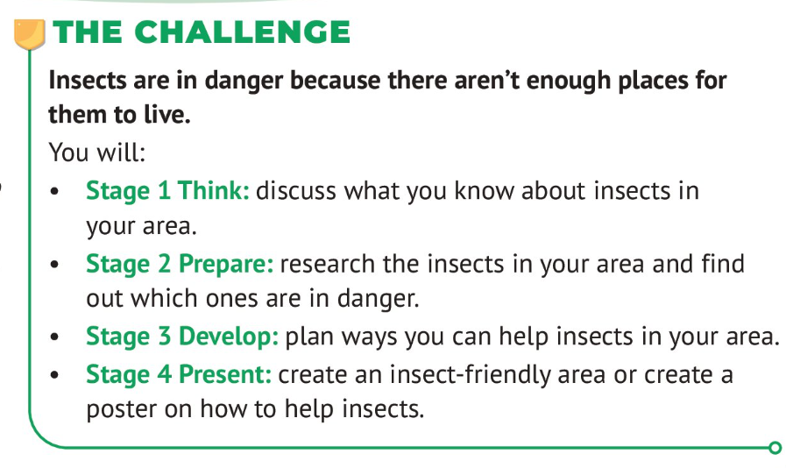
Problem-based learning
Shining Lights, Student’s Book1 A2, CUP&A,
Cummins & Sage 2026
Shining Lights, Student’s Book 1 A2, CUP&A, Cummins & Sage 2026

Slide 10
Glossophobia
Affects up to 75% of the world’s population
More common in younger people
More common in female than males
80% of students are estimated to suffer from it
Can generally be solved through therapy, practice and preparation
(Healthcentral.com)

Slide 11
What makes a great student presentation? And how can a teacher help students to achieve this?

Slide 12
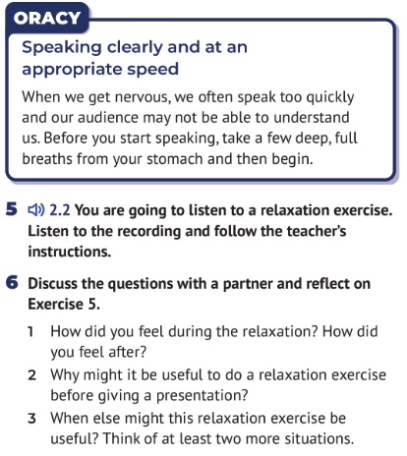
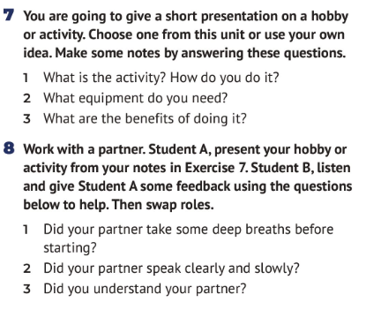
The Rehearsal
Shining Lights, Student’s Book 3 B1+, CUP&A,
Heyderman & Humphries 2026

Slide 13
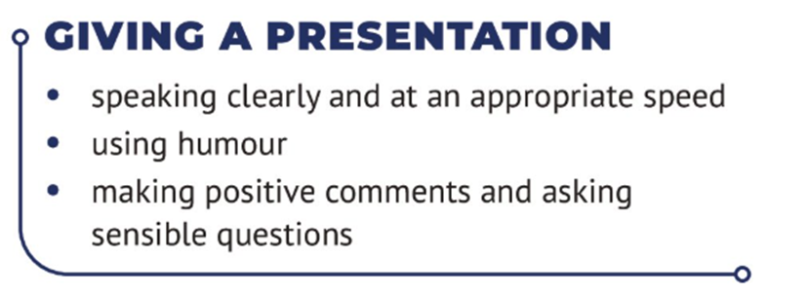
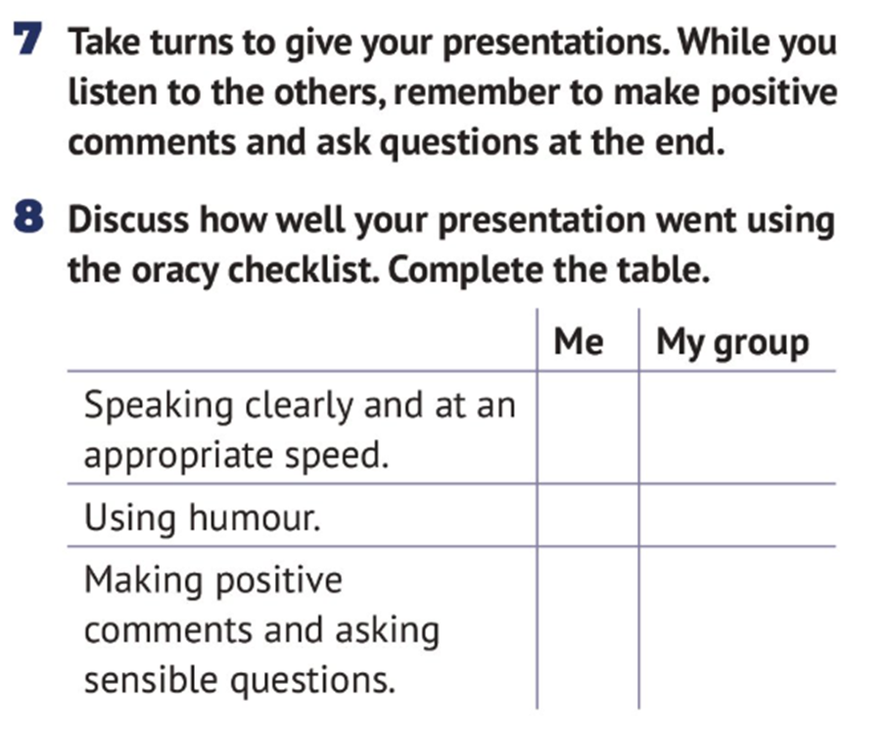
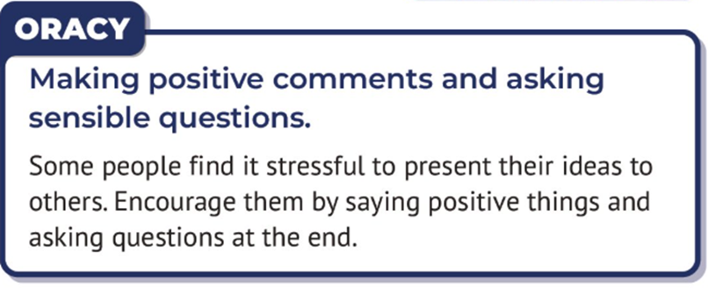
Shining Lights, Student’s Book 3 B1+, CUP&A,
Heyderman & Humphries 2026

Slide 14
Becoming better listeners
Students are often very focused on their speaking skills
Encouraging listening creates more meaningful communicative classrooms
Sometimes there are cross-cultural barriers to communicating
Skills that can be taught include:
Eye contact
Body language
Phrases (e.g. agreeing or disagreeing)

Slide 15
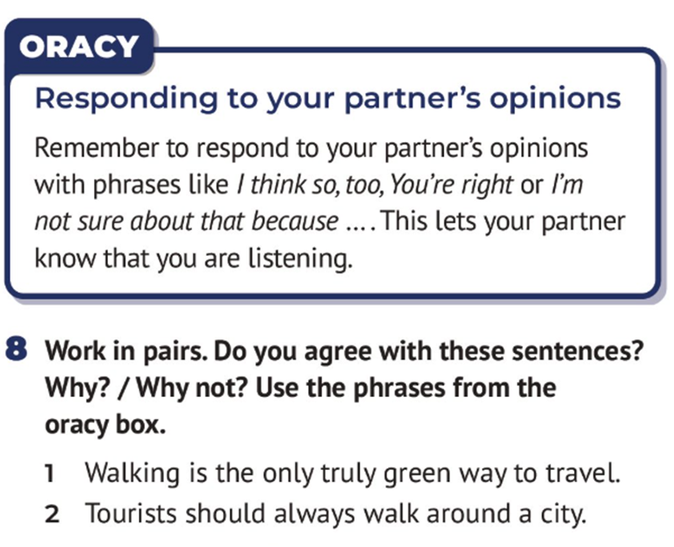
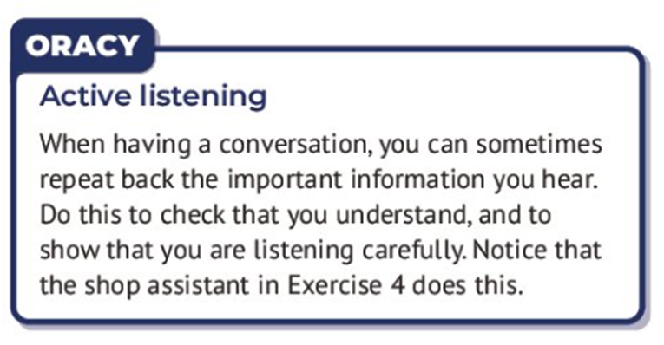
Building Active Listening Skills
(Shining Lights Level 1 A2)
(Shining Lights Level 2 B1)

Slide 16
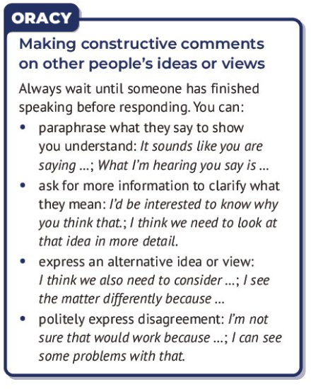
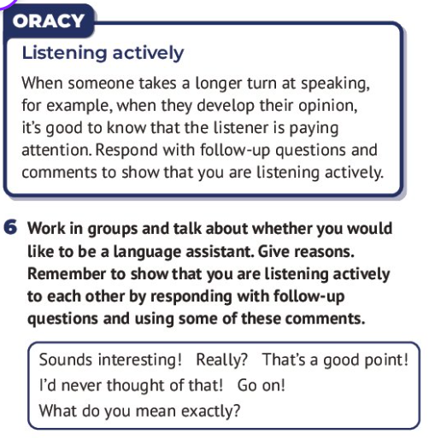
Building Listening Skills
(Shining Lights Level 3 B1+)
(Shining Lights Level 4 B2)

Slide 17
In Summary…
Oracy + ELT = The perfect match!
It can be adapted for any age or stage of learning
It can be integrated into existing curriculums
Oracy relies on mutual respect and agreement – this needs to be discussed and negotiated
Incorporate micro skills which can be built upon block by block
Oracy supports 21st Century skills such as: Critical thinking, Collaboration, Responsibility and Creativity

Slide 18
References and Further Reading

