Slide 1


UNLOCKING THE POWER OF HOMESTAYS IN INTERNATIONAL STUDENT SUCCESS
NEAS Conference, May 2026

Slide 2



Slide 3
For today
1.
Introduce research and challenges around host families
2.
Share reccommendations to support host families intercultural learning
3.
Share sample activities

Slide 4

But first...
What is the most effective way for international students to develop intercultural competence?
Take part in long programs (6 months or more)
High language proficiency
Stay with local families
Skilled program facilitation

Slide 5
Research

Slide 6

About research on host families
Limited compared to that related to students
Very anecdotal, nostalgic, emotional
It is the missing piece

Slide 7
Existing research
Deeper cultural immersion
Challenges: cultural stereotypes
Emotional experience
Impact not visible until later on
Learning experience for families
Local Connectedness crucial for student integration
Quality and frequency of interaction are key

Slide 8
What do students say?

Slide 9

Students voice
Need to belong and fit in
Need for intercultural understanding
Need for quality time and feeling like part of the family
Family being the cultural informants
Not feeling they are there just for the money

Slide 10
Challenges
Value Learning | Copyright 2022

Slide 11
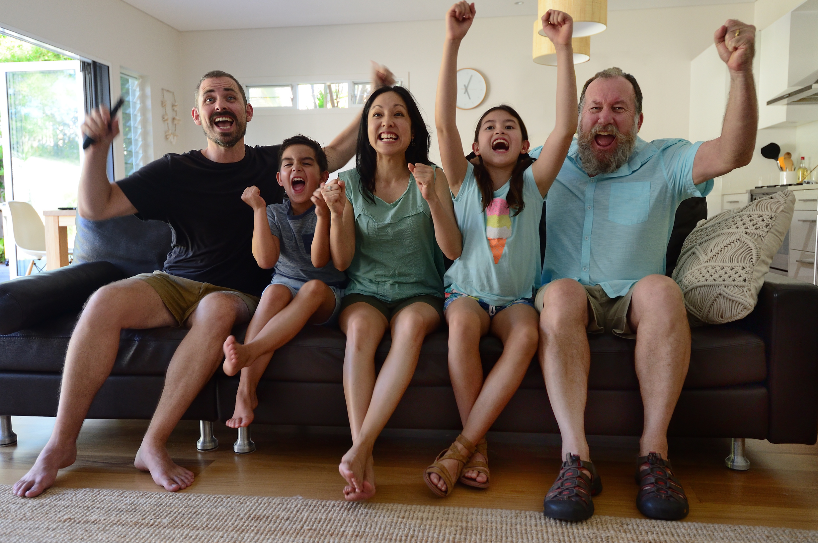
Families are not just one person
Families are diverse
Notes:
So, how does one develop that ability to interact effectively and appropriately?

Slide 12
Families are not just one person
Families are diverse
Different expectations
Notes:
So, how does one develop that ability to interact effectively and appropriately?

Slide 13
Families are not just one person
Families are diverse
Different expectations
Ethnocentric views on the experience
Notes:
So, how does one develop that ability to interact effectively and appropriately?

Slide 14
Families are not just one person
Families are diverse
Different expectations
Ethnocentric views on the experience
Power imbalance
Notes:
So, how does one develop that ability to interact effectively and appropriately?

Slide 15
Families are not just one person
Families are diverse
Different expectations
Ethnocentric views on the experience
Power imbalance
Limited resources
Don't want to loose families
Notes:
So, how does one develop that ability to interact effectively and appropriately?

Slide 16
Recommendations

Slide 17
A program to support host families
Goal based: Consider the double role - learner and facilitators/accommodation provider?
Notes:
So let's introduce Intercultural competence as the ability to interact effectively and appropriately with people from different cultural backgrounds.

Slide 18
A program to support host families
Goal based: Consider the double role - learner and facilitators/accommodation provider?
For every member of the family
Notes:
So let's introduce Intercultural competence as the ability to interact effectively and appropriately with people from different cultural backgrounds.

Slide 19
A program to support host families
Goal based: Consider the double role - learner and facilitators/accommodation provider?
For every member of the family
Developmental: what is needed at each stage?
Notes:
So let's introduce Intercultural competence as the ability to interact effectively and appropriately with people from different cultural backgrounds.

Slide 20
A program to support host families
Goal based: Consider the double role - learner and facilitators/accommodation provider?
For every member of the family
Developmental: what is needed at each stage?
Intentional interventions before, during and after
Notes:
So let's introduce Intercultural competence as the ability to interact effectively and appropriately with people from different cultural backgrounds.

Slide 21
A program to support host families
Goal based: Consider the double role - learner and facilitators/accommodation provider?
For every member of the family
Developmental: what is needed at each stage?
Intentional interventions before, during and after
Cultural content
Notes:
So let's introduce Intercultural competence as the ability to interact effectively and appropriately with people from different cultural backgrounds.

Slide 22
A program to support host families
Goal based: Consider the double role - learner and facilitators/accommodation provider?
For every member of the family
Developmental: what is needed at each stage?
Intentional interventions before, during and after
Cultural content
Skilled facilitators - intercultural competence - how to engage
Notes:
So let's introduce Intercultural competence as the ability to interact effectively and appropriately with people from different cultural backgrounds.

Slide 23
Tools to support intercultural learning

Slide 24
Orientations
Notes:
Being effective means that you achieved your goals and you are the one who can judge it.
Being appropriate means that you have achieved your goals while doing it in a way that was respectful of other people’s norms and values. And this is for the others to judge.

Slide 25
Orientations
Regular
reflection
Notes:
Being effective means that you achieved your goals and you are the one who can judge it.
Being appropriate means that you have achieved your goals while doing it in a way that was respectful of other people’s norms and values. And this is for the others to judge.

Slide 26
Orientations
Regular
reflection
Shared
activities
Notes:
Being effective means that you achieved your goals and you are the one who can judge it.
Being appropriate means that you have achieved your goals while doing it in a way that was respectful of other people’s norms and values. And this is for the others to judge.

Slide 27
Sample Activities for Orientations

Slide 28

Activities that help the host families to grow cultural self awareness (how they see the world, their perceptions and biases)
Orientations
Notes:
Intercultural competence includes a number of skills, knowledge and attitudes that can be developed, it means you can learn them, working on three key areas:
Your own self awareness

Slide 29
Days of the week
Please name the days of the week
Notes:
Intercultural competence includes a number of skills, knowledge and attitudes that can be developed, it means you can learn them, working on three key areas:
Your own self awareness

Slide 30
Days of the week
Please name the days of the week
Now do so in alphabetical order
Notes:
Intercultural competence includes a number of skills, knowledge and attitudes that can be developed, it means you can learn them, working on three key areas:
Your own self awareness

Slide 31
Days of the week
What happened when you re arranged the days of the week?
Why was it more difficult?
How is this exercise related to international studnets or host families?
Notes:
Intercultural competence includes a number of skills, knowledge and attitudes that can be developed, it means you can learn them, working on three key areas:
Your own self awareness

Slide 32

Map your homes
Draw a map of your home
Notes:
Intercultural competence includes a number of skills, knowledge and attitudes that can be developed, it means you can learn them, working on three key areas:
Your own self awareness

Slide 33
Map your homes
Draw a map of your home (both families and students)
Where do activities take place? Are there any no go areas?
What does the map say about values and ways of leaving?
Notes:
Intercultural competence includes a number of skills, knowledge and attitudes that can be developed, it means you can learn them, working on three key areas:
Your own self awareness

Slide 34
Sample Regular Reflections

Slide 35
Prompts for students and families to continue learning from each other, dealing with challenges and strengthen the relationship
Regular reflections
Notes:
Intercultural competence includes a number of skills, knowledge and attitudes that can be developed, it means you can learn them, working on three key areas:
Your own self awareness

Slide 36
Regular reflection
What was everyone's highlight of the month?
What was everyone's main challenge?
How can you support each other to work through these challenges?
How would you describe how the relationship with your student has evolved over the last month?
Notes:
Your awareness of others

Slide 37
Regular reflection
What do you think can be done to further strengthen the relationship between your family and your student?
Do you know what type of educational system your student is used to?
What can you do to help facilitate your students transition to a new system?
Notes:
Your awareness of others

Slide 38
Sample Shared Activities

Slide 39

Questions to prompt reflection and bring attention to the different approaches and perspectives families and students may have and lead to misunderstandings
Shared activities

Slide 40
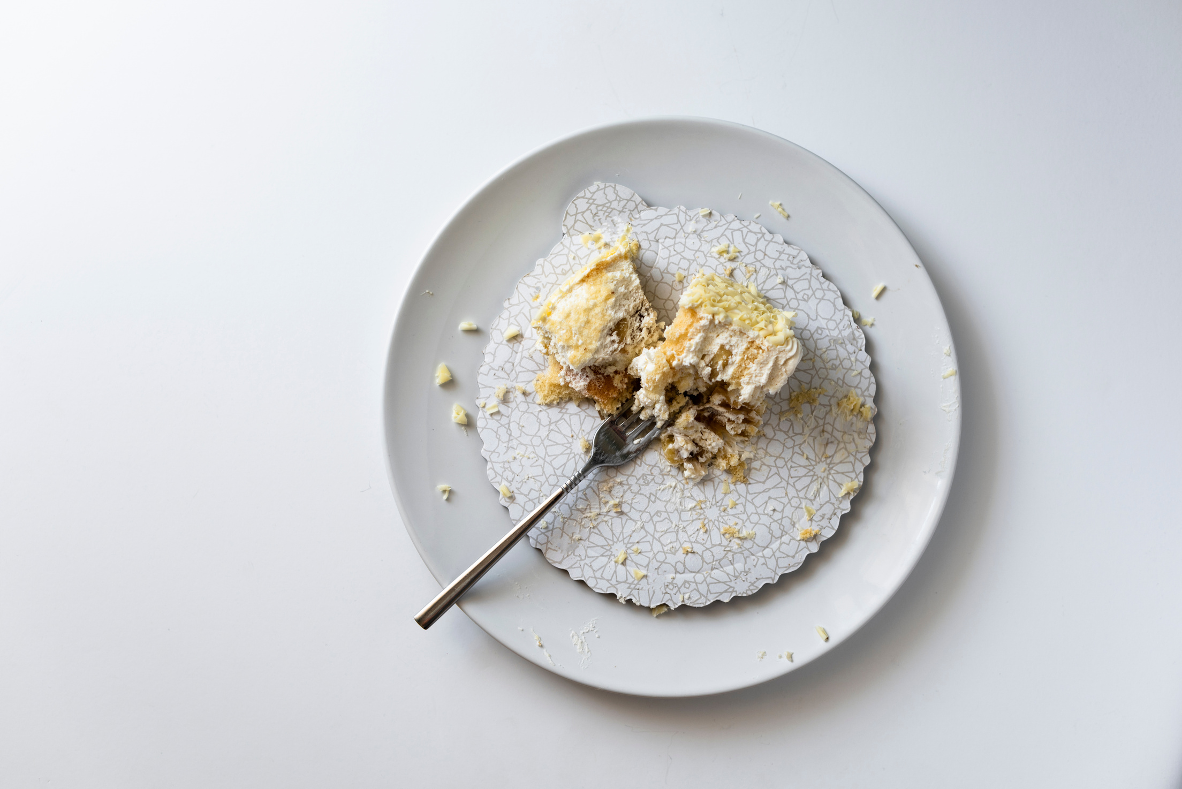
What does it most likely mean if a person does not finish their plate of food at a meal?
A. They don’t like the food
B. They are politely showing that they don’t want more food
C. They don’t care about wasting food
D. They are impolite

Slide 41
Explain to each other how you would indicate in a family setting that you like or don’t like the food.
How do you indicate that you want or don’t want more food?
What do you consider as “wasting food?”
How much food should you eat?
What kind of behaviour at the table is impolite?

Slide 42

What does it most likely mean if a person closes the door to their room?
A. They want privacy
B. They are sleeping
C. They don’t like you
D. They are angry
E. They are unhappy
F. Nothing special

Slide 43


Slide 44
We don't see things the way THEY are.
We see things the way
WE are
Anaïs Nin

Slide 45
For the little ones

Slide 46

For the younger ones
Notes:
Your awareness of others

Slide 47
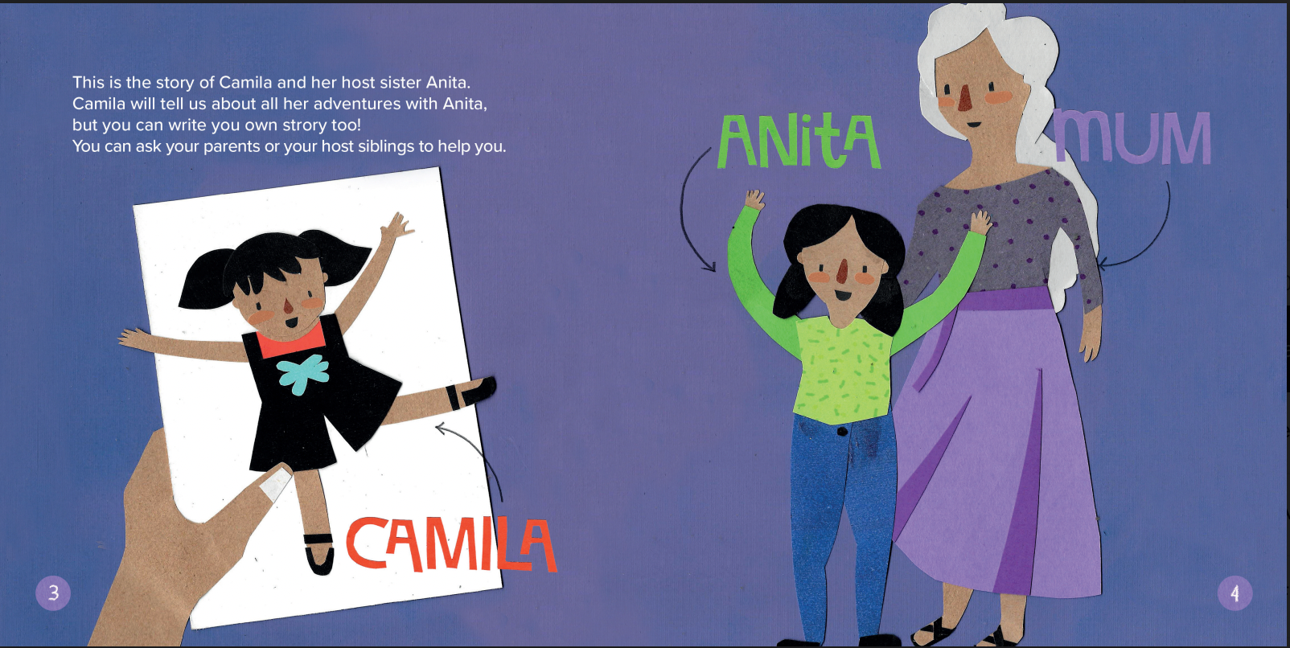
Notes:
Your awareness of others

Slide 48
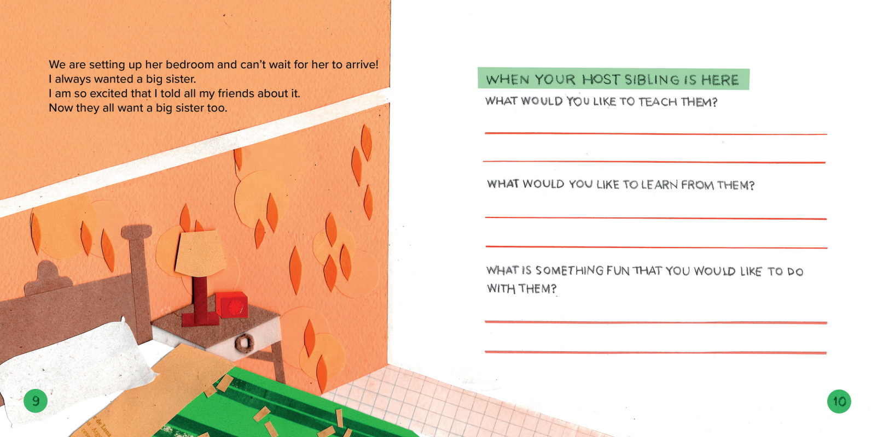
Notes:
Your awareness of others

Slide 49
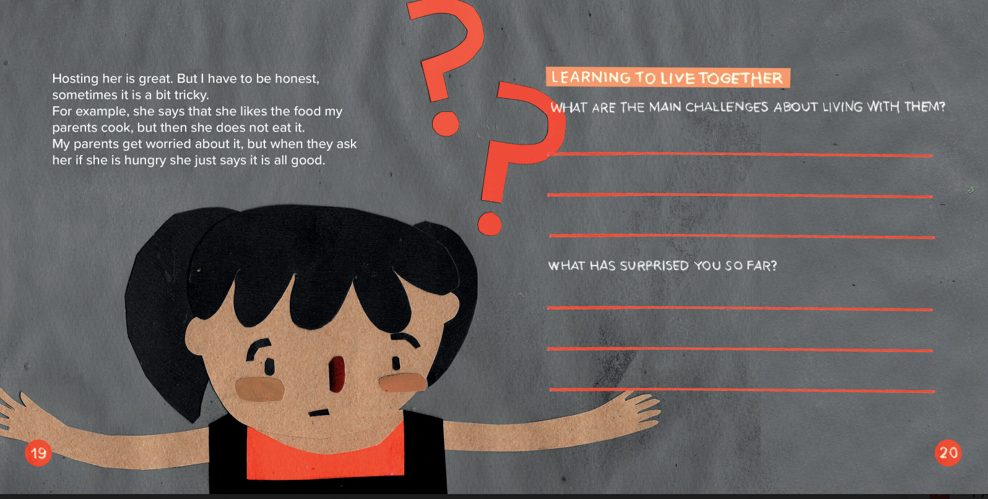
Notes:
Your awareness of others

Slide 50
What can YOU do?

Slide 51
Reconsider the role that families have in your organisation.
Revisit what you offer families: you need to go beyond monetary compensation.
Be more intentional.
Be pro-active: anticipate bias and sources of conflict.
Go beyond the intercultural fair.
Every interaction is an opportunity for learning and to build loyalty.
Notes:
Your awareness of others

Slide 52


Slide 53
And that's a wrap!
Thank you
WWW.VALUELEARNING.COM.AU

